Slide 1
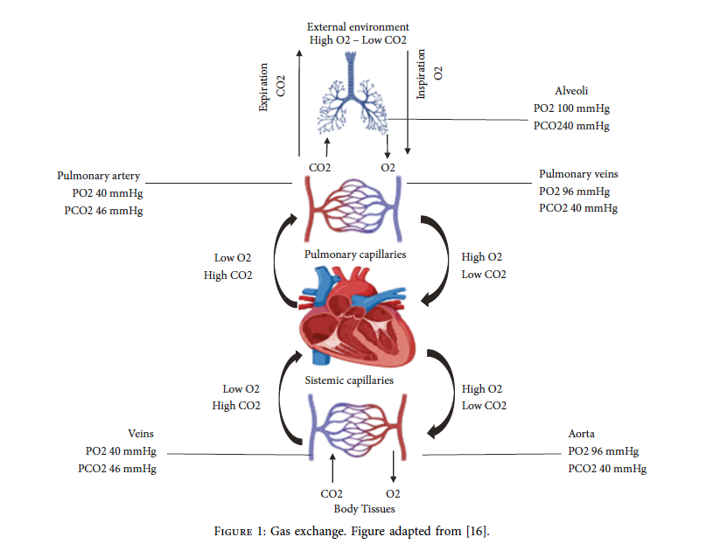
Hypercapnic Respiratory Failure
Notes:
In 1776, Lavoisier said that “of all the phenomena of the
animal economy, there is not one more surprising or worthy
of the attention of philosophers and physiologists than those
that accompany respiration” [10].
Quote and image from: https://doi.org/10.1155/2022/2635616

Slide 2
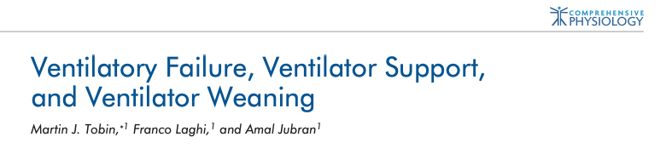
Key References
Nunn’s Physiology and West’s Respiratory Physiology
Notes:
Tobin, M. J., Laghi, F., & Jubran, A. (2012). Ventilatory Failure, Ventilator Support, and Ventilator Weaning. Comprehensive Physiology. doi:10.1002/cphy.c110030

Slide 3
History:
Haldane and Priestly 1905. “The Regulation of the Lung-Ventilation”
“Normal hyperpnea, such as that due to muscular work, may be explained as follows. The venous blood, returning to the lungs in larger quantity, and probably also more highly charged with CO2, causes a rapid rise in the alveolar CO2 pressure, and consequent rise in the arterial CO2 pressure. The respiratory centre is thus stimulated to increased activity, with consequent lowering of the alveolar CO2 pressure, until a point is struck at which an equilibrium is maintained between the effect of the increased supply of venous blood in raising the arterial CO2 pressure and that of the increased respiratory activity in lowering it.”
Notes:
https://physoc.onlinelibrary.wiley.com/doi/10.1113/jphysiol.1905.sp001081

Slide 4
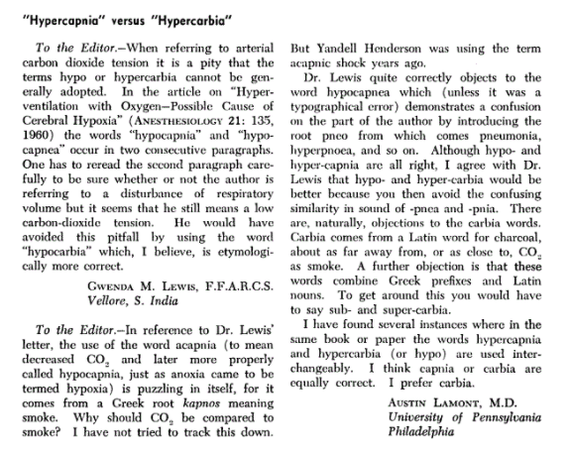
https://pubs.asahq.org/anesthesiology/article/22/2/324/15815/Hypercapnia-versus-Hypercarbia

Slide 5
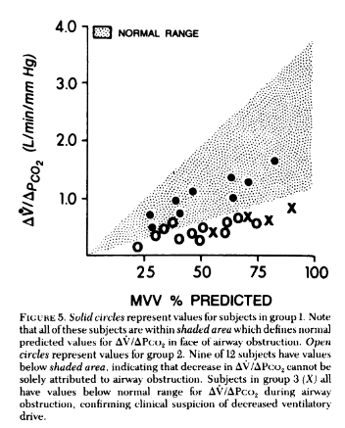
Fahey PJ, Hyde RW. “Won’t breathe” vs “can’t breathe”. Detection of depressed ventilatory drive in patients with obstructive pulmonary disease. Chest 1983;84:19-25. PMID: 6407808
Can’t breathe - won’t breathe distinction initially noted between whether patients with hypercapnia were generating the maximal amount of ventilation they could.

Slide 6

Notes:
Acute increases in PaCO2 are well tolerated (as long as you have access to oxygen).

Slide 7
Role of the respiratory system
Deliver O2 to support aerobic metabolism
Eliminate CO2 for acid-base balance.
CO2: The exhaust of life: O2 + C6H12O6 -> H2O and CO2
Respiratory failure: defined as failure to maintain normal arterial blood gas partial pressures.

Slide 8
CO2 has relatively mild acute effects
pH has dramatic acute effects – primarily on all protein based physiologic reactions.
Thus – in the acute setting, pH is the tightly controlled variable (by HCO3- / CO2 ratio)
“Homeostatic capacity” – depending on Ventilatory Reserve and metabolic milieu – a given level of frailty in the respiratory system may result in different levels of dysregulation.

Slide 9
https://www.ncbi.nlm.nih.gov/pmc/articles/PMC3303884/
In the healthy subject, about 16,000–20,000 mmol/day of carbon dioxide (CO₂), derived from oxidation of nutrients containing carbon, are produced.
Above reference describes process of metabolic adaptation

Slide 10
Section 1: PaCO2 Kinetics and Control
Any values of PaCO2 above 46 mmHg is abnormal – though transient elevations up to 50 mmHg may be encountered in ‘normal people’ doing breathe holds. West: held within 3mmHg always, possibly slightly higher in sleep. (10mmHg is the threshold for noct vent)
Mean normal PCo2 is 38.3 mmHg with 95% (2 SD) range being +/- 7.5 mmHg
Normals defined by 95% normal range, similar to other values (Nunn’s).
42 mmHg is the ULN of PaCO2 in SLC (Denver; Lee Brown) – measured 33.9+/-2.2 in men and 32.8 +/-3 mmHg in women. pH identical
Notes:
“Important to note than PaCO2 over 44 mmHg is not synonymous with hypoventilation - as it could also be due to increased VCO2 (from exercise, increased work of breathing, weight gain, hyperthermia, carbohydrate utilization, hyperthyroidism, etc.)”
(Also the issue of metabolic acid-base disorder and compensation)
Ventilatory control law
Statement of law
Whipp’s law (2008)During moderate exercise, V̇_{E} increases only to levels commensurate with the level of pulmonary CO₂ exchange required for Pa_{CO2} regulation. In particular, the system seems to “know” that when V_{D}/V_{T} is reduced, V̇_{E} “needs” to increase less per unit V̇_{CO2} to effect its regulatory function
Comroe’s law (1965)The lung is designed to eliminate CO₂ in a CO₂-free medium, air. When CO₂ is added to the inspired air, it clogs the mechanism for CO₂ elimination, and Pa_{CO2} must rise
Elevation: https://www.atsjournals.org/doi/full/10.1164/ajrccm.160.5.9806006
0.24 mmHg/yr decrease in PO2 (or increase in gradient) – hence Age/4 rule of thumb.
Precited O2: Predicted Pa_{O2} using our reference equation (Pa_{O2} = 0.1834 Pb − 0.2452 age − 31.453
The emergence of photosynthetic organisms 3 billion years ago increased the PO2 levels in the atmosphere and allowed the evolution of organisms that use glucose and O2 to produce ATP through mitochondrial electron transport and oxidative phosphorylation

Slide 11
PaCO2 stable despite a wide range of VCO2
Why is this so tightly regulated?
Thought experiment – VA = K * VCO2 / PaCO2
Ventilation is metabolically expensive (work of breathing = 2% of O2 at rest, but increases hugely with exercise or pathology)
The same pH can be achieved at any PaCO2 by adjusting the bicarbonate: pH = 6.1 + log [ HCO3 / (0.03 * pCO2) ]
Why doesn’t the body operate with with a PaCO2 of 70? (and an HCO3 of 44 = pH 7.42) This would be metabolically advantageous.
Especially in states where the work (power) of breathing is higher - such as lung disease
Notes:
54 - Cunningham DJC, Robbins PA, Wolff CB. Integration of respiratory responses to changes in alveolar partial pressures of CO2 and O2 and in arterial pH. In: Cherniack NS, Widdicombe JG, editors. Handbook of Physiology, Section 3. The Respiratory System. Volume II: Control of Breathing, part 2, Bethesda, MD: Am Physiol Soc, 1986, pp. 475-528.
Gamblegram = the ion stacked diagrams that would be relevant for showing renal compensation
Tobin: 10 fold changes in CO2 production during exercise do not change PaCO2 - https://journals.sagepub.com/doi/pdf/10.1177/0310057X1304100202

Slide 12
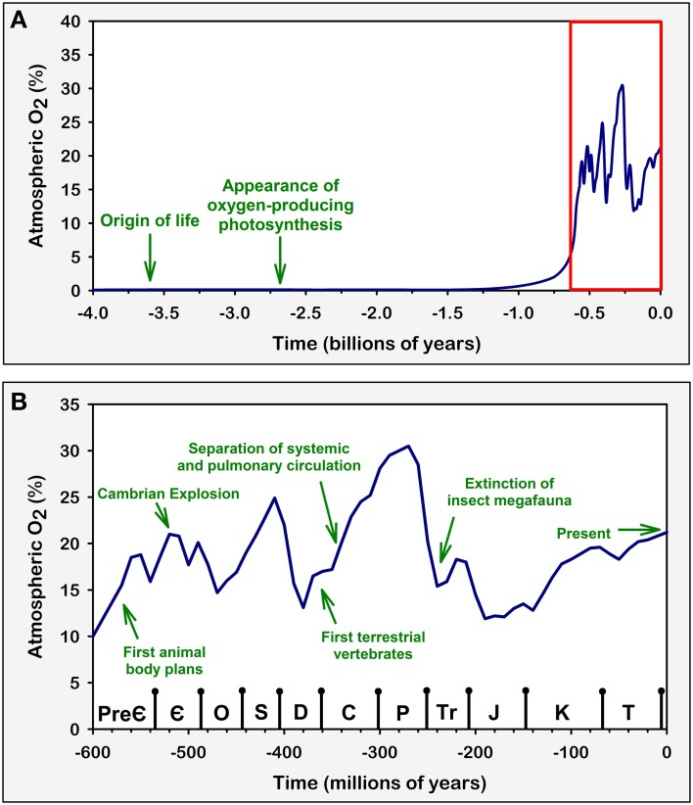
What happens when we get hypercapnic?
Why is our PaCO2 40+/- 5 (sea level) or 32 +/- ___ here?
If you were a human evolved to live with dinosaurs
Notes:
https://www.researchgate.net/figure/Variations-in-atmospheric-oxygen-concentrations-over-geological-time-Green-arrows-and_fig1_264759228

Slide 13
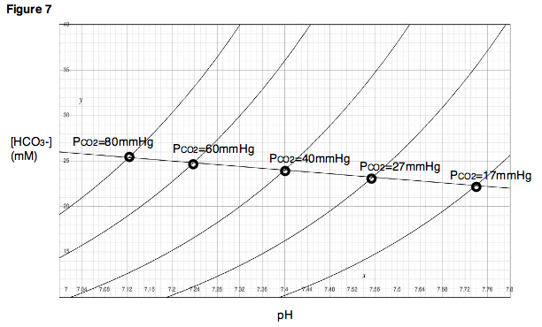
Davenport diagram
Notes:
graphical demonstration of the Henderson–Hasselbach relationships
Can do any combination of CO2 and pH by modifying bicarbonate.

Slide 14
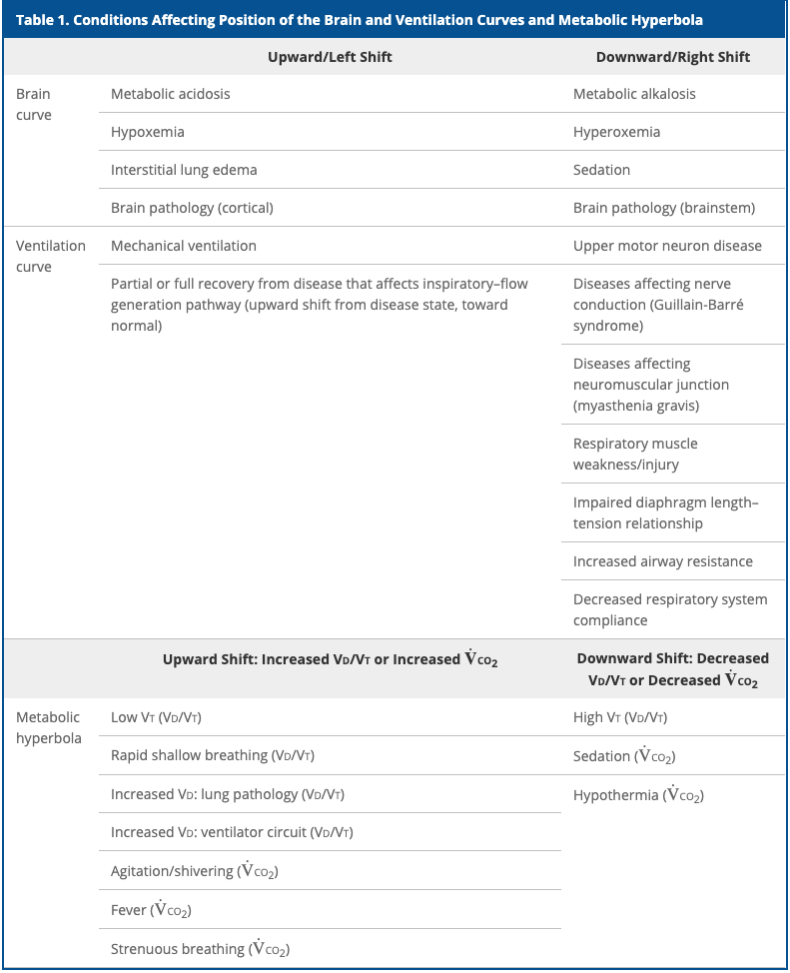
Notes:
Citation? Control of Ventilation? AnnalsAts or AJRCCM style – can you sustain what you need?

Slide 15
Why doesn’t PE cause hypercapnia?
PaCO2 = K * VCO2 / VE (1-Vd/Vt)
In healthy subjects, the control components and mechanical system can handle a wide variety of inputs without PaCO2 changing:
PaCO2 changing ALWAYS must indicate either a failure of the control system (won’t breathe), the mechanical system (can’t breathe), or both to respond to a stressor
Things that lead an inability of the respiratory system to cope can include load on respiratory muscles or reduction in their strength; or an increase in demand (deadspace, VCO2)

Slide 16
Vd/Vt, VCO2 changes = not the whole story
PaCO2 = K * VCO2 / VE (1-Vd/Vt)
VE is a dependent variable which the control system changes to keep PaCO2 the same
A change in Vd/Vt or VCO2 can be a stressor on the system, but in the absence of huge extremes (e.g. 2,4 Dinitrophenol overdose) is not the cause itself (unless control system is offline - on vent)
How huge can system compensate?
VCO2 – based on average VO2 max stress test data – should tolerate 8.8x resting VCO2 (in 70kg 63y/o female) prior to decompensating if that is the only abnormality
Even at VO2max 10 ml/kg/min
Vd/Vt – 89% (by re-arranging and solving, equiv to the above - PaCO2 = K * VCO2 / VE (1-Vd/Vt)
This is why a PE won’t cause hypercapnia except when a patient is on the vent.
Notes:
VO2 max of a normal person
If we assume a max VO2 stress test result for an average 70kg, 60-year-old female = VO2 at peak 1.66 L/min (24.5 mL/kg/min) – historically, 3.5 mL/min/kg = 1 met… so max: 7 mets
For reference 80kg 63 y/o male 2.38 L/min, 28.8 ml/kg/min.
From CHEST 2021 Canada reference. CHEST 2021; 159(5):1922-1933
Thus VCO2 max with RER ~1.1 (maximal test) = 1.82 L/min ( 7.7 mets )
Plus the normal ventilatory threshold 15%+ = 2.093 L/min ( 8.86 mets ) VCO2 should be able to be handled by a normal respiratory system in an avg 63y/o without a change in CO2 (ignoring improvements in V/Q mismatching)
Even if VO2 max is only 50% of predicted, that’s still a large range of deadspace / VCO2 that the pulmonary system can handle unless there is a mechanical impediment.

Slide 17
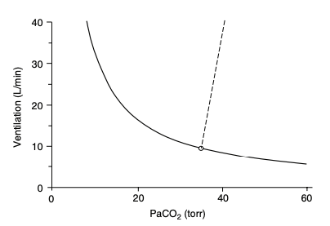
PaCO2 = K * VCO2 / VE (1-Vd/Vt)
(re-arrangement of PaCO2 = k * VCO2 / VA)
If you hold VCO2 and Vd/Vt constant, you get the metabolic hyperbola (solid line) which relates PaCO2 to Ve
Notes:
Tobin comprehensive physiology
Controller system sensitivity can be evaluated by forcing an increase in PaCO2 and measuring a subsequent increase in Ve – straight line, where change in Ve per mmHg paCO2 = sensitivity.
-normal range in healthy adults is 0.5 to 8.0 L/min/mmHg (1.5-5.0 in 80% of subjects) (269) - 269 - Tobin MJ, Gardner WN. Monitoring of the control of ventilation. In: Tobin MJ, editor. Principles and Practice of Intensive Care Monitoring. New York: McGraw-Hill, Inc., 1998, pp. 415-464

Slide 18
Sensitivity of the controller system to CO2: The PCO2/Ventilation Response ‘Curve’
The straight/dashed line is the amount that the respiratory system will respond to an increase in PaCO2 (slope = change in Ve / change in PaCO2)
Ventilation = S (PCO2– B), where S is slope, B is the intercept at zero ventilation.
Steeper slope = more sensitive, flatter = less sensitive
Normal range 0.5-8.0 L/min/mmHg (wide range)
80% of subjects have a response between 1.5 and 5 L/min/mmHg (118)
Notes:
118. Irsigler GB. Carbon dioxide response lines in young adults: The limits of the normal response. Am Rev Respir Dis 114: 529-536, 1976
313. Younes M, Georgopoulos D. Control of breathing relevant to mechanical ventilation. In: Marini JJ, Slutsky AS, editors. Physiological Basis of Ventilator Support. New York: Marcel Dekker, Inc., 1998, pp. 1-73.
(306) – Younes M. Mechanisms of ventilatory failure. Current Pulmonology 14: 243-292, 1993a.

Slide 19
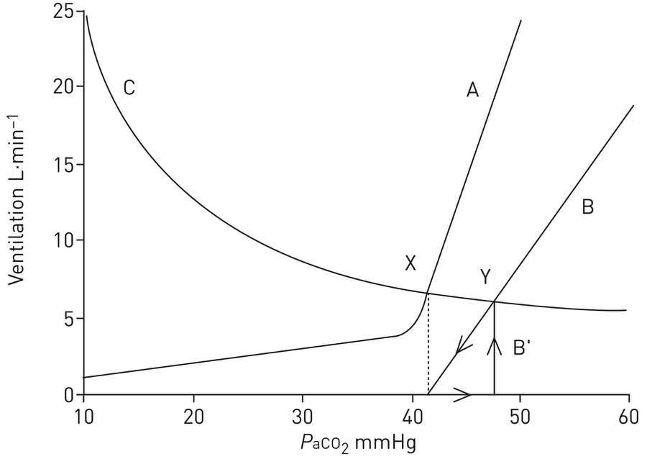
Example: Normal(A) -> Opiate(B)
Notes:
This diagram demonstrates how opiates can induce apnoea at the same arterial carbon dioxide tension (P_{aCO2}) as before opioid administration (dotted line) and also demonstrates that significant reductions in the hypercapnic ventilatory response (HCVR) only cause small changes in steady-state P_{aCO2}. Curve A represents the normal ventilatory response to CO₂ in an awake individual, demonstrating that ventilation is maintained at very low P_{aCO2} levels and that apnoea does not occur. Line B represents a 50% depression of the HCVR caused by opioid administration. A notable difference between curve A and line B is that in B, apnoea can occur. Note also that in this case, P_{aCO2} must rise to steady-state values (i.e. along the x-axis) for breathing to recommence (line B′). Curve C represents the CO₂ excretion hyperbola and demonstrates how changes in ventilation affect P_{aCO2}. Point X represents the awake state and point Y represents opioid-depressed breathing. Despite a 50% depression of the HCVR, the CO₂ changes only relatively modestly, illustrating the limited utility of single measurements of CO₂ in assessing respiratory depression. Reproduced and modified from [27] with permission from the publisher.
From https://erj.ersjournals.com/content/51/3/1702531#ref-8
Note: in this case, the opiate only caused a ~7 mmHg increase in PaCO2 despite a 50% reduction in sensitivity of the hypercapneic ventilatory response.
That is not always true.

Slide 20
Modifiers of response
Higher oxygen = flatter
Metabolic acidosis = steeper and left shifted
Notes:
From Nunn and Lamb’s

Slide 21
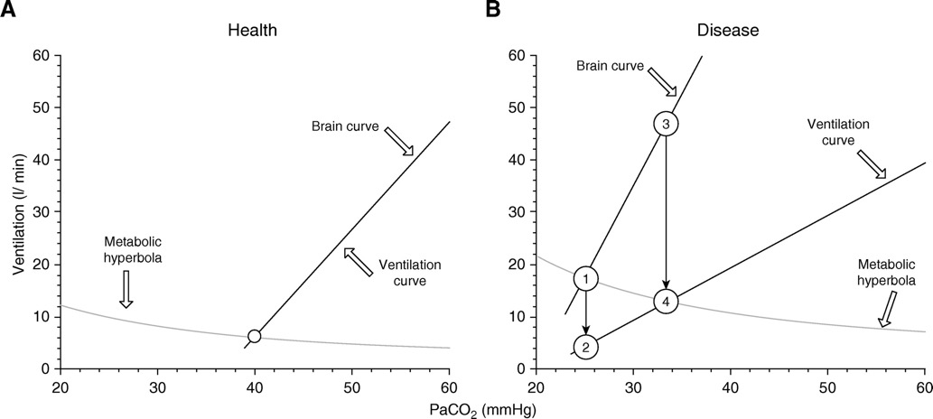
“Can’t breathe” – dissociation between drive and resulting ventilation”: corollary discharge
Brain Curve (Ve that would occur if the system were intact) and Ventilation curve (actual Ve)
Dissociation of brain curve and ventilation is a major contributor to dyspnea
Notes:
Graphical representation of the metabolic hyperbola and brain–ventilation curve of a healthy human. The intersection of the metabolic hyperbola and ventilation curve (open circle) determines the steady-state Pa_{CO2} and V.V.e (40 mm Hg and 6.2 L/min, respectively). (Note that these mathematically described curves and relationships are simplified presentations of experimental data, with the aim being to facilitate understanding of the effects of critical illness and mechanical ventilation on respiratory drive, and cannot be directly applied to compute the ventilatory demands of a critically ill patient.) (B) This human develops severe pneumonia, causing increased V.V.co₂ and Vd/Vt, which moves the metabolic hyperbola upward, and hypoxemia, which moves the brain curve to the left and increases its slope. Owing to increased respiratory system elastance, a given respiratory center output per minute (RCO/min) results in a lower V.V.e; thus, the slope of the ventilation curve is shifted downward. A dissociation of the ventilation curve from the brain curve occurs. In the presence of a dissociation, any change in Pa_{CO2} alters the RCO/min (mainly due to change in respiratory drive, RCO per breath) as much as the brain curve dictates, and any change in RCO/min can only change the actual ventilation as much as the ventilation curve dictates. Assuming for simplicity that the change in respiratory system elastance, and thus the deviation of the ventilation curve, occurs abruptly, the RCO/min corresponds initially to point 1 (V.V.e, 17.5 L/min), whereas the actual V.V.e drops to point 2 (4.5 L/min). This decrease in ventilation leads to a gradual increase of Pa_{CO2}, which in turn stimulates the respiratory center. The RCO/min progressively increases along the brain curve (from point 1 to point 3), following the increase in Pa_{CO2}. In parallel, this increase in RCO/min results in an increase in the actual V.V.e along the ventilation curve (from points 2 to 4). When RCO/min (point 3) results in an actual V.V.e at the intersection of the ventilation curve and the metabolic hyperbola (point 4), a steady state occurs; Pa_{CO2} stabilizes; and respiratory drive, RCO/min, and V.V.e do not increase further. Although the brain’s ventilation demands (46 L/min) are not met (actual V.V.e, 13 L/min), respiratory drive and RCO/min do not increase further because the CO₂ stimulus is constant.
Air hunger is the most prominent sensation in severe dyspnoea (Stevens et al. 2019); it is the extremely uncomfortable sensation that arises when ventilation (sensed via stretch receptors) fails to meet demand (conveyed by corollary discharge from brainstem to cerebral cortex) (Abstract Figure). Under conditions of fixed mechanical ventilation, air hunger can be induced by hypoxia and/or hypercapnia in proportion to level of chemoreflex stimulation of ventilation (Moosavi et al. 2003).

Slide 22
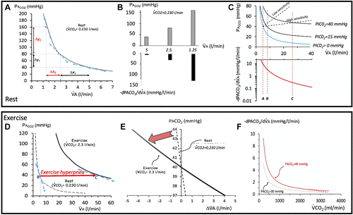
VA-PACO2 relationship and homeostasis
” The 1/x nature of the relationship between V̇A and PACO2 (PACO2 = K·V̇co₂·V̇A⁻¹) accounts for the fact that when V̇A decreases, any given change in V̇A produces larger and larger increase in PACO2: the respiratory plant gain for CO₂ (RPGCO2), i.e., the slope of tangent of V̇A-PACO2 relationship”
Notes:
https://journals.physiology.org/doi/full/10.1152/japplphysiol.00058.2022
‘This simple observation helps us to understand why a patient who is already hypoventilating (already hypercapnic) “requires” smaller decrements in alveolar ventilation than if normocapnic, to increase PACO2. Conversely, a smaller increment in alveolar ventilation will be needed to bring PACO2 from 100 to 60 mmHg than from 50 to 40 mmHg. In the “hyperventilation” range, RPGCO2 continues to decrease as V̇A increases, dropping for instance from 8 to 2 mmHg/L/min as V̇A rises from 5 to 10 L/min.’

Slide 23
Breath Holds
PaCO2 causes an irresistibly strong urge to breathe in individuals with normal respiratory systems
on room air, typically near 50 mmHg (diaphragmatic contractions occur at PaCO2 ~46-49)
on supplemental oxygen, can tolerate much longer (highly trained apneass can increase their conventional breakpoint to critical hypoxia, which is 20-30 mmHg O2)
can be extended by rebreathing gas (the sensation of air hunger is partially mediated by lack of movement in / out)
Notes:
Comprehensive physiology breath hold diving paper
Recall:
Any values of PaCO2 above 46 mmHg is abnormal – though transient elevations up to 50 mmHg may be encountered in ‘normal people’ doing breathe holds. West: held within 3mmHg always, possibly slightly higher in sleep. (10mmHg is the threshold for noct vent)

Slide 24
Central respiratory chemoreceptors likely trigger non-respiratory effects of CO2 because hypercapnia evokes no adverse sensation, emotional or otherwise, in patients with congenital central hypoventilation syndrome (CCHS) who lack a respiratory chemoreflex but have normal intellect and sensory perception (Shea et al., 1993; Weese-Mayer et al., 2010).
Notes:
Shea, S.A., Andres, L.P., Shannon, D.C., Guz, A., and Banzett, R.B. (1993).
Respiratory sensations in subjects who lack a ventilatory response to CO2.
Respir. Physiol. 93, 203–219.
Weese-Mayer, D.E., Berry-Kravis, E.M., Ceccherini, I., Keens, T.G., Loghmanee,
D.A., and Trang, H.; ATS Congenital Central Hypoventilation Syndrome
Subcommittee (2010). An official ATS clinical policy statement: Congenital
central hypoventilation syndrome: genetic basis, diagnosis, and management.
Am. J. Respir. Crit. Care Med. 181, 626–644.

Slide 25
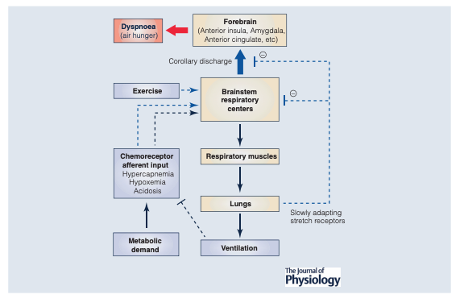
DOI: 10.1113/JP280769

Slide 26
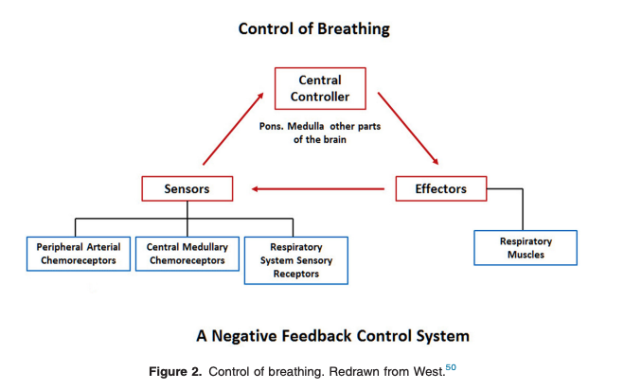

Slide 27
Drive to breath
3 sources:
Chemical drive – related to changes in arterial PO2 (NOT oxygen saturation), arterial and brain PCO2 and pH. Mediated by central and peripheral chemoreceptors.
Metabolic drive – related to metabolic rate and mediated by unknown mechanisms (e.g. how the Ve increases in CPET before blood gases change)
Wakefulness drive – disappears during sleep, such that a minor PaCO2 drop in presence of normoxia produces a central apnea during sleep or anesthesia
Anesthesia: (86).
Note: voluntary / supratentorial factors can increase this
Also, things like the ergoreflex probably play a greater role in exercise
Notes:
Wakefulness drive to breath ensures that you continue to ventilate some even when PaCO2 below the set point during the day, but this goes away when you sleep (hence the possibility of central apneas - which don’t occur when awake - duh)
86. Fink B, Hanks E, Ngai S, Papper E. Central regulation of respiration during anesthesia and wakefulness. Ann N Y Acad Sci U S A 109: 892-900, 1963.
According to https://www.cell.com/neuron/pdf/S0896-6273(15)00676-5.pdf – metabolic drive may be mediated by reflexes from muscle groups, though unclear which neural circuits involved.

Slide 28
“Simply stated, the sensation of dyspnea can be understood as resulting from the collection of peripheral sensing inputs processed centrally in the brainstem, increasing in turn the neural output to the respiratory muscles while sending a “copy” of this information toward the thalamus, the limbic system, and the sensorimotor cortex, where the sensation becomes “conscious””(3-5) https://journals.physiology.org/doi/full/10.1152/japplphysiol.00438.2021
Notes:
3. Chen Z, Eldridge FL, Wagner PG. Respiratory-associated thalamic activity is related to level of respiratory drive. Respir Physiol 90: 99–113, 1992. doi:10.1016/0034-5687(92)90137-l. Crossref | PubMed | Google Scholar
4. Eldridge FL, Chen Z. Respiratory-associated rhythmic firing of midbrain neurons is modulated by vagal input. Respir Physiol 90: 31–46, 1992. doi:10.1016/0034-5687(92)90132-G. Crossref | PubMed | Google Scholar
5. Guz A. Respiratory sensation in man. Br Med Bull 33: 175–177, 1977. doi:10.1093/oxfordjournals.bmb.a071419. Crossref | PubMed | ISI | Google Scholar
Indeed, when limited and unilateral defects are affecting the rostral medulla, abnormal symptoms ranging from hypoventilation during sleep and reduced CO₂ sensitivity to severe respiratory and cardiovascular control abnormalities are present (6, 7), whereas bilateral or more widespread lesions are usually lethal (8).
6. Morrell MJ, Heywood P, Moosavi SH, Guz A, Stevens J. Unilateral focal lesions in the rostrolateral medulla influence chemosensitivity and breathing measured during wakefulness, sleep, and exercise. J Neurol Neurosurg Psychiatry 67: 637–645, 1999. doi:10.1136/jnnp.67.5.637. Crossref | PubMed | ISI | Google Scholar
7. Nogues MS, Heidel K, Benarroch E. Unilateral focal lesions in the rostrolateral medulla influence chemosensitivity and breathing measured during wakefulness, sleep, and exercise. J Neurol Neurosurg Psychiatry 69: 138–139, 2000. doi:10.1136/jnnp.69.1.138. Crossref | PubMed | ISI | Google Scholar
8. Woischneck D, Kapapa T, Heissler HE, Reissberg S, Skalej M, Firsching R. Respiratory function after lesions in medulla oblongata. Neurol Res 31: 1019–1022, 2009. doi:10.1179/174313209X385608. Crossref | PubMed | ISI | Google Scholar

Slide 29
Anatomy
1. central medullary rhythm/pattern generator and integrator (brainstem) - primarily in the pre-Botzinger complex and pontine raphe. Bilateral (thus, not destroyed by acute ischemic stroke in the absence of catastrophe)
2. Sensory inputs Chemoreceptors –
carotid body (peripheral - sense a variety of stimuli such as O2 levels)
medulla (central – responds to H+ in the CNS ECF, linear increase in VA to increase in H+ in CSF - whose changes are moderate by active H+ transport at the BBB - generally reflective of PaCO2 because this can diffuse. CSF HCO3- buffers response. ).
Stimulation of the peripheral chemoreceptors increases the slope of the central H+ receptors (meaning, a given increase in H+ will result in a larger increase in ventilation). Note: carotid BODY (chemoreceptor) =/= carotid sinuses (baroreceptors, blood pressure)
3. precise synchronous distribution of motor output to the respiratory musculature of the upper airway as well as the chest and abdominal walls (via C3-4-5, phrenic keeps the diaphragm alive).
Notes:
DOI: 10.1183/09031936.00048514
“
In scenarios in which the receptors disagree, such as hypoxic hypocapnia, the peripheral chemoreceptor hypoxic response dominates, stimulating the respiratory drive to improve oxygenation despite further decreases in CO2.[1] - Lahiri S, Forster RE. CO2/H(+) sensing: peripheral and central chemoreception. Int J Biochem Cell Biol. 2003 Oct;35(10):1413-35. [PubMed: 12818238]
“

Slide 30
Ventilatory Control
Central Chemoreceptors | Ventral surface of medulla | Responds to H+ in ECF of CNS – this equilibrates with CO2 in blood (no charge) moreso than pH in blood. CSF HCO3 lessenss response. No O2 sensing. Slower response
Peripheral Chemoreceptors | Carotid and Aortic bodies. Aortic body contributes to sympathetic and cardiovasc response | Respond (rapidly) to PaO2, PaCO2, and pH
When CO2 and pH diverge? E.g. metabolic acidosis (DKA) does generate increased ventilation – but it is mediated at the PERIPHERAL receptors (pH sensors) not central (CO2 sensor, except in extreme acidosis where BBB becomes slightly more permeable)
Notes:
“The CB senses PCO2 and H1 in arterial blood, contributing to 20–30% of the reflex regulation of CO2-H1 levels in response to hypercapnic acidosis, while the central chemoreceptors are responsible for the other 70–80%”(presumably, this is in healthy individuals at sea level)
However, the CB chemosensory discharge also increased in response to isohydric hypercapnia (304 Iturriaga R, Mokashi A, Lahiri S. Dynamics of carotid body response in vitro in the presence of CO2-HCO3 . Role of carbonic anhydrase J Appl Physiol (1985) 75: 1587–1594, 1993. doi:10.1152/jappl.1993. 75.4.1587.) – thought related to drop in intracellular pH (even with normal blood pH) due to carbonic anhydrase
(from https://journals-physiology-org.ezproxy.lib.utah.edu/doi/pdf/10.1152/physrev.00039.2019).
Taken together, the evidence points to two major mechanisms underlying hypoxiai nduced tachycardia: 1) selective inhibition of CB chemoreceptor-induced cardiac parasympathetic activity by the lung inflation reflex and 2) an aortic chemoreceptor induced increase in cardiac sympathetic nerve activity and/ or inhibition of parasympathetic activity.
***does the impact of carotid body mediated complications vary with elevation?

Slide 31
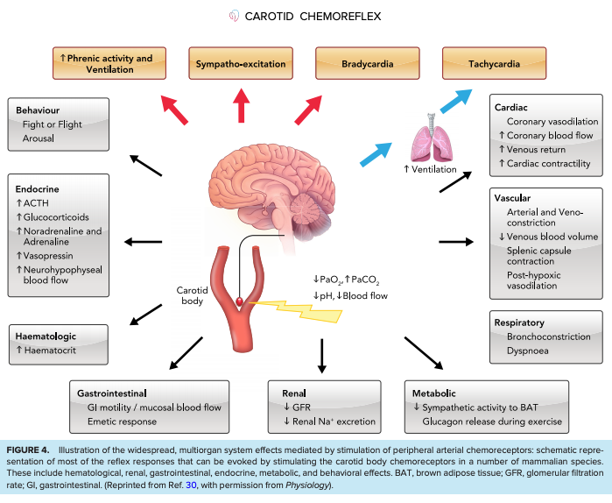
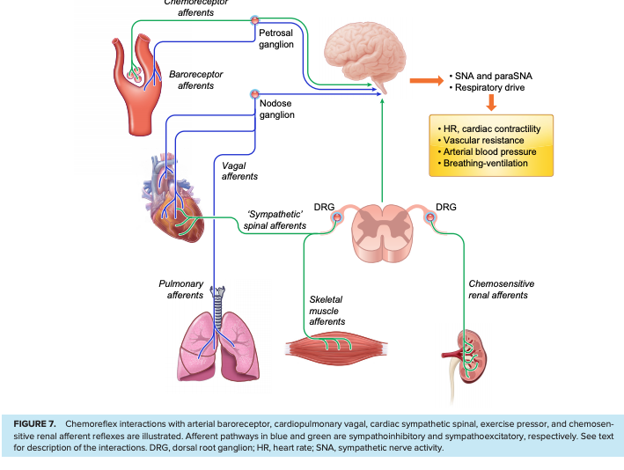
Notes:
https://journals-physiology-org.ezproxy.lib.utah.edu/doi/pdf/10.1152/physrev.00039.2019
CO2 as a hormone?
“Perhaps, in some instances, chemical regulators including hormones appeared first as metabolic by-products. A few such substances are known in physiological regulation: carbon dioxide, for example, is involved in the regulation of the respiratory activity of which it is a product, in insects as well as in vertebrates. Substances such as carbon dioxide are called parahormones to distinguish them from true hormones, which are specialized secretions.”

Slide 32
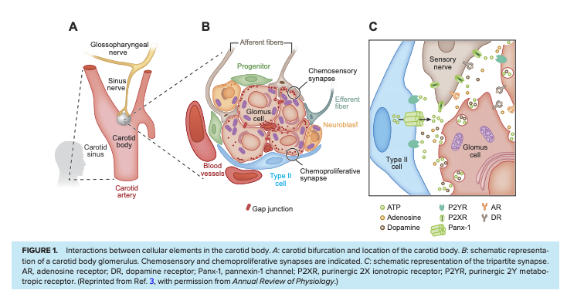
Carotid Body Phys
Glomus/type 1 cells surround blood (sense O2 by unclear means, and transmit it by L-type ca dep excitatory transmission) and Glial origin cells/type 2. Transmit to CNS by glossopharyngeal nerve
Hypoxemia or hypercapnia or acidemia -> more CB discharge -> reflex hyperventilation, increased vagus output (brady), sympathetic activity (muscules, splanchnic, renal vascular beds)
Senses PaO2, not CaO2, SaO2 or SpO2
Sympathetic overactivity is one mechanism for OSA and CHF effects on other organs
https://journals.physiology.org/doi/full/10.1152/japplphysiol.00809.2003
Notes:
The CB (also called ganglion minutum, carotid corpuscule, carotid ganglion, glomus caroticum, and carotid gland)
https://journals-physiology-org.ezproxy.lib.utah.edu/doi/pdf/10.1152/physrev.00039.2019
Some tonic hypoxic discharge (as 100% o2 will decrease ventilation – Dejours Test
In humans the mean dimensions of the CB are 2–3 mm and a mean weight of 18–20 mg. Despite the relatively small size, the CB has the highest blood flow (1.0–2.0 L/min/100 g) reported for any organ
, despite great efforts over the last 50 years, the exact nature of the oxygen sensor still remains elusive (for recent reviews, see Refs. 9, 10, 12, 14, 16, 19). Several hypotheses have been proposed to explain O2 sensing in the CB. The “metabolic hypothesis” argues that the O2 sensor is linked to oxidative phosphorylation metabolism in type I cells. The “membrane hypothesis” proposes that the sensors are molecules closely associated with K1 channels present in the type I cell membrane.
. Recent studies have provided evidence that the tachycardia may be independent of the ventilatory response to hypoxia, is mediated by parasympathetic inhibition, and is unlikely to be baroreflex mediated (371, 372) –
371. Paleczny B, Seredynski R, Tubek S, Adamiec D, Ponikowski P, Ponikowska B. Hypoxic tachycardia is not a result of increased respiratory activity in healthy subjects. Exp Physiol 104: 476–489, 2019. doi:10.1113/EP087233.
372. Siebenmann C, Ryrsø CK, Oberholzer L, Fisher JP, Hilsted LM, Rasmussen P, Secher NH, Lundby C. Hypoxia-induced vagal withdrawal is independent of the hypoxic ventilatory response in men. J Appl Physiol (1985) 126: 124–131, 2019. doi:10.1152/japplphysiol. 00701.2018.
The direction and magnitude of the blood pressure response depend on multiple factors, including the severity and duration of the hypoxemia, the balance between sympathetic-mediated vasoconstriction and the direct hypoxemia-induced vasodilation, the magnitude of the ventilatory response
Similar to the CB chemosensory potentiation induced by CIH, it is well known that chronic sustained hypoxia (i.e., high altitude) progressively increases carotid baseline chemosensory discharges and responses to hypoxia (488, 489). In addition, long-term exposure to sustained hypoxia produces hypertrophy and/or hyperplasia of type I cells and enlarges the CB (490–493). ET1 and its receptors have been involved in CB enlargement induced by sustained hypoxia (52, 488, 494).

Slide 33
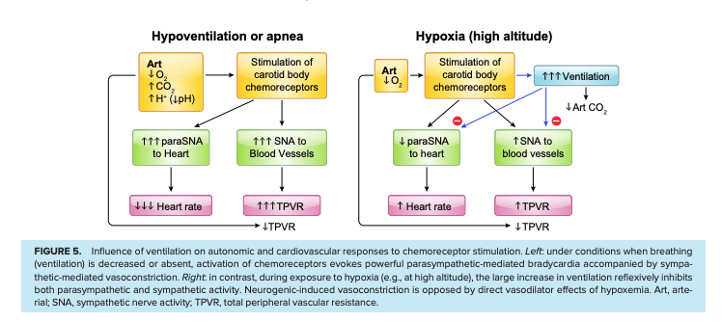
Mechanisms of Peripheral Chemo cont to phys
Brady during Hypoxemic PEA?
Caused by carotid body mediated chemoreflex parasympathetic discharge – protective to decreased myocardial O2 demand
Aortic bodies can sense CaO2 in addition to PaO2 – this mediates some of the physiologic responses to anemia and CO poisononing, though exact mechanisms not entirely understood.
Notes:
https://journals-physiology-org.ezproxy.lib.utah.edu/doi/pdf/10.1152/physrev.00039.2019

Slide 34
Mechanism is due to negative feedback with:
controller = respiratory centers, neurons, and muscles that achieve alveolar ventilation
Response in this: termed controller gain - Defined as the amount that minute ventilation changes in response to a change in PaCO2 (HCVR) or O2 (HVR)
controlled system = pulmonary gas-exchange organ
Response in this: termed plant gain. Defined as the amount that CO2 will change from a given change in ventilation.
Notes:
Interestingly, fever causes tachypnea, while metabolic acidosis, hypoxemia, and hypercapnia generally cause increases in tidal volume
➔ Thus, physiologic states where obstruction (and prolonged expiration) limit the ability to breathe quickly – fever may be particularly poorly tolerated?

Slide 35
Mechanism of activation (central)
Thus, two facts are clearly established: activation of serotonergic raphe neurons stimulates ventilation and full effects of CO2 on breathing require ongoing activity of raphe neurons
https://www.cell.com/neuron/pdf/S0896-6273(15)00676-5.pdf
=> on this line, Buspirone has been shown to ameliorate chemoreflex in CSA associated with HF in this phase 2 randomized trial
Giannoni A, Borrelli C, Mirizzi G, Richerson GB, Emdin M, Passino C. Benefit of buspirone on chemoreflex and central apnoeas in heart failure: a randomized controlled crossover trial. Eur J Heart Fail 2020 23(2):312-320.
Notes:
Interestingly, Busprione (5h-HT1a presynaptic receptor agonist) decreases the chemoreceptor reflex sensitivity and decreased central apnea index by 80% - “a randomized, placebo-controlled, cross-over phase II trial has investigated its efficacy on CA in patients with systolic HF (6)” - Giannoni A, Borrelli C, Mirizzi G, Richerson GB, Emdin M, Passino C. Benefit of buspirone on chemoreflex and central apnoeas in heart failure: a randomized controlled crossover trial. Eur J Heart Fail 2020 23(2):312-320.

Slide 36
Citations 52-57
Notes:
52.Aubier M, Murciano D, Fournier M, Milic-Emili J, Pariente R, Derenne JP. Central respiratory drive in acute respiratory failure of patients with chronic obstructive pulmonary disease. Am Rev Respir Dis 1980;122:191–199.Abstract, Medline, Google Scholar
53.Doorduin J, Nollet JL, Roesthuis LH, van Hees HW, Brochard LJ, Sinderby CA, et al. Partial neuromuscular blockade during partial ventilatory support in sedated patients with high tidal volumes. Am J Respir Crit Care Med 2017;195:1033–1042.Abstract, Medline, Google Scholar
54.Holle RH, Schoene RB, Pavlin EJ. Effect of respiratory muscle weakness on P0.1 induced by partial curarization. J Appl Physiol 1984;57:1150–1157.Crossref, Medline, Google Scholar
55.Borel CO, Teitelbaum JS, Hanley DF. Ventilatory drive and carbon dioxide response in ventilatory failure due to myasthenia gravis and Guillain-Barré syndrome. Crit Care Med 1993;21:1717–1726.Crossref, Medline, Google Scholar
56.Moosavi SH, Topulos GP, Hafer A, Lansing RW, Adams L, Brown R, et al. Acute partial paralysis alters perceptions of air hunger, work and effort at constant P_{CO2} and V.V._{E}. Respir Physiol 2000;122:45–60.Crossref, Medline, Google Scholar
57.Mendonca CT, Schaeffer MR, Riley P, Jensen D. Physiological mechanisms of dyspnea during exercise with external thoracic restriction: role of increased neural respiratory drive. J Appl Physiol (1985) 2014;116:570–581.Crossref, Medline, Google Scholar

Slide 37
Hypoxia & Hypercapnia Ventilatory Responses
Chemoreflex sensitivity = overall, is comprised of HVR (hypoxic ventilatory response) and HCVR (hypercapnic ventilatory response) – can be measured by a rebreathing test (or breath hold, below)
The ventilatory response to PaO2 is hyperbolic, being almost flat in the high PaO2 range and the slope increases progressively as PaO2 decreases (313)
Threshold where it starts to increase = ~60
Below that threshold, there is a syndergistic response with CO2 (ie. low PaO2 and high PaCO2 -> larger ventilatory response)
Notes:
Note: Ventilatory response to hypercapnic acidosis is larger than for equivalent metabolic acidosis, suggesting that CO2 itself is sensed, not just pH
15. Borison HL, Hurst JH, McCarthy LE, Rosenstein R: Arterial hydrogen ion versus CO2 on depth and rate of breathing in decerebrate cats. Respir Physiol 1977, 30:311-325
313 - Younes M, Georgopoulos D. Control of breathing relevant to mechanical ventilation. In: Marini JJ, Slutsky AS, editors. Physiological Basis of Ventilator Support. New York: Marcel Dekker, Inc., 1998, pp. 1-73.

Slide 38
Chemoreceptor response time
Peripheral – corresponds to circulation time – half-time to response is 10s
Transit time ~6 seconds
Peripheral = fine tuning / rapid response. People survive fine with carotid body removal (likely more important in hypoxic patients)
Vent increases linearly beyond PaCO2 39 mmHg
Central chemoreceptor – requires diffusion CNS – 75s response time
Responsible for roughly 80% of ventilation in health
responsible for steady state PCO2
Vent increases linearily beyond PaCo2 45 mmHg (**)
Notes:
**Duffin J, McAvoy GV. The peripheral-chemoreceptor threshold to carbon dioxide in man. J Physiol 1988; 406:
15–26.
For what its worth: changes in Ve are mainly changed by Vt, not RR
However, if mechanical constraints limited ability to change Vt, RR will pick up the slack.
In healthy individuals, the respiratory drive changes minimally with mild hypoxemia (Pa_{O2}, 60–70 mm Hg), but at lower Pa_{O2}, it increases progressively with hypoxemia (48, 50). Although Pa_{O2} is a relatively weaker modulator of respiratory drive than Pa_{CO2}, Pa_{O2} may significantly affect the respiratory drive through changes of the ventilatory response to Pa_{CO2} (37, 50, 51).

Slide 39
Central vs peripheral chemoreceptors
Bilateral denervation of the carotid bodies (e.g. b/l endarderectomy) leads to ABSENCE of hypoxemia drive to breath AND blunting of H+ response to breathe.
(Dahan A, Nieuwenhuijs D, Teppema L. Plasticity of central chemoreceptors: effect of bilateral carotid body resection on central CO2 sensitivity. PLoS Med 2007; 4: e239.; Rodman JR, Curran AK, Henderson KS, et al. Carotid body denervation in dogs: eupnea and the ventilatory response to hyperoxic hypercapnia. J Appl Physiol 2001; 91: 328–335.)
Conversely, adaptation to elevation (lower inspired o2 -> thus we increase VA to lower co2 and allow for more O2) requires the carotid bodies to be functioning.
Carotid body doesn't increase VA slope in response to hypoxemia until PaO2 <55-60 mmHg. Consequence (and question): anemia, Carbon monoxide inhalation do NOT cause hyperventilation.
Hypoxemic response also involves increase in CO to avoid tissue hypoxia.
Plasticity occurs in several circumstances: e.g. hypoxemia will lead to an increase in O2 sensitivity at peripheral chemoreceptors that persists for several days after normoxia is restored.
Long term facilitation occurs after intermittent hypoxemia -> carotid sensitization -> sustained adrenergic activity (may be responsible for some of the daytime changes seen in obstructive sleep apnea)
Notes:
==> possible mechanism for why things like RAAS blockade or hyperaldosteronism may be linked to OSA?

Slide 40
Rebreathing test: measures HCVR
Steady state method = increase inspired CO2 and then wait for 4-5 mintues for steady state and measure Ve – repeat. Time consuming
Rebreathing: rebreathe from 7%CO2 containing bag with 50% oxygen for 4 minutes (this keeps O2 high enough)
Ventilation is plotted against the PCO2 in the bag – easier to do but corresponds to steady state method.
EtCO2 and EtO2 generally taken to reflect arterial levels.
Rebreathing > Stead state for reproducibility
https://openres.ersjournals.com/content/4/1/00141-2017
Note: P0.1 occlusion has been validated to approximate this.
Notes:
Comroe’s Law: lung is designed to eliminate CO2 in a CO2-Free medium. When CO2 is added to the inspired air – PaCO2 must rise.
https://www.ncbi.nlm.nih.gov/pmc/articles/PMC3889173/
The apparent breakdown of such homeostatic regulation in the classic hypercapnic ventilatory response during CO₂ breathing (Duffin, 2005), Poon (2011) suggests that the latter condition may reflect a shift of equilibrium in an underlying ‘homeostatic competition’ between the respiratory controller’s conflicting goals to minimize both the chemical and mechanical costs (or “discomforts”) of breathing (among other homeostatic and non-homeostatic goals that compete for use/disuse of the respiratory apparatus)
However, for inhaled CO₂ levels > ~3% the CO₂-clogging effect becomes increasingly challenging and the controller must now balance the benefit of maintaining Pa_{CO2} homeostasis against the mounting respiratory effort required to cope with the elevated V˙iCO2 level

Slide 41
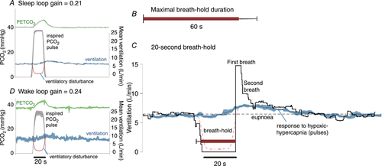
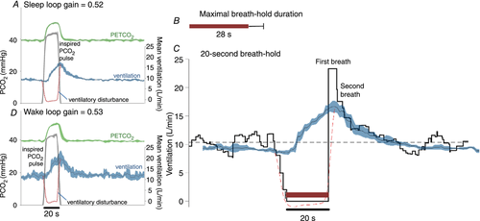
Sensitivity of controller system can also be measured with breath holds
https://physoc.onlinelibrary.wiley.com/doi/full/10.1113/JP276206
High chemoreflex sensitivity on top
Low chemoreflex sensitivity on bottom
Notes:
A – low
inspired pulses of hypoxic–hypercapnic gas (14% O₂–6% CO₂) cause an increase in end-tidal () that then elicits a chemoreflex ventilatory response. In this example, the ventilatory response is small. Traces shown are the ensemble average of multiple pulses administered during sleep (black line represents mean, coloured shading represents 95% confidence interval). Dashed red line illustrates the calculated ventilatory disturbance (i.e. the calculated drop in ventilation that would cause the observed rise in , see Sands et al. 2017b); by design, the pulse is approximately equivalent to apnoea (ventilation = 0). Loop gain is taken as the ventilatory response to this disturbance (Fourier analysis, Sands et al. 2017b). B, maximal breath-hold duration was long (60 ± 11 s, mean ± SD) in this participant (see A). C, ventilation during spontaneous 20 s breath-holds. Ventilation falls to zero and, at breath-hold termination (time = 0), there is a period of ventilatory recovery. Note the first recovery breath is much larger than subsequent breaths (15 L/min; 230% of eupnoea). The second breath is considerably smaller (10 L/min; 154% of eupnoea) and is more in line with the ventilatory response to hypoxic hypercapnia (pulses; 135% eupnoea, shown superimposed, from A). The first recovery breath was considered to be particularly influenced by factors beyond chemical stimuli. D, inspired pulses during wakefulness appear remarkably similar to those during sleep.
B- high
A, inspired pulses of hypoxic–hypercapnic gas elicit a large chemoreflex ventilatory response in this example, thus a greater value of loop gain is measured (response/disturbance). Traces shown are the ensemble average of multiple pulses administered during sleep (black line represents mean, shading represents 95% confidence interval). Dashed line illustrates the calculated ventilatory disturbance. B, maximal breath-hold duration was short (28 ± 7 s, mean ± SEM) in this participant (see A). C, ventilation during spontaneous 20 s breath-holds (ensemble average). Note the first recovery breath is larger than subsequent breaths (23.5 L/min; 229% of eupnoea). The second breath response is smaller but still high (17.5 L/min; 170% of eupnoea) and is more in line with the ventilatory response to hypoxic hypercapnia (pulses; 192% eupnoea, shown superimposed, from A). Just as seen in Fig. 2, the breaths after the first recovery breath appear consistent with the response to chemical stimuli. D, inspired pulses during wakefulness appear remarkably similar to those during sleep.

Slide 42
Breath holds
“However, the strong associations observed, by us and others (Stanley et al. 1975; Trembach & Zabolotskikh, 2017), indicate that variability in maximal breath-hold duration generally reflects variability in loop gain more than it reflects variability in the “breaking-point” (i.e. the change in chemical drive that triggers voluntary breath-hold termination)”
=> amount of desaturation depends on lung volume, position (supine vs standing = larger FRC)
Notes:
Second, it is not clear whether loop gain is a fixed underlying trait or can be confounded by concomitant alterations in airway patency, gas exchange abnormalities and sleep/wake state. Third, the impact of therapeutic intervention on loop gain are unknown
Summary of other ways to measure loop gain
Can you measure loop gain clinically?
One of the ways to talk about the impaired hypoxic or hypercapneic drive to breath in OHS is as a decrease in loop gain
-yes, methods: https://www.atsjournals.org/doi/full/10.1164/ajrccm.163.5.ed1101c
‘These findings support a role of obesity-dependent reduced lung volume and increased plant gain as a mechanism increasing loop gain in OSA patients.’ – correlated with FRC
Can you measure loop gain clinically?
-yes, methods: https://www.atsjournals.org/doi/full/10.1164/ajrccm.163.5.ed1101c
https://www.frontiersin.org/articles/10.3389/fneur.2018.00896/full - reivew of loop gain
Loop gain increased in Obesity generally:
“in most OSA patients the main factor affecting plant gain is functional residual capacity. Reductions in lung stores of either CO₂ or O₂ will increase plant gain, because smaller tidal volumes will produce greater fluctuations in alveolar gas tensions. Thus reduced functional residual capacity increases plant gain (12, 13).“ – thus, obesity is expected to increase plant gain
12 Dempsey JA, Smith CA, Przybylowski T, Chenuel B, Xie A, Nakayama H, et al. The ventilatory responsiveness to CO₂ below eupnoea as a determinant of ventilatory stability in sleep. J Physiol. (2004) 560:1–11. doi: 10.1113/jphysiol.2004.072371
13 Khoo MC. Determinants of ventilatory instability and variability. Respir Physiol. (2000) 122:167–82. doi: 10.1016/S0034-5687(00)00157-2
But opposite in those with hypercapnia
obesity increases sensitivity to hypercapnia (44, 65), and inclusion of chronically hypercapnic patient in which CO₂ sensitivity is depressed (66).
44 Narkiewicz K, Kato M, Pesek CA, Somers VK. Human obesity is characterized by a selective potentiation of central chemoreflex sensitivity. Hypertension (1999) 33:1153–8. doi: 10.1161/01.HYP.33.5.1153
65 Yuan H, Pinto SJ, Huang J, McDonough JM, Ward MB, Lee YN, et al. Ventilatory responses to hypercapnia during wakefulness and sleep in obese adolescents with and without obstructive sleep apnea syndrome. Sleep (2012) 35:1257–67. doi: 10.5665/sleep.2082
66 Verbraecken J, De Backer W, Willemen M, De Cock W, Wittesaele W, Van de H. Chronic CO₂ drive in patients with obstructive sleep apnea and effect of CPAP. Respir Physiol. (1995) 101:279–87. doi: 10.1016/0034-5687(95)00037-E

Slide 43
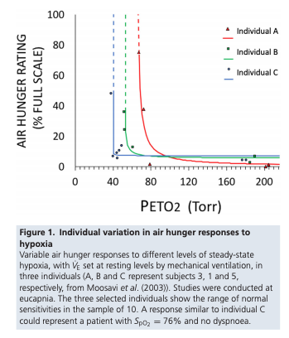
Individual Variation in ventilatory response
“Ventilatory responses vary markedly with up to 10-fold differences in isocapnic hypoxic and hypercapnic responses (McGurk et al. 1995; Swenson et al. 1995). “
Note: hypoxic vent response can take a more prominent role in altitude and chronic lung disease – but generally does not influence ventilation under normoxic conditions.
ventilatory threshold to hypoxemia occurs when PaO2 sensed in the carotid bodies is < 60 mm Hg. Also leads to increased HR & cardiac output
95% 0.5-8.0 l/min/mmhg, 80% between 1.5 and 5.0.
Meaning, 3mmHg ought to increase ventilation by double, roughly.
Notes:
J Physiol Silent Hypoxemia in COVID 19
Similarly, in the setting of exercise:
“For example, Sun and colleagues (23) report that the variability in the V̇ E/V̇ CO2 slope for normal-weight men and women who are similar in age to the patients in the present study is ~3.0”
Sun XG, Hansen JE, Garatachea N, Storer TW, Wasserman K. Ventilatory efficiency during exercise in healthy subjects. Am J Respir Crit Care Med 2002;166:1443–1448.
Signaling from the peripheral and central chemoreceptors in response to changes in arterial Pco₂, pH and PO₂, like that of HPV (49), varies 5-fold to 10-fold among healthy individuals (69, 70).
69 .Swenson ER, Duncan TB, Goldberg SV, Ramirez G, Ahmad S, Schoene RB. Diuretic effect of acute hypoxia in humans: relationship to hypoxic ventilatory responsiveness and renal hormones. J Appl Physiol (1985) 1995;78:377–383.Crossref, Medline, Google Scholar
70 .McGurk SP, Blanksby BA, Anderson MJ. The relationship of hypercapnic ventilatory responses to age, gender and athleticism. Sports Med 1995;19:173–183.Crossref, Medline, Google Scholar
Compr Physiol 2:2203-2254, 2012.
“The topic is complicated by findings that control of ventilation differs between that of Andean highlanders and Himalayan highlanders [see Slessarev et al. (279) and Duffin (67) for
recent discussion].
In highlanders, there appears to be two main differences in the control of breathing compared to altitude acclimatized (3850 m) lowlanders: (1) there is an increased basal VE in highlanders, indicating a greater nonchemoreflex drive to breathe (278, 279, 323) and (2) highlanders exhibit a decreased ventilatory sensitivity to arterial CO2 (central [H+]) compared to lowlanders that has been attributed to a decreased central sensitivity to CO2 and absent peripheral sensitivity to
CO2 (279), in essence relegating the peripheral chemoreceptor a Po2 sensor.
=➔ only applies to ethnic/genetic highlanders? (not necessarily)
Acute exposure to high-altitude (hypobaric hypoxia) results in a respiratory alkalosis because the ensuing hypoxia stimulates a hyperventilatory response (in attempts to preserve a high arterial Po2) with consequent decreases in arterial [H+] and PCO2 (Fig. 24). In lowlanders that are acclimatized to high altitude or hypobaric hypoxia over a period of days to weeks, the respiratory alkalosis is persistent and only partially compensated by renal retention of Cl−, which serves
to increase [H+] and lower [HCO3 −] by decreasing [SID]. A benefit of acclimatization for lowlanders is an improved ability of the blood to provide O2 to the tissues because the prolonged alkalosis produces an increase in blood O2 saturation despite a fall in arterial Po2 (Fig. 25) that helps to maintain the arterio-venous O2 difference despite hypoxia (344). In contrast, in high-altitude dwellers, there is usually a hypocapnia without alkalosis (161, 263, 323),
High-altitude results in an increase in ventilatory CO2 sensitivity such that for a given increase in arterial PCO2, there are increased arterial and central [H+] with increased stimulation of CCRs (67, 75). In contrast to high or extreme altitude, there occurs relatively little adjustment in ventilation and acid-base status up to one-half atmosphere (3048 m or 10,000 ft) when arterial Po2 approaches 60 mmHg (56, 248).

Slide 44
Factors responsible for individual variation: from (DOI: 10.4187/respcare.10075)
Neurotransmitter accumulation:
Hypoxia - Glutmate increases ventilatory demand, but then in converted to GABA -> decreased ventilatory demand. This manifests as initial increase in ventilation, then later decrease.
Hypercapnia – Results from Acetylcholine activity ( citation 59)
Genetic (O2)s: citation 60 - Azad P, Stobdan T, Zhou D, Hartley I, Akbari A, Bafna V, Haddad GG. High-altitude adaptation in humans: from genomics to integrative physiology. J Mol Med (Berl) 2017;95(12):1269-12
Notes:
Citaton 59 - Burton MD, Kazemi H. Neurotransmitters in central respiratory control.
Respir Physiol 2000;122(2-3):111-121.
Such variability is thought by some to reflect central neurotransmitter
production and release (or accumulation) over
time.58 During acute or chronic hypoxemia, the excitatory
neurotransmitter glutamate increases ventilatory demand.59
As glutamate levels rise, so too does its conversion to
gamma aminobutyric acid, a neurotransmitter that depresses
ventilation. The biphasic ventilatory response to acute hypoxemia
(described below) likely signifies the interplay of
these neurotransmitters and perhaps reflects interindividual
genetic differences in their expression
[ ] citation 57 - Forster HV, Pan LG, Funahashi A. Temporal pattern of arterial CO2
partial pressure during exercise in humans. J Appl Physiol (1985)
1986;60(2):653-660

Slide 45
What things modify the sensitivity of the control system + mechanical system?
respiratory stimulants such as medroxyprogesterone or acetazolamide (244-246). Or Almitrine (carotid chemoreceptor stimulant)
Is Acetazolamide a stimulant, or just moves the metabolic hyperbola?
https://pubmed.ncbi.nlm.nih.gov/25323235/ - acetazolamide (n=11; ΔLG -0.20±0.06, p=0.005) does change loop gain – primarily changes plant gain
O2 also changes loop gain (n=11; mean±sem change in loop gain (ΔLG) -0.23±0.08, p=0.02)
Buspirone decreases it
Opiates, sleep, analgesia decrease HCVR
The ventilatory response to CO2 is enhanced in the presence of hypoxia and/or metabolic acidosis – low pre-existing HCO3 (313)
Decreased by narcotics and sleep. Decreased by sleep deprivation (Cooper KR, Phillips BA. Effect of short-term sleep loss on breathing. J. Appl. Physiol. 1982; 53: 855–8.)
Pain does not affect the slope of the HVR and HCVR
Testosterone increased HCVR, finasteride/leurprolide decrease (https://journal.chestnet.org/action/showPdf?pii=S0012-3692%2821%2900108-2)
“Abdallah and colleagues 45 have recently shown that a single dose of fast-acting, oral morphine in dyspneic patients with COPD was associated with improvements in dyspnea (intensity and unpleasantness) and exercise tolerance but with considerable variation in response between subjects.”
Notes:
244 Skatrud JB,Dempsey JA. Relative effectiveness of acetazolamide versus medroxyprogesterone acetate in correction of chronic carbon dioxide retention. Am Rev Respir Dis 127: 405-412, 1983b.
245. Skatrud JB, Dempsey JA, Bhansali P, Irvin C. Determinants of chronic carbon dioxide retention and its correction in humans. J Clin Invest 65: 813-821, 1980.
246. Skatrud JB, Dempsey JA, Iber C, Berssenbrugge A. Correction of CO2 retention during sleep in patients with chronic obstructive pulmonary diseases. Am Rev Respir Dis 124: 260-268, 1981.
From: https://www.cell.com/neuron/pdf/S0896-6273(15)00676-5.pdf
In brief, RTN generates a considerable portion of the drive to breathe during non-REM sleep. During REM sleep, the contribution of RTN is reduced but still present, REM-off aminergic systems are generally silent, and breathing frequency is regulated by unknown mechanisms. Drugs that selectively activate RTN neurons could, in principle, be useful to treat central sleep apnea syndromes and periodic breathing that are prevalent during nREM sleep
https://pubmed.ncbi.nlm.nih.gov/25323235/ suggests acetazolamide does actually lower loop gain
More on acetazolamide: 6 . Raurich JM , Rialp G , Ibáñez J , Llompart-Pou JA , Ayestarán I . Hypercapnic respi-ratory failure in obesity-hypoventilation syndrome: CO2 response and acetazol-amide treatment eff ects . Respir Care . 2010 ; 55 ( 11 ): 1442 - 1448 .

Slide 46
Modifiers of chemoreceptor sensitivity:
Older age (65-73) and DM reduce vent drive (O2 and CO2) 40-50% compared to 22-30y/o
1st degree relatives of those with OHS don’t have different HCVR - https://thorax.bmj.com/content/55/11/940.abstract
And Javaheri S, Colangelo G, Corser B et al. Familial respiratory chemosensitivity does not predict hypercapnia of patients with sleep apnea-hypopnea syndrome. Am. Rev. Respir. Dis. 1992; 145: 837–40.
→ In general, appears the HCVR is more an adaptation to environment and circumstance than genetics, per se (may be harder to function as an instrument)
Notes:
Second, both older individuals and those with diabetes have blunted ventilatory response to chemoreceptor stimulation.49,120 Studies of older subjects (64–73 y old) found respiratory drive responses to both hypoxemia and hypercapnia are reduced by 40–50% compared to youngadults (22–30 y old).48,49
Kronenberg RS, Drage CW. Attenuation of the ventilatory and heart
rate responses to hypoxia and hypercapnia with aging in normal men.
J Clin Invest 1973;52(8):1812-1819.
Peterson DD, Pack AI, Silage DA, Fishman AP. Effects of aging on
ventilatory and occlusion pressure responses to hypoxia and hypercapnia.
Am Rev Respir Dis 1981;124(4):387-391.
Nishimura M, Miyamoto K, Suzuki A, Yamamoto H, Tsuji M, Kishi
F, Kawakami Y. Ventilatory and heart rate responses to hypoxia and
hypercapnia in patients with diabetes mellitus. Thorax 1989;44
(4):251-257.

Slide 47
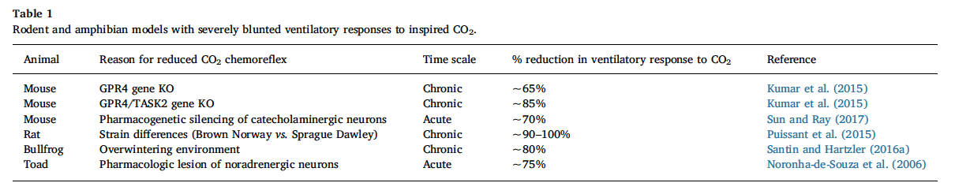
How important is the chemoreceptivity arc?
Does it maintain steady state PaCO2? Arguments against:
With exercise, the PaCO2 never rises (ie. Ve increases before it does). Additionally, at moderate intensity exercise hyperpnea (overshoot) occurs
Animals with reduced CO2 reflex (knockouts) still maintain normal pH
Could you do this test in humans - CCHS? Opiates resting PaCO2? (anecdotally, PaCO2 only changes in response to a perturbation)
Hypothesis: diving animals develop respiratory acidosis, and chemoreflex is the mechanism by which they restore homeostasis after a big dive
Notes:
Comparative Biochemistry and Physiology, Part A 215 (2018) 6–19
http://dx.doi.org/10.1016/j.cbpa.2017.09.015
A large portion of animals breath-hold dive or periodic breath – perhaps some of our ventilatory control is due to shared ancestry with these animals.
“
However, data presented
in this review indicate that the CO2 chemoreflex, and by extension
CO2/pH sensing by central chemoreceptors, is not required for
steady-state ventilation, gas exchange, and blood gas homeostasis
across air-breathing vertebrate taxa, at least while awake
“

Slide 48
Why does the respiratory system regulate ventilation based on CO2/pH levels and not Oxygen levels?
Traditional hypothesis: Occurred at the transition from water to air - water breathers (Gil oxygenation) passive diffuse CO2 out (30x more soluble than O2 in h2O) and thus maintain low PaCO2.
However, in air oxygen is plentiful and CO2 is reversed, thus CO2 accumulates and animals require a method to deal with CO2 accumulation (respiratory acidosis) - increased ventilation (and bicarbonate retention)
Yet – it seems that the development of exercise normocapnia does NOT correspond to this, suggesting an alternative hypothesis .
Notes:
http://dx.doi.org/10.1016/j.cbpa.2017.09.015
This metabolic ventilatory
drive may elicit appropriate ventilatory responses to maintain normal
PaCO2/pHa by detecting modalities associated with muscle contraction
and pulmonary CO2 excretion, but not changes in arterial CO2/pH

Slide 49
Why is control system primarily based on CO2? Pt 2
“This is partly explained by the fact that CO2 (possessing a higher solubility at a similar molecular weight) is 20 times more diffusible across tissues than O2. Thus, alterations in metabolism/respiration are detected much more rapidly through CO2 chemosensory pathways.”
Peripheral chemoreceptors react faster
Also linear relationship?
[ ] citation 54 = West Physiology
Ventilatory Response does not vary whether acidosis is metabolic or respiratory.
Notes:
A study examining how acute
hypercapnia generates breathlessness in normal subjects
found that by increasing PETCO2
from 39–43 mm Hg only a
slight sensation of breathlessness was experienced.87 In contrast,
breathlessness intensified rapidly as PETCO2
rose to 45–48 mm Hg, becoming intolerable at 50 mm Hg.
Modest hypocapnia suppresses hypoxia related drive to breath

Slide 50
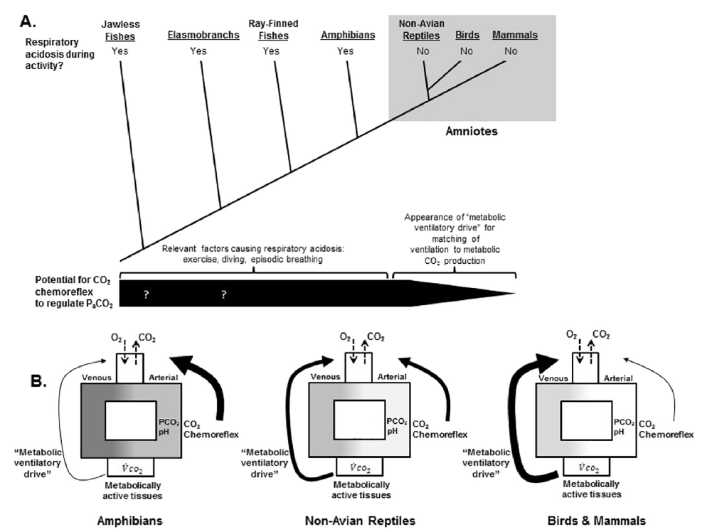
“Metabolic Ventilatory Drive” more important?
Notes:
http://dx.doi.org/10.1016/j.cbpa.2017.09.015
Fig. 2. Phylogenetic trends in matching ventilation to metabolism during activity coupled with the likelihood of encountering a respiratory acidosis during daily life. A. depicts a
simplified phylogeny of vertebrates. Whether or not these animals experience a respiratory acidosis in response to activity is noted across the top by “yes” or “no”. All amniotes assessed
thus far can match ventilation to metabolic demands across a range of exercise intensities, thus preventing a respiratory acidosis, while fish and amphibians cannot. The thickness of the
black bar across the bottom of the cladogram estimates the propensity for CO2 chemoreflex activation during daily life across vertebrates. Because ectotherms have physiology and/or
lifestyles that preclude tight regulation of arterial blood gases, the CO2 chemoreflex likely plays a large role in the regulation of blood gases (thick portion of the black bar). Question
marks signify uncertainty due to lack of data. In contrast, mammals and birds tightly couple ventilation to metabolic demands, and therefore are unlikely to rely on CO2/pH feedback from
chemoreceptors detecting arterial blood gases under normal conditions (narrowing of black bar). B. displays simplified models illustrating a hypothetical shift from a major reliance on
chemoreceptors detecting arterial blood CO2/pH to the “metabolic ventilatory drive” across air-breathing tetrapods. Thickness of the arrows represents the hypothetical relative contribution
of each mechanism to overall ventilatory control of CO2 homeostasis. Gray scale of the animated circulation represents regular swings in arterial blood gases with darker shades
signifying increasing severity of the respiratory acidosis. Because amphibians have only a small capability to match ventilation to metabolic demands, arterial CO2/pH will vary, forcing
amphibians to rely heavily on CO2/pH chemoreceptors for correcting acid-base disturbances. In non-avian reptiles, ventilation can better match metabolic demands during activity, but
lifestyles and breathing patterns of these animals still produce substantial arterial Pco2 changes. Thus both the metabolic drive and chemoreflex drive likely contribute to the maintenance
of arterial CO2/pH in these animals. In most endothermic mammals and birds, metabolic ventilatory drive seems to dominate ventilatory control, preventing significant changes in arterial
blood gases, and consequently the CO2 chemoreflex plays on a minor role in maintaining steady-state PaCO2 in these animals.

Slide 51
He BT, Lu G, Xiao SC, et al. Coexistence of OSA may compensate for sleep related reduction in neural respiratory drive in patients with COPD. Thorax 2017;72:256–62.
NREM drive to breath assessed by Ve / EMGdi ratio in overlap syndrome against COPD alone, OSA alone, and healthy subjects. (n=16,19,14,12 each)
Ve decreased 10% in healthy, 24% in COPD, 21% in OSA, and 27% in OVS
Drive: decreased in COPD (20-30%), increased in OSA (in response to upper airway resistance), and remained unchanged on OVS (cancelled).
Thus, OVS may be protective against sleep hypoventilation?
ETCO2 similar between OVS and OSA - either deadspace increased in OVS or apneas/hypopneas were less consequential (traction?) – OVS had mostly hypopneas
Critique: no matching for disease or severity symptoms – are these differences in pathophysiology, or reflection of what conditions are often present at the diagnosis of sleep complaints?
Notes:
OSA and COPD – interact in complex, sometimes competing or self-canceling ways.
Of note, hypopnea definition (in terms of SpO2 desaturation) is probably more sensitive and less specific to a threshold of disease severity in COPD patients due to gas-exchange abnormaliies.
-commentary Laghi F, Owens RL. Thorax March 2017 Vol 72 No 3
Synthesis: in addition to the issue of tracheal traction, COPD and OSA may have competing effects on the drive to breath, with OSA increasing airway resistance and protecting against sleep hypoventilation. OVS, thus has been found to occupy a middle ground.
Neural drive to breath is known to decrease at night in patients with COPD
AHI definition does not adequately capture the varying hypoventilation, or that hypopneas – which are defined on the basis of desaturation – are more likely to occur in patients with gas-exchange abnormalties.
Smoking as shared risk factor
Additionally, across the spectrum some pathophysiology may be synergistic (predisposition to hypoxemia), some may be subtractive (tracheal traction from emphysema, apposing effects on nocturnal drive to breathe) and some may be unrelated (sleep disruption). Exactly how the two disorders interact may vary by disease severity of each,
REM atonia of the voluntary, skeletal muscles.

Slide 52
Pathogenesis of obstructive sleep apnea in individuals with the COPD + OSA Overlap syndrome versus OSA alone Physiological Reports. 2020;8:e14371. https://doi.org/10.14814/phy2.14371
OSA pathogenicity:
Anatomic factors: upper airway collapsibility (may stiffen when lung is hyper-inflated, but emphysema loss of elastic recoil may lessen this – hard to know a priori)
Neurologic / Physiologic factors: upper airway muscle response (worsened by ICS? Smoking?), respiratory-related arousability from sleep (may be lower in OVS due to frequent awakenings in the absence of upper airway collapse), control of breathing (respiratory drive generally increased)
Matched OSA (n=15) to OVS (n=15; most with moderate obstruction) on gender, age, BMI. Exclude: narcotics, sedatives, supp O2, recent exacerbation, BMI over 36, active smoking, heavy EtOH
PSG to determine Veupnea, Vpassive and Pcrit, Varousal/ArTh, Loop gain
“Consistent differences in key OSA traits were not observed between OVS and OSA alone.”. OVS: lower sleep efficiency, REM SpO2
Reduced upper airway response in those with air trapping; increased loop gain in those with worse airflow obstruction (contrary to expection; perhaps mediated by hypoxemia?). Somewhat lower arousal threshold – perhaps explains how hypercapnia can occur?
No difference in collapsibility: perhaps this is selection – if you have to have dx of OSA, then by definition the airway must be collapsable
Notes:
“
Veupnea: Ventilation during sleep in the absence of upper
airway obstruction (i.e., on therapeutic CPAP pressure),
such that ventilation should match baseline ventilatory
drive.
Vpassive and Pcrit: Both are measures of collapsibility of
the upper airway, determined at baseline ventilatory
drive (i.e., without accumulation of any additional drive
that might result from prolonged upper airway obstruction).
Vpassive measures ventilation at atmospheric pressure
(zero cm H2O) under such nonactivated airway
conditions, while Pcrit measures the pressure at which
inspiratory flow goes to zero under nonactivated airway
conditions.
Varousal and Ventilatory arousal threshold (ArTh): Both are
measures of the tendency to wake from sleep due to inspiratory
flow limitation. Varousal measures the minimum
ventilation that can be sustained without arousal during
steady-state conditions. Ventilatory drive accumulates
under such conditions, leading to increases in intrathoracic
pressure swings; a high Varousal indicates a tendency
to wake up with minimal increase in intrathoracic pressure
swings. The ArTh is a calculated value, using the LG and
Veupnea data to estimate the ventilatory drive that is present
at the ventilation measured by Varousal.
Vactive and Upper airway gain (UAG): Both are measures
of the ability of the upper airway to dilate in response to
increases in respiratory drive. Vactive measures ventilation
at atmospheric pressure (zero cm H2O) under maximally
tolerated increased respiratory drive (i.e., at the same
point in drive as Varousal and ArTh). The UAG is a calculated
value, using Vpassive, Vactive, Veupnea, and LG to determine
the increase (or decrease) in ventilation achieved
using an increase in respiratory drive.
Loop Gain (LG): Measures instability in ventilatory control,
by measuring the ratio of ventilatory response to a
steady-state ventilatory disturbance. The disturbance is
the increase in drive that results from steady-state inspiratory
flow limitation conditions, and response is determined
by suddenly alleviating the flow limitation.

Slide 53
Other factors besides chemoreflex arc
Pulmonary CO2 monitoring (hypothetical)
Central command (supramedullary inputs)
Sensory neurons from muscles of respiration via spinal cord.
Notes:
http://dx.doi.org/10.1016/j.cbpa.2017.09.015

Slide 54
How is this useful? Needs to lead to a prediction
Will supplemental O2 increase exercise capacity in non-hypoxemic COPD individuals with air trapping? (by decreasing chemoreflex sensitivity, as opposed to direct effects on hypoxia)
Yes (because it has very little to do with the PaO2 – though patients who are hypoxemic will have an especially steep HCVR curve)
Increased exercise capacity is not directly related to tissue hypoxemia.
Would other things that influence the loop gain work?
Will opiates increase exercise capacity in patients with dynamic hyperinflation? Yes (though potential to worsen hypercapnia)
Notes:
Slowing the respiratory rate thereby reduces dynamic hyperinflation-related constraints on VT, allowing a larger VT, which improves the VD/VT. Low-dose opiates also improve exercise capacity by nearly 20% in COPD patients by blunting the ventilatory reflexes to hypoxaemia and hypercapnia [100]. By limiting excessive increases in respiratory rate, opiates reduce the ventilatory demand for a given workload and reduce dynamic hyperinflation in addition to diminishing dyspnoea perception for a given V′E [100].
Citation 100 from https://erj.ersjournals.com/content/erj/51/2/1700860.full.pdf
Note:
From https://journals-physiology-org.ezproxy.lib.utah.edu/doi/pdf/10.1152/physrev.00039.2019
The surgical CB resection developed by Nakayama was extensively used in Japan from 1945 to 1960 to relieve the perception of dyspnea associated with bronchial asthma in young subjects. Nakayama (548) reported the effects of unilateral or bilateral CB resections to relieve the sensation of air hunger in a large number of patients (>3,900) with bronchial asthma.
Suspected mechanism: blocking peripheral chemoreflex response -> less hypercapnic and hypoxemic ventilatory responses. “Thus, bilateral resection of the CBs in humans resulted in a permanent elimination of the hypoxic ventilatory responses in normocapnic conditions (552).” - Since the main role played by the CB chemoreceptor in humans is to control respiratory gases, several concerns regarding the potential deleterious effect of bilateral CB ablation have been raised (354, 451, 543, 553, 554).

Slide 55
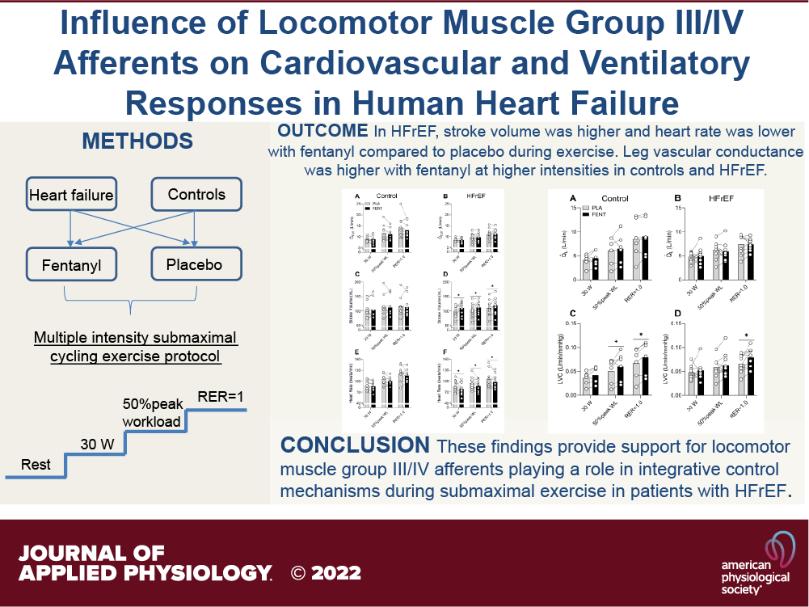
Mechanism of cross talk is complex
https://journals.physiology.org/doi/abs/10.1152/japplphysiol.00371.2021

Slide 56
Exercise
In light aerobic exercise, the gain of the hypercapnic ventilatory reflex is unchanged (Forster et al., 2012).
Classically taught as not involving the central chemoreceptors – however, they may be involved (through non-CO2 means)
during intense anaerobic exercise, when blood lactate accumulation occurs, breathing increases even further.
VCO2 can increase 30-fold with high-intensity exercise, reflecting both the high rate of skeletal muscle CO2 production and acid titration of CO2 stores. (Comp Phys 2012) – the acidification of the tissue beds (even if not due to contraction of muscle) leads to increased mobilization of CO2 stores.
Note: sustained, and elderly this is probably lower (see calculation earlier)
Notes:
“VCO2 can increase 30-fold with high-intensity exercise”
Forster, H.V., Haouzi, P., and Dempsey, J.A. (2012). Control of breathing during exercise. Compr. Physiol. 2, 743–777.

Slide 57
Exercise
Isocapneic hyperpnea: very precise regulation of Va compared to VCO2 at various work rates – 10-fold change (and among individuals with very different body size; and, unlike O2, it does not change with age). Interestingly, this can still be achieved after denervation of carotid bodies (at least at moderate work rates) - suggesting the primary mechanism involve sensors in the lungs and central control.
1. Anticipatory, feed forward mechanism: allows increase in VA to occur prior to drop in pH (increase in CO2).
2. Muscles provide feedback (blocking muscle afferents with curare lowers Va similar to drop from intrathecal fentanyl - interestingly this blockage can improve exercise performance in those with COPD)

Slide 58
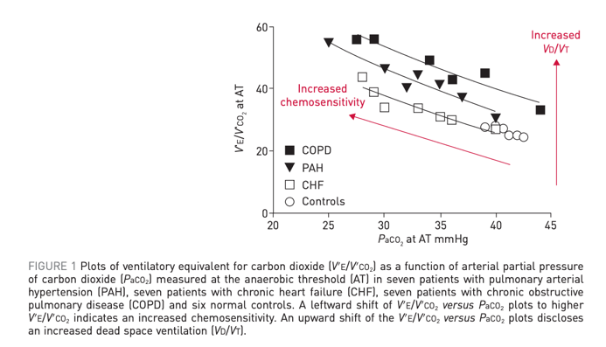
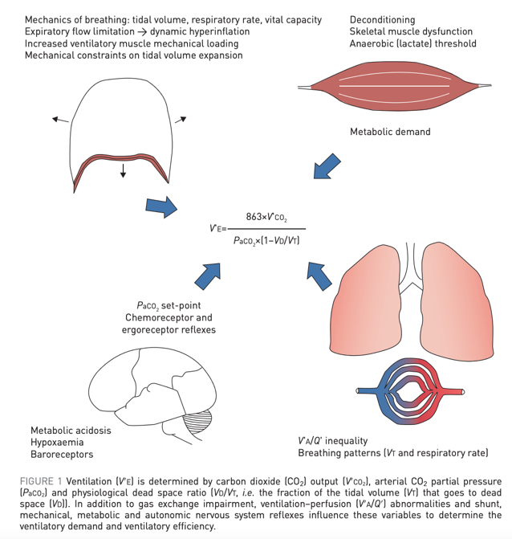
Relation of VE/VCO2 to HCVR
Exercise: depends on both metabolic drive (poorly understood) and chemical drive (aka chemoreflex from central and peripheral baroreceptors)
VE/VCO2 depends on the direction and magnitude of change in PaCO2 with increasing exercise intensity and Vd/Vt
Notes:
. If PaCO2 is driven down by a high ventilatory stimulation from sensitised peripheral chemoreceptors, baroreceptors or by ergoreceptors in skeletal muscle, the slope of the V′E/V′CO2 relationship will increase. The arterial CO2 set-point itself is influenced by factors such as metabolic acidosis, hypoxaemia, baroreceptors in the pulmonary vasculature and sympathetic nervous system hyperactivity
https://erj.ersjournals.com/content/erj/51/2/1700860.full.pdf for this whole slide
----
https://erj.ersjournals.com/content/erj/51/2/1702517.full.pdf

Slide 59
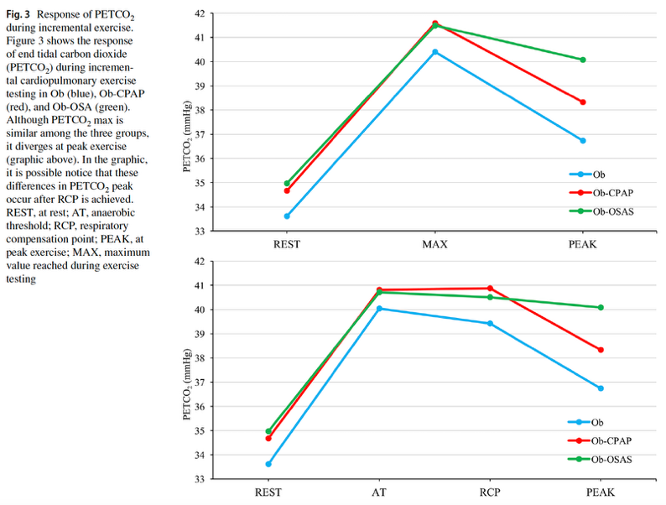
CPETS IN OSA https://doi.org/10.1007/s11325-021-02475-0
Obese patients referred to sport clinics. 3 groups: Obese, obese w untreated OSA, obese with treated OSA for at least 8 weeks.
Untreated OSA: lower VO2 max, lower peak VE, higher DBP, higher PETCO2 from the resp-compensation point to max
Max peak CO2 higher if you’ve been tolerating apneas -> reduced vent drive to breathe perhaps?

Slide 60
CPET in OSA - Meta-analysis – 2017x
Mild decrease in VO2 max with obesity
Lower HR: chronotropic incompetence from chronic downregulation of beta receptors? (or ventilatory limitation?)
No difference in peak minute ventilation, peak O2 pulse or peak systolic blood pressure
Confounds: activity level, adiposity/distribution
https://erj.ersjournals.com/content/51/6/1702697

Slide 61
Hypoventilation training for exercise performance
[ ] https://en.wikipedia.org/wiki/Hypoventilation_training
Argument by PaCO2 = VE * (1-Vd/Vt) * VCO2
Makes sense at rest…. Could spend less.
Buteyko Method https://en.wikipedia.org/wiki/Buteyko_method
-does have support in asthma https://pubmed.ncbi.nlm.nih.gov/32212422/

Slide 62
However, it seems like maximal exertion would be the operative natural selection pressure. If you ventilate less, would your oxygen delivery change? What is the oxygen extraction in tissues?
Isn’t there some data that extremely fit athletes desaturate at maximum exertion due to pulmonary limitation.
[x ] look in to this and think more deeply. Swenson’s GR lecture from a few years back? Only the fittest athletes are pulmonary limited (I believe would desaturate) – for the rest, gains could be made.
https://medicine.utah.edu/internalmedicine/grand-rounds/video.php?video=0_hzt79bct
Notes:
Ex induced hypoxemia in elite athletes - https://link.springer.com/article/10.1007/BF00417266
https://link.springer.com/article/10.2165/00007256-200030010-00005

Slide 63
Verbraecken and McNicholas: Respiratory mechanics and ventilatory control in overlap syndrome and obesity hypoventilation. Respiratory Research 2013 14:132. doi:10.1186/1465-9921-14-132 https://link.springer.com/content/pdf/10.1186/1465-9921-14-132.pdf
“In subjects with chronic hypercapnia, there is an increased blood bicarbonate concentration, which may inhibit the ventilatory response to CO2 and decreases mouth occlusion pressure response during wakefulness and sleep [50]. When normocapnic, overlap patients can however have a normal or even enhanced ventilatory response to CO2 [51]. This is in contrast to the data on decreased hypercapnic (HCVR) and hypoxic (HVR) ventilatory response in OHS, as compared to obese, non-hypercapnic subjects [52].” – all these are pretty old references
Differentiation of OHS and OVS
OVS: can be non-obese, can have either maintained/elevated chemical drive to breath or decreased drive to breath
Reflects the gradual adaptation of chemoreceptors to hypercapnia / HCO3 elevation.
OHS: must be obese, must not have another chronic pulmonary condition; generally, seems to be mediated by a decreased drive to breath
Obesity: default is increased HCVR; if this fails, you get OHS *** find citation for this.
Notes:
50 – 52
50. Radwan L, Maszczyk Z, Koziorowski A, Koziej M, Cieslicki J, Sliwinski P,
Zielinski J: Control of breathing in obstructive sleep apnoea and in
patients with the overlap syndrome. Eur Respir J 1995, 8:542–545.
51. Verbraecken J, De Backer W, Willemen M, De Cock W, Wittesaele W,
Van de Heyning P: Chronic CO2 drive in patients with obstructive sleep
apnea and effect of CPAP. Respir Physiol 1995, 101:279–287.
52. Zwillich CW, Sutton FD, Pierson DJ, Greagh EM, Weil JV: Decreased hypoxic
ventilatory drive in the obesity hypoventilation syndrome. Am J Med
1975, 59:343–348.

Slide 64
Verbraecken and McNicholas: Respiratory mechanics and ventilatory control in overlap syndrome and obesity hypoventilation. Respiratory Research 2013 14:132. doi:10.1186/1465-9921-14-132 https://link.springer.com/content/pdf/10.1186/1465-9921-14-132.pdf
Spirometric abnormalities re: OHS pathogenesis
Note: for the purposes of this manuscript, it may make sense to point out that these are CONSEQUENCES of respiratory derangments, not consequences of them
“Various compensatory mechanisms are adopted by morbidly obese subjects to maintain eucapnia, despite chronically loaded breathing [82], but are impaired or overwhelmed in OHS.
Piper AJ, Grunstein RR: Big breathing: the complex interaction of obesity, hypoventilation, weight loss, and respiratory function. J Appl Physiol 2010,108:199–205.
Summary of Spirometry changes:
FVC, TLC, RV – 0.5% decrease per BMI
FRC and ERV – 1% decrease per BMI unit
99. Jones RL, Nzekuwu MU: The effects of body mass index on lung volumes. Chest 2006, 130(3):827–833.
Due to ventilating at a lower volume, compliance decreases by:
20% in eucapnic obese
60% in hypercapnic obese (OHS only) - so possibly some component of can’t breathe
[110.] Sharp JT, Henry JP, Sweany SK, Meadows WR, Pietras RJ: The total work of breathing in normal and obese men. J Clin Invest 1964, 43:728–739.
Abdominal obesity, particularly when the patient is supine – also increased respiratory system inertance – leading to three fold increase work of breathing
[110,115]. 115. Lee MY, Linn CC, Shen SY, Chiu CH, Liaw SF: Work of breathing in eucapnic and hypercapnic sleep apnea syndrome. Respiration 2009, 77:146–153

Slide 65
Verbraecken and McNicholas: Respiratory mechanics and ventilatory control in overlap syndrome and obesity hypoventilation. Respiratory Research 2013 14:132. doi:10.1186/1465-9921-14-132 https://link.springer.com/content/pdf/10.1186/1465-9921-14-132.pdf
Ventilation control abnormalities in OHS
VO2 higher, even at rest. Thus, higher drive to breath required [126, 127]
OHS patients fail to increase [52, 95]; can voluntarily regain eucapnia [86]
“hypercapnic ventilatory response is < 1 l/min/mmHg in OHS, between 1.5 and 2.5 l/min/mmHg in eucapnic obese individuals and 2-3 l/min/mmHg in healthy subjects [51,128,129].”
Improves with PAP [130, 131]
“It has been hypothesized that elevated leptin levels may be a compensatory mechanism by which obese subjects remain normocapnic, but resistance to leptin may develop [140].”
“Strikingly, leptin levels are a better predictor of hypercapnia than the degree of adiposity [148]”
Notes:
86 - 86. Leech J, Önal E, Aronson R, Lopata M: Voluntary hyperventilation in obesity hypoventilation. Chest 1991, 100:1334–1338.
51 - 51. Verbraecken J, De Backer W, Willemen M, De Cock W, Wittesaele W, Van de Heyning P: Chronic CO2 drive in patients with obstructive sleep apnea and effect of CPAP. Respir Physiol 1995, 101:279–287.
126. BaHamman A: Acute ventilatory failure complicating obesity hypoventilation: update on a ‘critical care syndrome’. Curr Opin Pulm Med 2010, 16:543–551.
127. Steier J, Jolley CJ, Seymour J, Roughton M, Polkey MI, Moxham J: Neural respiratory drive in obesity. Thorax 2009, 64:719–725.
128. Rapoport DM, Garay SM, Epstein H, Goldring RM: Hypercapnia in the obstructive sleep apnea syndrome: a reevaluation of the “Pickwickian syndrome”. Chest 1986, 89:627–635.
129. Berthon-Jones M, Sullivan CE: Time course of change in ventilatory response to CO2 with long-term CPAP therapy for obstructive sleep apnea. Am Rev Respir Dis 1987, 135:144–147.
130. Lin CC: Effect of nasal CPAP on ventilatory drive in normocapnic and hypercapnic patients with obstructive sleep apnoea syndrome. Eur Respir J 1994, 7:2005–2010.
131. De Lucas-Ramos P, de Miguel-Diez J, Santacruz-Siminiani A, González-Moro JM, Buendía-García MJ, Izquierdo-Alonso JL: Benefits at 1 year of nocturnal intermittent positive pressure ventilation in patients with obesity hypoventilation syndrome. Respir Med 2004, 98:961–967
140 - 140. Lévy P, Pépin JL, Arnoud C, Tamisier R, Borel JC, Dematteis M, Godin-Ribuot D, Ribuot C: Intermittent hypoxia and sleep-disordered breathing: current concepts and perspectives. Eur Respir J 2008, 32:1082–1095.
148 - 148. Redolfi S, Corda L, La Piana G, Spandrio S, Prometti P, Tantucci C: Long-term non-invasive ventilation increases chemosensitivity and leptin in obesity hypoventilation syndrome. Respir Med 2007, 101:1191–1195.
The development of awake hypercapnia has been shown to correlate strongly with the proportion of sleep time spent less than 90% SaO2 [97]
97. Kaw R, Hernandez AV, Walker E, Aboussouan L, Mokhlesi B: Determinants of hypercapnia in obese patients with obstructive sleep apnea: a systematic review and metaanalysis of cohort studies. Chest 2009,
136:787–796
In a recent study it was confirmed that patients with higher bicarbonate concentration had a more blunted CO2 response [135]
135 - 135. Raurich JM, Rialp G, Ibanez J, Llompart-Pou JA, Ayestaran I: Hypercapnic respiratory failure in obesity hypoventilation syndrome: CO2 response and acetazolamide treatment effects. Repir Care 2010, 55(11):1442–1448

Slide 66
Role of Leptin? PMID: 30309268
Leptin: produced by adipose tissue -> BBB -> suppresses appetite and increases energy expenditure
Prior research: ob/ob leptin knockouts -> impaired HCVR
In Mice with diet induced obesity (= leptin resistant, primarily due to impaired transport across BBB), intranasal (bypassing BBB) leptin relieves UA obstruction and stimulates respiration.
If the leptin is given intraperitoneally, there is no effect. The effect of intranasal leptin was mediated by receptor signaling in the hypothalamic and medullary centers
Both routes increase VCO2 by 5-6%; but intranasal increased VE 40% in NREM

Slide 67
Is the respiratory system overbuilt?
https://journals.physiology.org/doi/full/10.1152/japplphysiol.00444.2020

Slide 68
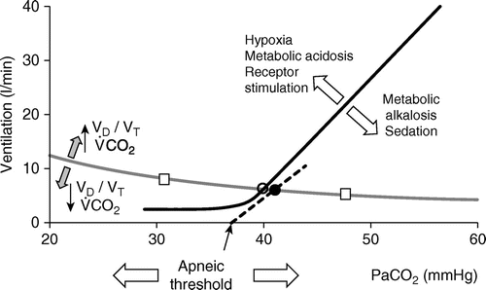
Wakefulness drive to breath
Defined in absence… the hockey stick (a maintained low level of ventilation) goes away when you go to sleep.
An increase in PaCO2 and/or hydrogen ion (with or without hypercapnia) results in an increase in the respiratory motor output (313).
The aforementioned responses to hypercapnia and hypoxemia occur in mechanically ventilated patients irrespective of whether they are awake or asleep (313). Responses to hypocapnia, however, occur only during sleep (and anesthesia) (86, 243)
Volitional control of breathing = mediated through corticospinal tract. Crucial for resisting daytime apneas resulting from hypocapnia [ 85] because the reticular activiating system continues to discharge. [86]
Notes:
85 Dubois M, Chenivesse C, Raux M, et al. Neurophysiological evidence for a cortical contribution to the
wakefulness-related drive to breathe explaining hypocapnia-resistant ventilation in humans. J Neurosci 2016;
36: 10673–10682.
86 Moss IR. Canadian Association of Neuroscience review: respiratory control and behavior in humans: lessons
from imaging and experiments of nature. Can J Neurol Sci 2005; 32: 287–297.
--[x] might this have some implication to how you ventilate a patient with compensated hypercapnia?
https://www.atsjournals.org/doi/full/10.1164/rccm.201903-0596SO
243 - Skatrud JB, Dempsey JA. Interaction of sleep state and chemical stimuli in sustaining rhythmic ventilation. J Appl Physiol 55: 813-822, 1983a.
Wakefulness drive to breath = a stimulus to keep breathing at some Ve even when the CO2 is below the apneic threshold (the flat part of the hockey stick)
- It is also affected by pH and PaO2

Slide 69
How does this relate to central apneas?
Def: 10s pause. Synd requires 5+ central events /hr and 50+% of all events.
Either: high loop gain, or decreased central neuron output (e.g. narcotics/ataxic breathing - leads to decreases in HCVR)
Apneic threshold = PaCO2 below which breathing stops during sleep. ~33-35 mmHg at sea level; presumably lower at elevation
PaCO2 to terminate an apnea ~1-4 CO2 higher than PaCO2 to start an apnea
Hypoxemia (e.g. elevation, ILD) -> physiologic hyperventilation lowers the PaCO2 baseline.
As PaCO2 baseline is closer to Apneic threshold (= called the CO2 reserve), CSAs become more common.
Occurs in NREM predominantly; much less common in REM
CO2 rebreathing (increased FiCO2) will eliminate central apneas by increasing the CO2 reserve (elevating PaCO2 by Comroe’s law).

Slide 70
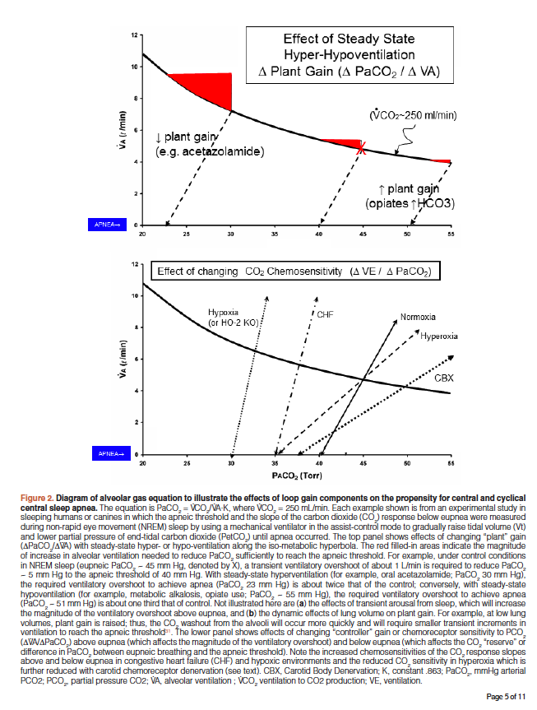
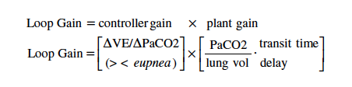
Loop gain – central apneas
https://doi.org/10.12688/f1000research.18358.1

Slide 71
https://www.ncbi.nlm.nih.gov/pmc/articles/PMC3119134/
Wellman 2011: “In this study, we present a noninvasive method for measuring four important physiological traits causing OSA: 1) pharyngeal anatomy/collapsibility, 2) ventilatory control system gain (loop gain), 3) the ability of the upper airway to dilate/stiffen in response to an increase in ventilatory drive, and 4) arousal threshold”
Methods that most pathophysiologic phenotyping uses

Slide 72
OSA research paradigm over the last 5 years: Phenotyping
Might different phenotypes of OSA – whether by symptoms (e.g. the “sleepy” phenotype seems to have more cardiovascular impact - https://academic.oup.com/eurheartj/article/40/14/1149/5146754?login=true ) or by pathophysiology (loop gain, arousal threshold, airway p_crit)
This observation is driven by some patients being high on the traditional metric of AHI, but not experience symptoms. This may correspond to difference in degree of intermittent hypoxia, intrathoracic pressure swings, variations in sympathetic tone, differences in hemodynamic changes
E.g. sustained desaturation predicting cardiovascular risk?
Much of the data reviewed in the manuscript treats obstructive sleep apnea as a monolithic entity. However, increasing evidence points to heterogenous impacts on end-organ systems which may allow for increasingly precise characterization of the impacts of the disorder.
Goal: “Clarification of the purported end-organ susceptibility for systemic effects of OSA” and “Translation of the OSA subtypes into personalised medicine.“

Slide 73
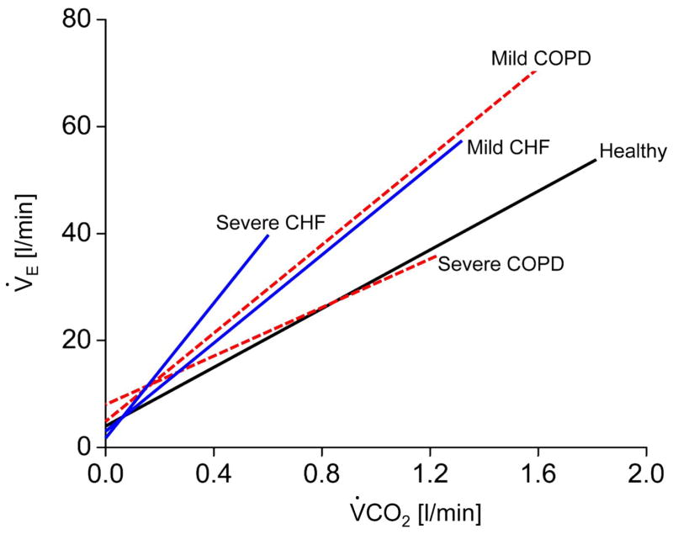
Part 2: Mechanisms of Hypercapnia
Why are patients with COPD more prone to hypercapnia than patients with CHF, despite both having poor V/Q matching and pulmonary mechanics?
CHF patients perceive an increase in VCO2 in excess of the additional Ve needed to compensate for the deadspace fraction. This also happens in mild COPD
In severe COPD, VE required and MVV are close (dynamic hyperinflation, flow limitation) and CO2 cannot be defended
Why does CO2 raise during rebreathing (increased FiCO2), but not during increases in VCO2?

Slide 74
Why might hypercapnic respiratory failure commonly result from sleep disordered breathing?
1. Loss of the wakefulness drive to breath
2. Lower chemoreflex sensitivity
Numerous studies have documented blunted responsiveness to CO2 during sleep attributable to both an increase in the set point for CO2 and to a decrease in the ventilatory response slope to increasing PCO2. 7–11 (from doi:10.1016/j.jsmc.2014.05.014 )
In addition to changes in body mechanics making the reserve smaller
This occurs first/mostly in REM (both because drive and mechanics are most altered)
REM sleep hypoventilation is the first to develop, as ventilation in this stage of sleep is dependent on only the diaphragm and the central drive to breath. (normal PaCO2 increased 4-6 mmHg)
So more properly, anything cause daytime hypercapnia is likely to show up as nocturnal hypercapnia first.

Slide 75
Obesity and respiratory mechanics [ ] move
Relation of sleep to overall hypercapneic failure: (https://onlinelibrary.wiley.com/doi/full/10.1111/resp.12376)
the main reason for the particular vulnerability to hypoventilation during sleep is that sleep is associated with diminished ventilatory drive, particularly during rapid eye movement (REM) sleep
NREM: constant VE, mostly depends on central and peripheral chemoreceptors
REM: variable VE, reduced non-diaphragmatic muscle use
Notes:
“Obesity, operationally defined as body mass index (BMI) >30 kg/m², increases the load on the respiratory system in a number of ways. With increasing obesity, there is a progressive decrease in lung volume measurements (e.g. TLC, VC, RV), which are, nevertheless, usually within the conventional normal ranges until BMI exceeds 40 kg/m².22 Although most obese people are not regarded as having a typical restrictive ventilatory defect, a fairly consistent finding, even with mild obesity, is a reduction in FRC and expiratory reserve volume (ERV)22 due to the effects of obesity on the relaxation volume of the respiratory system. Hence, the obese person is breathing at a less compliant portion of the thoracic volume–pressure curve.23 Despite commonly used measures of airway function, such as the ratio of FEV₁ to FVC, usually being normal in obesity, quiet breathing occurs at low lung volumes (close to RV) where expiratory flow reserve is necessarily reduced.24 As a result, tidal expiratory flow limitation can develop predisposing to dynamic hyperinflation, air trapping and the development of PEEPi. Furthermore, breathing at low lung volumes predisposes to regional small airway closure, atelectasis and reduced lung tissue compliance.25
Increased respiratory loads, such as those outlined above, result in an increase in the total work of breathing at rest in the obese person23 and in the morbidly obese, VO₂ dedicated to breathing is significantly (fivefold) greater than normal weight subjects.26 Furthermore, studies show reduced diaphragmatic neuromuscular coupling and musculoventilatory transfer in response to CO₂ stimulation indicating reduced respiratory muscle output for a given level of respiratory drive.27 Among eucapnic obese subjects, there is a compensatory increase in respiratory drive that maintains appropriate ventilation in the face of the extra work of breathing and respiratory muscle inefficiency associated with obesity.27 Compensation, however, may fail when respiratory loads increase further (e.g. superimposed chest infection) and/or if drive becomes blunted (discussed below), leading to daytime and/or night-time hypercapnia.
“

Slide 76
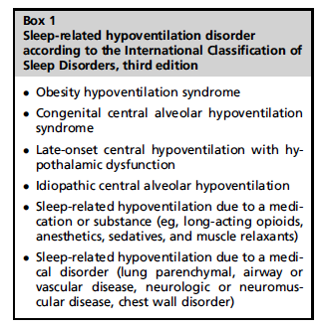
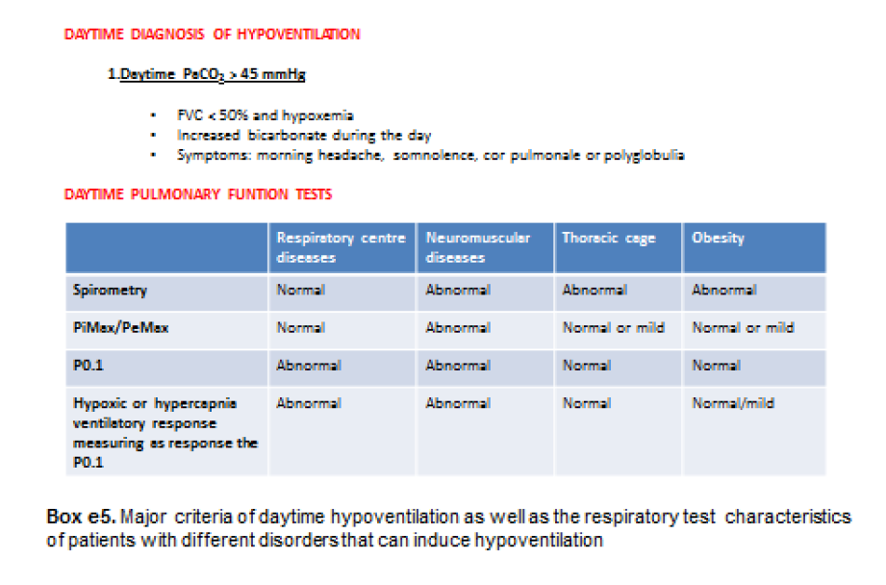
Nocturnal hypoventilation: 10 mmHg increase in PaCO2 compared to daytime.

Slide 77
Why might capnometry (# output) or capnography (waveform output) be helpful in sleep studies?
SpO2 traditionally is used as a surrogate for ventilation (under the assumption that decreased ventilation will lead to desaturation)
However:
Desaturations can occur for other reasons than apneas or hypopneas (ie, COPD related SDB
Depending where someone is on the oxygen-hemoglobin dissociation curve, drops in PaO2 may or may not cause drops in SpO2
If a patient is on supplemental oxygen, hypopneas and hypoventilation may almost never cause desaturations.
The combination of Oximetry and Capnometry could differentiate hypoventilation-caused-hypoxias from V/Q-mismatch-caused hypoxias
Note: if unstable breathing patterns, TcCO2 may be preferred to EtCO2 due to absence of stable expiratory plateaus

Slide 78
OHS as a model disease

Slide 79
Rate of accumulation of CO2
--Apneic Oxygenation in Man 1959 -> rate of accumulation is 3-4 increase in mmHg per minute in the acute setting
No changes in bicarbonate (ie. this is all acute)
https://pubmed.ncbi.nlm.nih.gov/13825447/
From this, you ought to be able to calculate how long it takes to reach steady state… though Vd would change with the size of the bicarbonate buffering system.
CO2 stores - Farhi LE and Rahn H. Dynamics of changes in carbon dioxide stores. Anesthesiology 21: 604–614, 1960.
Notes:
Be used to estimate the kinetics of CO2 changes – similar to creatinine clearance (analogous to CO2 clearance in the lungs)
(with a conceptual difference being changes in production)

Slide 80
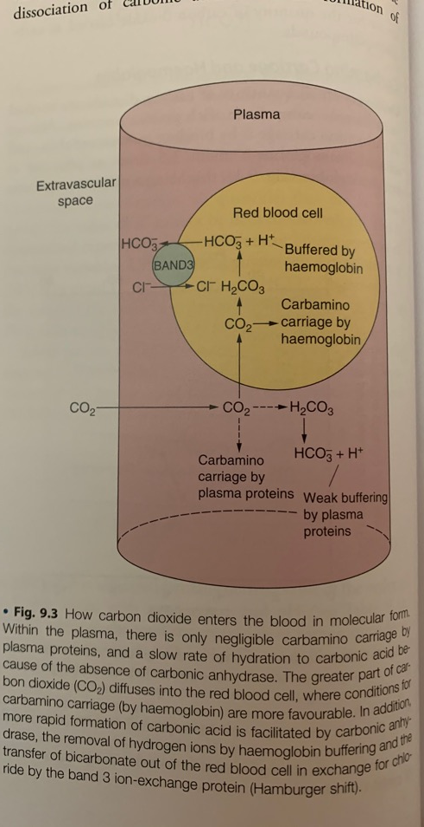
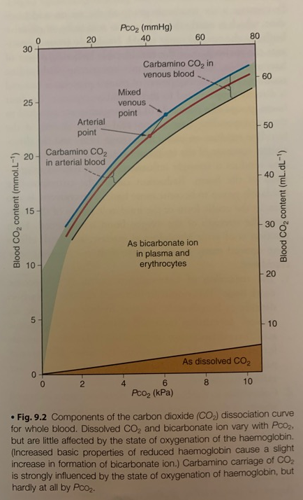
CO2 sequestration in the body:
Carried in blood as dissolved (small), carabamino compounds (some), and bicarbonate ion (majority see to the right)
Over longer term, CO2 will be sequestered in bone as CaCO3, and other tissues
120L volume CO2 (100x greater than oxygen)
Notes:
The term “serum bicarbonate” is not strictly accurate because the chemical methods measure all CO₂ liberated from the serum. Some laboratories use the more correct term “total serum CO₂” to describe measured serum bicarbonate. It is important to note that bicarbonate represents 96% of total serum CO₂, and the remainder is mostly dissolved CO₂
(From https://www.ncbi.nlm.nih.gov/pmc/articles/PMC6680300/)

Slide 81
Patient D.J.
Notes:
Acute Hypercapnia is well tolerated… but the impact is in determining the cause of hypercapnia, reversing it, and instituting changes so that it doesn’t happen again.

Slide 82

Patient D.J.
PCO2?
Notes:
Acute Hypercapnia is well tolerated… but the impact is in determining the cause of hypercapnia, reversing it, and instituting changes so that it doesn’t happen again.

Slide 83
Patient D.J.
PCO2?
More carbonated than cola.
Carbonic anhydrase >
Ideal gas law
2.2g CO2 * 1mol/44 g CO2 = 0.05 mol = 50 mmol
12 oz = 355 mL
50 mmol / 0.355 L = 140 mmol/L
Notes:
Acute Hypercapnia is well tolerated… but the impact is in determining the cause of hypercapnia, reversing it, and instituting changes so that it doesn’t happen again.

Slide 84
Equilibration of PaCO2 when Ventilation changes?
Not symmetric: classic teaching = loading is 3x slower than unloading
Hyperventilation will lead to drop in all compartments of CO2 stores quickly
Hypoventilation – raise will be slower
T1/2 after reduction in ventilation ~16 mins; after increase in ventilation ~3 minutes
Vs 30 seconds for Oxygen
Might be an artifact of deadspace according to Gattinoni DOI: 10.1164/rccm.202005-1687OC

Slide 85
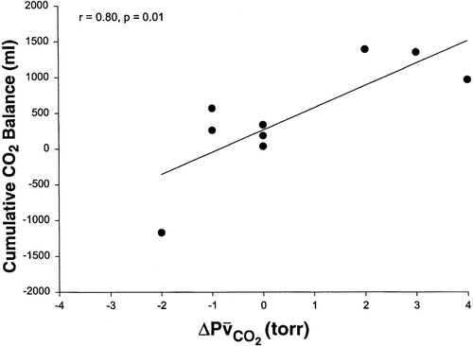
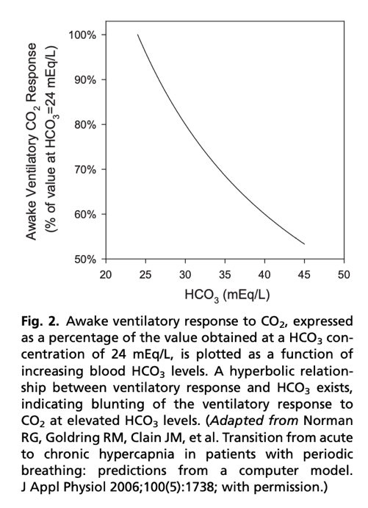
How much CO2 is ‘sequestered’? From https://doi.org/10.1152/jappl.2000.88.1.257
Notes:
Mixed venous CO2
In essence, bicarbonate generation increases the Vd of CO2 (following the creatinine anaology)
Scott’s grand rounds from April (acute breath holds)– all of those kinetics are applicable to the acute change, where there is no bicarbonate buffer.
=➔ free diving, consider bicarbonate supplementation?
From doi:10.1016/j.jsmc.2014.05.014 , summarizing the above study
when CO2 response was abnormally low, a modest rise in awake PCO2 and [HCO3] was seen over multiple days. Similarly, when renal HCO3 excretion rate was lowered to simulate chloride deficiency, the model demonstrated a modest rise in awake PCO2 and [HCO3] over multiple days, even with normal CO2 response. Significantly, the combination of low CO2 response and low renal HCO3 excretion rate produced a synergistic effect on the degree of elevation of PCO2 during wakefulness.

Slide 86
DOI: 10.1164/rccm.202005-1687OC
Healthy human stores of adult male: 1.75L per kg
Estimate: Blood = 2.4%, Interstitium = 8.8% of total, remaining 89% is in tissue (slow compartment).
The majority of CO2 (80%+) is stored in a slow compartment (ie. not the blood and interstitium; the amount depends, probably, on the amount of carbonic anhydrase in each compartment)
This provides a rationale for NIV’s effect on dayitime effect on PaCO2, intermittent ECCO2R in hypercap resp failure (and the noted phenomena where people don’t reach steady state in ECCLS trials)
Notes:
From DOI: 10.1164/rccm.202008-3306ED
The total CO2 stores of the adult
human body are about 1.75 l/kg. The CO2
stores are classically classified in three
different compartments as a function
of their equilibration times. Blood is
considered the rapid compartment
(minutes), the muscles are the intermediate
compartment (hours), and fat and bone are
described as the slow compartment (days)
(4).

Slide 87
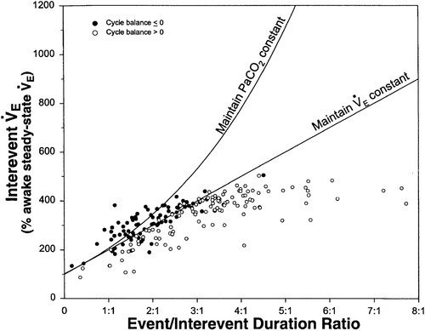
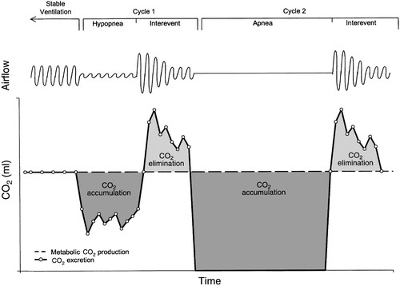
Contribution of Apneas – CO2 loading and unloading
Notes:
(this explains why CPAP works in most OHS) https://doi.org/10.1152/jappl.2000.88.1.257
No relationship was seen between the CO₂ balance for each cycle and its interevent tidal volume or interevent ventilation. Positive CO₂ balance was not associated with a low interevent ventilation and occurred despite increased interevent ventilation to rates as high as 45 l/min.’
Thus, the authors infer the pathophysiology relates to **temporal** V/Q mismatching (as apposed to the usual **spatial** V/Q mismatch), rather than overall inability to compensate.
This is why they used Mixed Venous CO2 as a check – to ensure that temporal V/Q mismatching wasn’t compensated through changes in cardiac output
As the relative duration of the event increased (increasing ratios), there was a progressive increase in the interevent ventilation to a plateau at ratios >3:1. This plateau occurred at an interevent ventilation that was 450% of the awake steady-state value and reflects the maximum ventilation achieved by any patient during the interevent periods.
=➔ this would be different in someone who has pulmonary disease (or deconditioning) – limited in ability to increase
A model has been proposed where daytime hypercapnia can develop if sleep disordered breathing duration is sufficiently long or interapnea periods too short to restore ventilation and eucapnia (Berger et al., 2000). Berger and colleagues have suggested that gradual elevations in CO₂ occur over time since the ventilatory response to hypercapnia is insufficient compared to the rise in CO₂ which occurs during sleep.

Slide 88
CO2 loading and abnormal HCO3 handling
Transient CO2 load during apneic/hypopneic events -> kidneys retain HCO3
HCO3 excretion is slower than PCO2 – will persist into the day
If CO2 Loading/HCO3 retention is severe enough (or retention disordered) that it is not fully normalized, persistent HCO3 retention (met alkalosis) occurs
Excess HCO3 decreases the HCVR (change in PCO2 leads to buffered change in H+ CSF) -> hypoventilation and hypercapnia during the day.
How many patients with a diagnosis of OHS are on loop diuretics? How many were started on loop in the year preceding diagnosis?
Notes:
Might it be better to think about this as the spectrum of disease associated with nocturnal CO2 loading and impaired ventilatory responses, of which obesity (in exclusion, as in OHS) represents 1 end of the spectrum – but heart failure, diuretics, opiates, obstruction, etc. also likely do as well.
doi:10.1186/1465-9921-14-132 Cite this article as: Verbraecken and McNicholas: Respiratory mechanics and ventilatory control in overlap syndrome and obesity hypoventilation. Respiratory Research 2013 14:132.
https://link.springer.com/content/pdf/10.1186/1465-9921-14-132.pdf
In subjects with chronic hypercapnia, there is an increased blood bicarbonate concentration, which may inhibit the ventilatory response to CO2 and decreases mouth occlusion pressure response during wakefulness and sleep [50]. When normocapnic, overlap patients can however have a normal or even enhanced ventilatory response to CO2 [51]. This is in contrast to the data on decreased hypercapnic (HCVR) and hypoxic (HVR) ventilatory response in OHS, as compared to obese, non-hypercapnic subjects [52].
Confounding factor:
Sodium retention is enhanced by hypercapnia and ameliorated by long-term oxygen therapy in hypoxemic patients [47].
[ ] 47. De Leeuw PW, Dees A: Fluid homeostasis in chronic obstructive lung disease. Eur Respir J 2003, 22(Suppl 46):33s–40s.
➔ does metabolic alkalosis lead to aldosterone secretion? If so, this would be a possible mechanism for fluid retention (and would be expected to be ameliorated by ace/arb)
Hypoxemia and (less robustly demonstrated) hypercarbia both predispose to fluid retention). Habitual sodium intake and the use of diuretics are among the most conspicuous confounders.
Does CKD-> bicarb generation troubles that are PROTECTIVE vs obesity hypoventilation?
➔ this is one theoretical difference between obesity hypoventilation syndrome pathogenesis and COPD-OSA overlap syndrome…
(One challenge of this:
- Additionally, a high bicarbonate level indicates a metabolic alkalosis but does not differentiate a primary from a compensatory one. Because obese patients are frequently hyperaldosteronemic and are often on diuretics, corticosteroids, or both, they are prone to develop primary metabolic alkalosis that triggers mild compensatory hypercapnia.⁷ ,⁸
)
Could we look at people who meet diagnostic criteria for OHS – then look how many might be on diuretics -> make the bicarbonate (and/or acid-base status) misleading?
-reference 8 Schrier RW, Masoumi A, Elhassan E. Aldosterone: role in edematous disorders, hypertension, chronic renal failure, and metabolic syndrome. Clin J Am Soc Nephrol 2010;5:1132–40

Slide 89
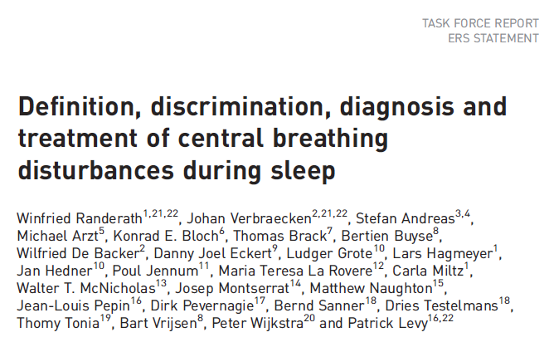
Pathogenesis
ERS Stage 0: At risk if BMI 30+; normal otherwise
HCO3- Level: Dashed
CO2 Level: Solid
Asleep
REM
Awake
Notes:
Hypoventilation, first at night
HCO3⁻ retention
Decreased Hypercapnic Ventilatory Response (HCVR)
Normocapnic obese vs. OHS differ in HCVR
Severe obesity alone is not sufficient; severe OSA alone is not sufficient
Transient CO2 load during apneic/hypopneic events -> kidneys retain HCO3
HCO3 excretion is slower than PCO2 – will persist into the day, depending on severity and the patients ability to hyperventilate or excrete HCO3 (absence of things causing metabolic alkalosis) during the day
If CO2 Loading/HCO3 retention is severe enough (or retention disordered) that it is not fully normalized, persistent HCO3 retention (met alkalosis) occurs
Excess HCO3 decreases the HCVR (change in PCO2 leads to buffered change in H+ CSF) -> hypoventilation and hypercapnia during the day.

Slide 90
Pathogenesis
ERS Stage 1: Obesity-associated sleep hypoventilation, intermittent
Physiology: HCO3- changes slower than CO2
HCO3- Level: Dashed
CO2 Level: Solid
Supine?
AHI up
Asleep
REM
Awake
Notes:
Hypoventilation, first at night
HCO3⁻ retention
Decreased Hypercapnic Ventilatory Response (HCVR)
Normocapnic obese vs. OHS differ in HCVR
Severe obesity alone is not sufficient; severe OSA alone is not sufficient
Transient CO2 load during apneic/hypopneic events -> kidneys retain HCO3
HCO3 excretion is slower than PCO2 – will persist into the day, depending on severity and the patients ability to hyperventilate or excrete HCO3 (absence of things causing metabolic alkalosis) during the day
If CO2 Loading/HCO3 retention is severe enough (or retention disordered) that it is not fully normalized, persistent HCO3 retention (met alkalosis) occurs
Excess HCO3 decreases the HCVR (change in PCO2 leads to buffered change in H+ CSF) -> hypoventilation and hypercapnia during the day.

Slide 91
Pathogenesis
ERS Stage 2: Obesity-associated sleep hypoventilation, sustained
Physiology: HCO3- retention
HCO3- Level: Dashed
CO2 Level: Solid
Asleep
REM
Awake
Notes:
Hypoventilation, first at night
HCO3⁻ retention
Decreased Hypercapnic Ventilatory Response (HCVR)
Normocapnic obese vs. OHS differ in HCVR
Severe obesity alone is not sufficient; severe OSA alone is not sufficient
Transient CO2 load during apneic/hypopneic events -> kidneys retain HCO3
HCO3 excretion is slower than PCO2 – will persist into the day, depending on severity and the patients ability to hyperventilate or excrete HCO3 (absence of things causing metabolic alkalosis) during the day
If CO2 Loading/HCO3 retention is severe enough (or retention disordered) that it is not fully normalized, persistent HCO3 retention (met alkalosis) occurs
Excess HCO3 decreases the HCVR (change in PCO2 leads to buffered change in H+ CSF) -> hypoventilation and hypercapnia during the day.

Slide 92
Pathogenesis
ERS Stage 3: sustained hypoventilation
Physiology: HCO3- lowers CO2 response
HCO3- Level: Dashed
CO2 Level: Solid
Asleep
REM
Awake
Notes:
Hypoventilation, first at night
HCO3⁻ retention
Decreased Hypercapnic Ventilatory Response (HCVR)
Normocapnic obese vs. OHS differ in HCVR
Severe obesity alone is not sufficient; severe OSA alone is not sufficient
Transient CO2 load during apneic/hypopneic events -> kidneys retain HCO3
HCO3 excretion is slower than PCO2 – will persist into the day, depending on severity and the patients ability to hyperventilate or excrete HCO3 (absence of things causing metabolic alkalosis) during the day
If CO2 Loading/HCO3 retention is severe enough (or retention disordered) that it is not fully normalized, persistent HCO3 retention (met alkalosis) occurs
Excess HCO3 decreases the HCVR (change in PCO2 leads to buffered change in H+ CSF) -> hypoventilation and hypercapnia during the day.

Slide 93
Pathogenesis
ERS Stage 4: sustained hypoventilation + cardiometabolic comorbidities
Physiology: increased risk of pHTN, etc.
HCO3- Level: Dashed
CO2 Level: Solid
Asleep
REM
Awake
Notes:
Hypoventilation, first at night
HCO3⁻ retention
Decreased Hypercapnic Ventilatory Response (HCVR)
Normocapnic obese vs. OHS differ in HCVR
Severe obesity alone is not sufficient; severe OSA alone is not sufficient
Transient CO2 load during apneic/hypopneic events -> kidneys retain HCO3
HCO3 excretion is slower than PCO2 – will persist into the day, depending on severity and the patients ability to hyperventilate or excrete HCO3 (absence of things causing metabolic alkalosis) during the day
If CO2 Loading/HCO3 retention is severe enough (or retention disordered) that it is not fully normalized, persistent HCO3 retention (met alkalosis) occurs
Excess HCO3 decreases the HCVR (change in PCO2 leads to buffered change in H+ CSF) -> hypoventilation and hypercapnia during the day.

Slide 94
Inter-apneic periods insufficient to unload the large amount of CO2 produced and retained during apneic periods (Ayappa I, Berger KI, Norman RG, Oppenheimer BW, Rapoport DM, Goldring RM. Hypercapnia and ventilatory periodicity in obstructive sleep apnea syndrome. Am J Respir Crit Care Med. 2002;166(8):1112-1115.)
-> thus, apneas -> CO2 sequestering. Inter apnea ventilation has to increase (which will be limited by the constraints of the respiratory system and the temporal V/Q mismatching)

Slide 95
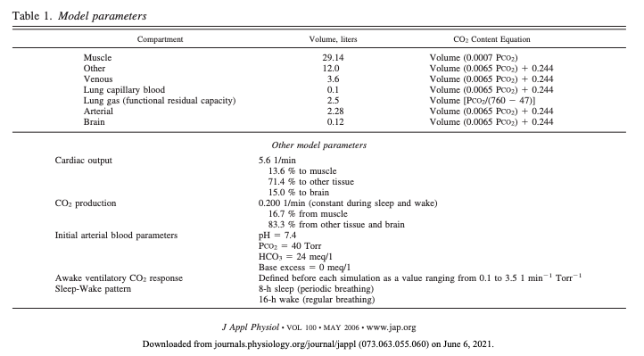
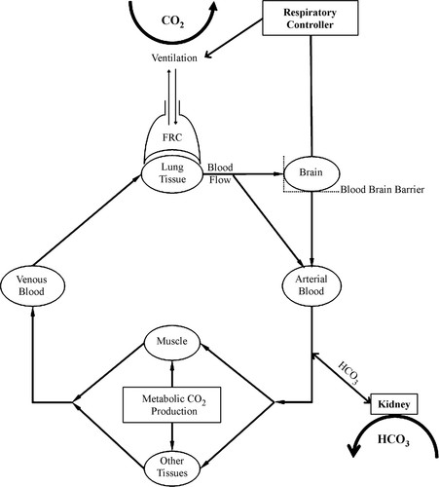
How does acute become chronic?
Notes:
Norman and colleagues 9 previously
demonstrated via computational modeling that intermittent
nocturnal hypercapnia from sleep-disordered
breathing could transition to chronic, sustained hypercapnia
over a period of days if either renal bicarbonate
excretion or ventilatory responsiveness to CO 2 were
decreased, with a synergistic eff ect seen when both were
diminished.
https://journals.physiology.org/doi/full/10.1152/japplphysiol.00502.2005
Schematic of the model used in the simulations. Briefly, CO₂ produced in the tissues is circulated to the lung on the basis of partial pressures and storage capacities of the various compartments. In the lung, CO₂ is removed by ventilation, which is controlled by the respiratory controller responding to the pH of the brain compartment. Arterialized blood leaves the lung and returns to the tissue and the kidney, where bicarbonate (HCO₃⁻) transfer occurs. HCO₃⁻ is transferred on the basis of a target pH and the current Pco₂ according to a specified time course. FRC, functional residual capacity.
‘’
(The CO2 kinetics of the above model was validated at: Rapoport DM, Norman RG, and Goldring RM. CO₂ homeostasis during periodic breathing: predictions from a computer model. J Appl Physiol 75: 2302–2309, 1993
In terms of timing – the model reached steady state within 3 weeks
These simulations suggest that chronic hypercapnia could develop if either:
There is impaired ability to excrete bicarbonate – (diuretics could do this?)
Low hypercapic drive to ventilate (ventilatory CO2 response)
(or both)
In sum: An inciting acute ventilatory event, such as apnea or hypopnea, causes a transient increase in Pa_{co2}. Patients with an adequate and immediate ventilatory response sufficient to maintain the average Pa_{co2} at 40 Torr will show no net change in total tissue CO₂ stores and will therefore remain eucapnic (4). In contrast, patients with inadequate interapnea unloading of CO₂, due either to blunting of the interapnea ventilatory response (3) or to limitation of the interapnea duration relative to duration of apnea (1), will demonstrate a progressive rise in Pa_{co2} over subsequent events with compensatory renal bicarbonate retention
The role of bicarbonate handling in this is supported by the same evidence arguing for including HCO3 27 in the definition: Should bicarb 27 be used? (also can be quantified as base excess over 2 mmol/l - In this prospective observational cohort study, we have demonstrated that obese subjects with a raised BE, but with a normal daytime Pa co 2 , have a ventilatory response between those of normal obese subjects (with-out evidence of awake hypoventilation) and those with hypercapnia and, thus, conventionally defi ned OHS.
https://www.atsjournals.org/doi/full/10.1513/AnnalsATS.201508-563OC also discusses empirical support for the role of both of these physiologic traits.
Reportedly it takes hours for the muscle compartment to equilibrate

Slide 96
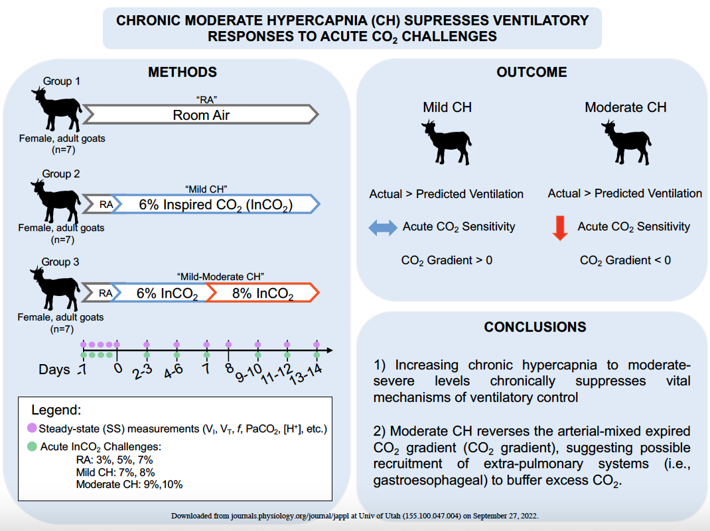
Chronic Moderate Hypercapnia Suppresses Ventilatory Responses to Acute CO2 Challenges – J App Phys 2022
Goat data: 14d exposure to
room air (GR1; control)
6% inspired CO2 (GR2; mild CH)
7d of 6% InCO2 followed by 7d of 8% InCO2 (GR3; moderate CH).
Mild CH group: transient decrease chemoreceptor (change in MV to change in PaCO2); Mod more-so and gastric CO2 offloading occurs and blunting of reflex becomes sustained.
Increased ventilation in both GR2 and 3 beyond what was expected by initial chemoreflex sensitivity measurements.
’Submissive Hypercapnia’: ‘Permissive hypercapnia that is induced by clinicians to allow for PaCO2 to increase, submissive hypercapnia is the decision of one’s respiratory controller to succumb to the present hypercapnia through limiting increases in ventilation and thus preserving energy requirements’ [48]
Notes:
48. Poon CS, Tin C, and Song G. Submissive hypercapnia: Why COPD patients are more prone to CO2 retention than heart failure patients. Respir Physiol Neurobiol 216: 86-93, 2015.
Human data:
Variable findings in human studies, as several studies have reported varying data on acute chemoreflex adaptation during CH (9, 20, 26, 53, 55).
9. Clark JM, Sinclair, R.D., and Welch, R.E. . Rate of acclimitization to chronic hypercapnia in man. In: Underwater Physiology Proceedings of the Fourth Symposium on Underwater Physiology, edited by C.J. LambertsonNew York: Academic, 1971, p. 399-408
20 Guillerm R, and Radziszewski E. Effects on man of 30-day exposure to a PICO2 of 14 torr (2 %): application to exposure limits. Undersea Biomed Res 6 Suppl: S91-114, 1979.
26. Jennings DB, and Chen CC. Ventilation in conscious dogs during acute and chronic hypercapnia. J Appl Physiol 41: 839-847, 1976.
53. Scano G, Spinelli A, Duranti R, Gorini M, Gigliotti F, Goti P, and Milic-Emili J. Carbon dioxide responsiveness in COPD patients with and without chronic hypercapnia. Eur Respir J 8: 78-85, 1995.
55. Schaefer KE, Hastings BJ, Carey CR, and Nichols G, Jr. Respiratory Acclimatization to Carbon Dioxide. J Appl Physiol 18: 1071-1078, 1963.
Within normal physiological ranges the relationship between PaCO2 and ventilation, is linear, where V̇ I increases ~2-5L/min per every 1 mmHg increase of PaCO2 (6).
6. Benner A, Lewallen NF, and Sharma S. Physiology, Carbon Dioxide Response Curve. In: StatPearls. Treasure Island (FL): 2022.
70mmHg as onset of Narcosis? Such levels are the beginning threshold in humans for the onset of CO2 narcosis and subsequentially acute-on-chronic respiratory failure (49, 58).
49. Powell LL. Causes of respiratory failure. Vet Clin North Am Small Anim Pract 32: 1049-1058, 2002.
58. Shebl E, Mirabile VS, and Burns B. Respiratory Failure. In: StatPearls. Treasure Island (FL): 2022.
"acknowledgment of gastric ventilation in times of respiratory acidosis brings into focus two fundamental questions of central chemosensitivity: 1) what is the need for multiple sites of chemoreception? and 2) what functions do the numerous chemoreceptors possess?”

Slide 97
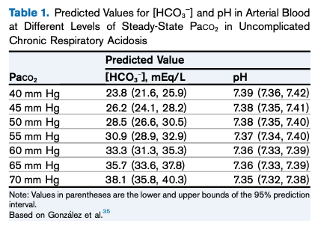
HCO3
3-5 days to reach steady state metabolic compensation in dogs; unknown time in humans
Acute: 0.1 mEq/L per 1 mmHg – modified some by pre-existing degree of HCO3. Not dependent on kidney (carbamate buffering)
Chronic: 1960s – 0.35 to 0.4 mEq/L per 1mmHg Co2 increase; 0.48 - 0.51 mEq/L per 1mmHg more recently; depends on renal function.
Summarized in doi: 10.1053/ j.ajkd.2019.05.029
Notes:
The anticipated effect of an NaHCO3 load of 1 mmol per kilogram of body weight is an increase in plasma [HCO3 − ] of w2 mEq/L if bicarbonate space is 50% of body weigh

Slide 98
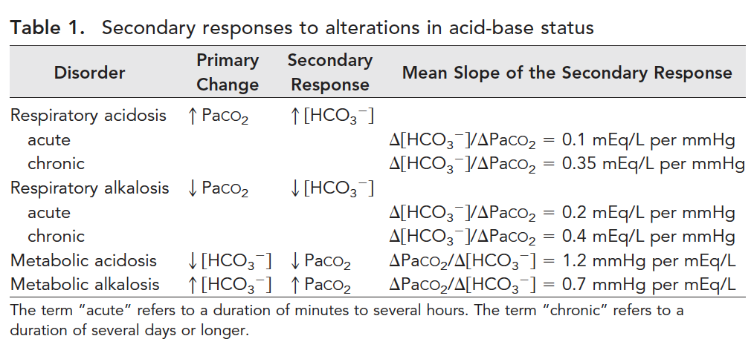
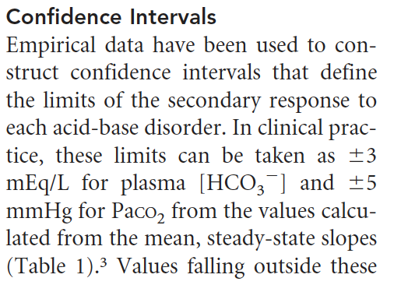
J Am Soc Nephrol 21: 920–923, 2010. doi: 10.1681/ASN.2009121211
Acute resp compensation – nonbicarbonate buffer systems. Validated in numans
Chronic resp secondary process: extrapolated from dogs (who often have resp alkalosis; unclear applicabil)
COPD data suggests 0.35, though steeper slope suggested in some studies*
Met alk: likely takes 24-36 hours. 0.7 ratio is from human studies
Notes:
*Met alk studies - .23,26
Note: patients with chronic acid-base disturbance almost certainly have different ACUTE adapatation to changes that are not accounted for in the rules.
Additionally, the “feedback” from CO2 changes in response to metabolic processes probably feeds back to worsen the HCO3 retention.
Slope study:
T Martinu, D Menzies, S Dial. Re-evaluation of acid-base
prediction rules in patients with chronic respiratory acidosis.
Can Respir J 2003;10(6):311-315.

Slide 99
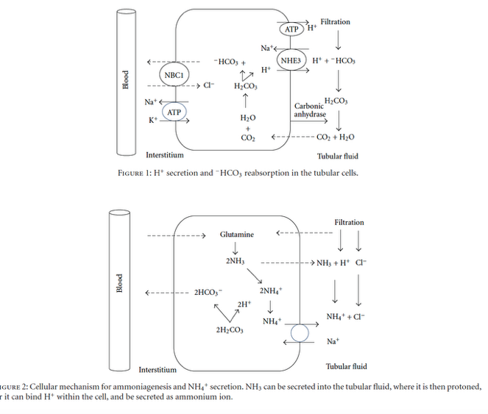
doi:10.1155/2012/915150
Renal bicarbonate retention primarily mediated by NH4 excretion, though phosphate / pendrin also play a role. {?NH4+ Cl-}
Notes:
The renal response is completed in its full extent after 3–
5 days, resulting in a new steady state in which increase of
3.5mEq in bicarbonate concentration is expected for every
increase of 10mmHg pCO2 [18, 19].
[18] N. Madias and H. Adrogue, “Respiratory acidosis and alkalosis,”
in Respiratory Monitoring (Contemporary Management in
Critical Care),M. Tobin, Ed., vol. I, no. 4, pp. 17–53, Churchill
Livingstone, Edimburgh, UK, 1991.
[19] S. K. Epstein and N. Singh, “Respiratory acidosis,” Respiratory
Care, vol. 46, no. 4, pp. 366–383, 2001.
Systematically investigated studies on acid-base disorders
in patients with COPD are few, but there are evidences that
about one-third of these patients have multiple disorders in
which the associated respiratory acidosis-metabolic alkalosis
is the most frequently found disorder [38, 39].
[38] V. Saini, N. Saini, J. Kaur, and G. P. Singh, “Acid base status
in chronic obstructive pulmonary disease patients,” Indian
Journal of Clinical Biochemistry, vol. 8, no. 1, pp. 36–38, 1993.
[39] C. Gu´erin, P. Nesme, V. Leray et al., “Quantitative analysis of
acid-base disorders in patients with chronic respiratory failure
in stable or unstable respiratory condition,” Respiratory Care,
vol. 55, no. 11, pp. 1453–1463, 2010.

Slide 100
Sources of HCO3 variability outside Ve response - DOI: 10.1080/10408363.2019.1568965
Women: menstrual cycle – PaCO2 drops 3 mmHg during luteal cycle; SBE drops 2 mmol/l
Gas in the syringe / preclinical issues (e.g. time for leukocytes to metabolize)
Alkaline tide after a meal
Notes:
Finally, since blood-gas analyses are sensitive to many
preanalytical variations, 5 measured venous bicarbonate
concentration would probably be an interesting alternative
for early-OHS screening
---Baird G . Preanalytical considerations in blood gas analysis . Biochem
Med (Zagreb) . 2013 ; 23 ( 1 ): 19 - 27 .

Slide 101
DOI: 10.1378/chest.14-1970
NOTE: it is not clear if HCO3 elevation is a causative agent, a secondary acid-base response, or both (as in the case where ~40% of the change in HCO3 is a result of the feedback – mentioned in J Am Soc Nephrol 21: 920–923, 2010. doi: 10.1681/ASN.2009121211

Slide 102
SBE / Base Excess
HCO3 does about 75% of the buffering
Base excess = amnt of acid needed to achieve pH 7.4, CO2 40. Empirically determined (though there is inter-individual variation in size of non-bicarbonate buffers)
BE = HCO3−24.8 + β · (pH−7.40); β is buffer power of non-hco3 (which depends on hemoglobin, o2 satl, etc – often proprietary formula)
-2 to +2 mmol / L is normal; BE – Blood, BE-ECF = SBE
For our purposes (hypercapnia research) – a function of same variables; no added information
https://doi.org/10.1007/s00134-022-06748-4
Notes:
It should be noted that arterial standard
[HCO 3 2 ] obtained from the ABL90FLEX blood-gas
analyzer (Radiometer Medical ApS) is not measured but
calculated according to complex formulas including
correction factors for hemoglobin and oxygen saturation
and that BE is calculated from arterial standard
[HCO 3 2 ].
Different analyzers vary in the formula they use

Slide 103
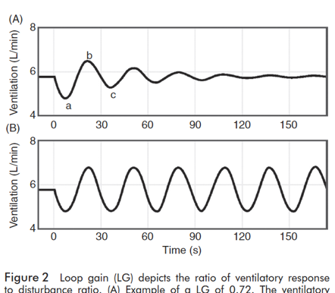
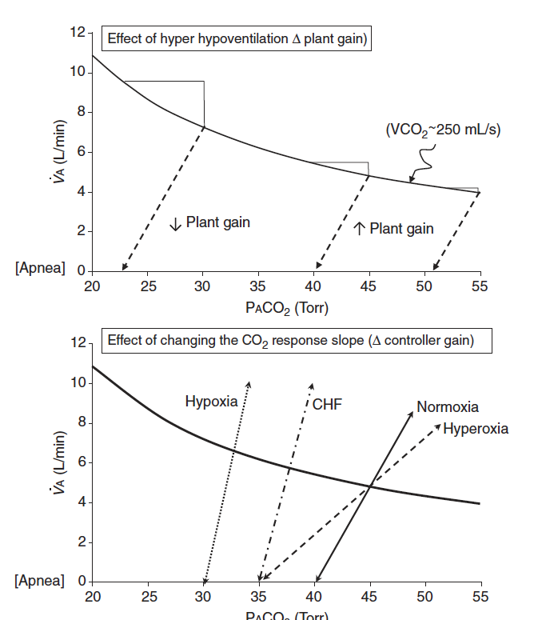
Does the PaCO2 ‘set-point’ change?
For example, in OHS:
Loop gain terminology primarily describes tendency toward stability of ventilation. ‘Gain’ of the feedback loop.
Controller gain: ventilatory response to PO2 and PCO2 )
Plant gain: changes in pulm capillary blood PO2 and PCO2 in response to changes in vent
Mixing gain: effective circulation time – time which cap blood changes are sensed by controller
Many changes are known to influence chemoreflex sensitivity
Ventillatory long-term facilitation is the process that should keep things on track
Ventilatory long-term facilitation is the term for adaptation to chronic stimulus (ie. sustained hypercapnia should increase loop gain to re-establish a baseline, and if this goes wrong you get a ‘wandering baseline’)
Notes:
Although ventilatory LTF has not been reported as such in OSA patients, when compared to age, sex and BMI matched non-OSA participants, untreated OSA patients exhibit a reduced P_{ET}CO₂, reduced CO₂ reserve and increased CO₂ sensitivity below eupnea, which reflects the expression of ventilatory LTF and ventilatory feedback (47, 55). Following CPAP treatment P_{ET}CO₂ and the CO₂ reserve increased in the OSA patients, further supporting the possible presence of ventilatory LTF in untreated OSA patients (47).
https://www.frontiersin.org/articles/10.3389/fneur.2018.00896/full
47 - Salloum A, Rowley JA, Mateika JH, Chowdhuri S, Omran Q, Badr MS. Increased propensity for central apnea in patients with obstructive sleep apnea: effect of nasal continuous positive airway pressure. Am J Respir Crit Care Med. (2010) 181:189–93. doi: 10.1164/rccm.200810-1658OC
55 - Chowdhuri S, Shanidze I, Pierchala L, Belen D, Mateika JH, Badr MS. Effect of episodic hypoxia on the susceptibility to hypocapnic central apnea during NREM sleep. J Appl Physiol. (2010) 108:369–77. doi: 10.1152/japplphysiol.00308.2009
Not clear that it really does ’reset’ so much as never able to compensate (by the modeling done in the next set of slides).
Perhaps this is different with Opiates, oxygen, etc.

Slide 104
1963 - Operation Hideout
21 sailors breathed normal atmosphere for 9 days, then 42 days of 1.5% (FiCO2 0.015; normal is 0.0004)
Alveolar CO2 increased, renal compensation occurred by 24 days. Ventilation changes?
Burgraff et al 2018 (https://pubmed.ncbi.nlm.nih.gov/30211447/) – reduction in cognitive performance throughout the 30 days of hypercapnia (6% FICO2), PaCO2 to 55, higher ventilation – transient increase in chemoreflex, then return to normal
Notes:
For example, due to limitations in CO₂ scrubbing technology, astronauts on the ISS are chronically exposed to 0.005–0.008 (0.5–0.8%), ∼10–20 times higher than earth, with allowable transient (∼1 h) increases in as high as 0.02 (2%; Law et al. 2014).
From Burgraff:
Figure 13. Proposed mechanism(s) accounting for the shift in ventilatory set-point during 30 days of exposure to 6% InCO2 The shift in ventilatory set-point may involve either presynaptic and/or postsynaptic mechanisms. A, the proposed presynaptic mechanism involving both tonic and phasic chemosensitive input into a respiratory motor neuron. Under eucapnic conditions, the primary input onto the respiratory motor neuron is from tonic presynaptic chemosensitive input. During acute hypercapnia, input from the tonic presynaptic input is elevated, alongside increased input from the phasically chemosensitive presynaptic neuron. During chronic hypercapnia, the phasically active chemosensitive input is silenced, whereas elevated input from the tonic chemosensitive presynaptic neuron is maintained. B, the alternative postsynaptic mechanism accounting for a shift in the ventilatory set-point during chronic hypercapnia. In this schematic, there is the presence of both tonically active and phasically active receptors upon the postsynaptic membrane of a respiratory motor neuron. Under eucapnic conditions, activity from the presynaptic chemosensitive neuron activates the tonically active receptors upon the postsynaptic membrane of the respiratory motor neuron. However, during acute hypercapnia, there is both elevated activity of the tonically active receptors, and contribution from the phasically active receptors. During chronic hypercapnia, the phasically active receptors are silenced, whereas activity from the tonically active receptors is maintained at an elevated level.

Slide 105
FiCO2 – Comroe’s Law
Modification to alveolar gas equation for FiCO2: [ ] TODO
Second order effects: hyperventilation and acid-base compensation… to a point.
At least 3% (21 mmHg) handled: https://apps.dtic.mil/sti/pdfs/AD0664899.pdf - increase of PaCO2 of 3mmHg, increase of HCO3 of 1 mEq immediately, 2 mEQ by day 5. Small increase in resting VE, larger increase with exercise.
7-10% FiCO2 cause acidosis, by that reference. (“Schwartz’ studies”)

Slide 106
Submarines and Space Shuttles
Until the advent of nuclear submarines, atmospheric regulation limited duration of submersibles (e.g. Diesel uses O2 combustion).
Now, can keep at 0.5 to 1.5% CO2 with molecular sieves (think Styrofoam that holds the CO2, then can be flushed outside the vessels)
1% atmospheric CO2 increased inspired PCO2 7.5 mmHg and increased Ve 2-3L/min., with lots of variability. – but after a few days the increased ventilation declines and Ve returns to normal – PCO2 increases to reflected the increased inspired CO2. – believed to reflect attenuation of the central chemoreceptor response
Notes:
NOTE: still not clear to me what method of ‘long-term’ control there is to keep the set point from creeping to 40 to 50 to 60 etc.

Slide 107
Chronic hypercapnia by inspired CO2
At 1.5% CO2 inspired, kidneys able to normalize pH. Though paCO2 level increases
At 3.0% and 6%, kidneys are only able to partially compensate, even after 30 days
Bicarbonate excretion in urine was undetectable for 7 days after returning to room air -> suggesting maximal retention was ongoing to coordinate.
Notes:
34. Schaefer KE, Hastings BJ, Carey CR, Nichols G. Respiratory acclimatization to carbon dioxide. J Appl Physiol 18: 1071–1078, 1963. doi:10.1152/jappl.1963.18.6.1071.
35. Burgraff NJ, Neumueller SE, Buchholz K, Langer IIT, Hodges MR, Pan L, Forster HV. Ventilatory and integrated physiological responses to chronic hypercapnia in goats. J Physiol 596: 5343– 5363, 2018. doi:10.1113/JP276666.
36. Crosby A, Talbot NP, Balanos GM, Donoghue S, Fatemian M, Robbins PA. Respiratory effects in humans of a 5-day elevation of end-tidal PCO2 by 8 Torr. J Appl Physiol 95: 1947–1954, 2003. doi:10.1152/japplphysiol.00548.2003.
37. Schaefer KE. Atmung und Saure-Basengleichgewicht bei langdauerndem Aufenthalt in 3% CO2. [Breathing and acid-base equilibrium in the case of long-term stay in 3% CO2]. Pflugers Arch 251: 689–715, 1949. doi:10.1007/BF00361640.

Slide 108
FiCO2 35% and the case of S.M.
SM, amygdala fat deposits, carbon dioxide inhaled fear. Due to Urbach-Wiethe Dz
No fear to conventional stimuli, but high concentration of inhaled CO2 (35%) still provoked panic - ‘first time experienced fear since childhood’ https://www.nature.com/articles/nature.2013.12350
https://www.nature.com/articles/nn.3323
==> fear mechanism is independent of amygdala. (In this case fear comes through the chemo receptors, and not to the amygdala)
Justin Feinstein NIH grant Oklahoma inhaled carbon dioxide
https://grantome.com/grant/NIH/P20-GM121312-01-6548
RCT - https://clinicaltrials.gov/ct2/show/NCT03925987

Slide 109
FiCo2 = 35% = fear toxin?
Batman Begins - fear bag = co2
https://chrisnolan.fandom.com/wiki/Fear_toxin
Dr. Jonathan Crane Batman Begins (3/6) Movie CLIP - The Doctor Isn't In (2005)
‘Scarecrow’ https://www.youtube.com/watch?v=tgV57vrkKuc
Administrator

Slide 110
Aside; Naked mole rats evolved tolerance
See https://link.springer.com/chapter/10.1007/978-3-030-65943-1_9 for review

Slide 111
Presentation of Hypercapnic Resp Failure
Patients with hypercapnic respiratory failure are diagnosed either
In a compensated state when they are referred to a pulmonologist or sleep medicine physician (30-70% for OHS)
In a decompensated state when they are admitted to the hospital
Does this apply to across causes of hypercapnia?
Probably, not studied though
Does this apply to Utah?
Probably not. Can you think why?
Notes:
9. Nowbar S, Burkart KM, Gonzales R, et al. Obesity-associated
hypoventilation in hospitalized patients: prevalence, effects, and
outcome. Am J Med. 2004;116(1):1-7.
26. Marik PE, Desai H. Characteristics of patients with the “malignant
obesity hypoventilation syndrome” admitted to an ICU. J Intensive
Care Med. 2013;28(2):124-130.
29. Castro-Añón O, Pérez de Llano LA, De la Fuente Sánchez S, et al.
Obesity-hypoventilation syndrome: increased risk of death over
sleep apnea syndrome. PLoS One. 2015;10(2):e0117808.
60. Priou P, Hamel J-F, Person C, et al. Long-term outcome of
noninvasive positive pressure ventilation for obesity hypoventilation
syndrome. Chest. 2010;138(1):84-90.
69. Pérez de Llano LA, Golpe R, Ortiz Piquer M, et al. Short-term and
long-term effects of nasal intermittent positive pressure ventilation
in patients with obesity-hypoventilation syndrome. Chest. 2005;
128(2):587-594.
“Thus significant COPD, untreated hypothyroidism, use of opiates (including methadone), and use of sedating or psychoactive medications are, in our experience, often found in patients with hypercapnia and OSAHS. Unfortunately, as the drugs frequently are hard to discontinue it is difficult to prove their role in the hypercapnia other than conceptually.”
“These patients frequently come to the attention of the clinician after an episode of severe acute respiratory decompensation or an intercurrent unrelated hospitalization leading to iatrogenic suppression of ventilation with oxygen, sedatives, or overdiuresis”
Berger, K., Goldring, R., & Rapoport, D. (2009). Obesity Hypoventilation Syndrome. Seminars in Respiratory and Critical Care Medicine, 30(03), 253–261. doi:10.1055/s-0029-1222439

Slide 112
When does hypercapnia cause hypoxemia?
SpO2 <90% catches people’s attention
Corresponds to a PaO2 of ~55 mmHg (depending exactly on the individual’s oxygen hemoglobin dissociation curve.
Normal A-a gradient? 4 + (0.25 * Age)
Critical PAO2 = paO2 + (Normal A-a gradient)
Critical PAO2 = 51 + 0.25 * Age
At 4500 ft:
PaCO2 = 58.17 - 0.19 * Age
At seal Level:
PaCO2 = 75.95 – 0.19 * Age
PA_{O2} = (P_{atm} – P_{H2O}) * Fi_{O2} – (Pa_{CO2} / RQ) + Fi_{O2} * Pa_{CO2} * (1-RQ)/RQ
PA_{O2} = (650 – 47) * 0.21 – (Pa_{CO2} / 0.8) + 0.21 * Pa_{CO2} * (1-0.8)/0.8
PA_{O2} = 126.63 – (Pa_{CO2} / 0.8) + 0.05 * Pa_{CO2}
PA_{O2} = 126.63 – 1.3 * Pa_{CO2}

Slide 113
Notes:
Hypercapnia is largely iatrogenic: without supplemental oxygen, people with hypercapnia wouldn’t persist – especially if they had concomitant lung disease.
This also makes sense why these people might be so frail and prone to readmission… as your PaCO2 goes up, your buffer goes down. In fact, that’s probably why we’re evolved to hyperventilate with altitude. – called referred to as “ventilatory acclimatization” (92).
Lastly: PaCO2 increases exponentially as VE decreases linearly (think of CO2 clearance and how GFR is much more different th

Slide 114
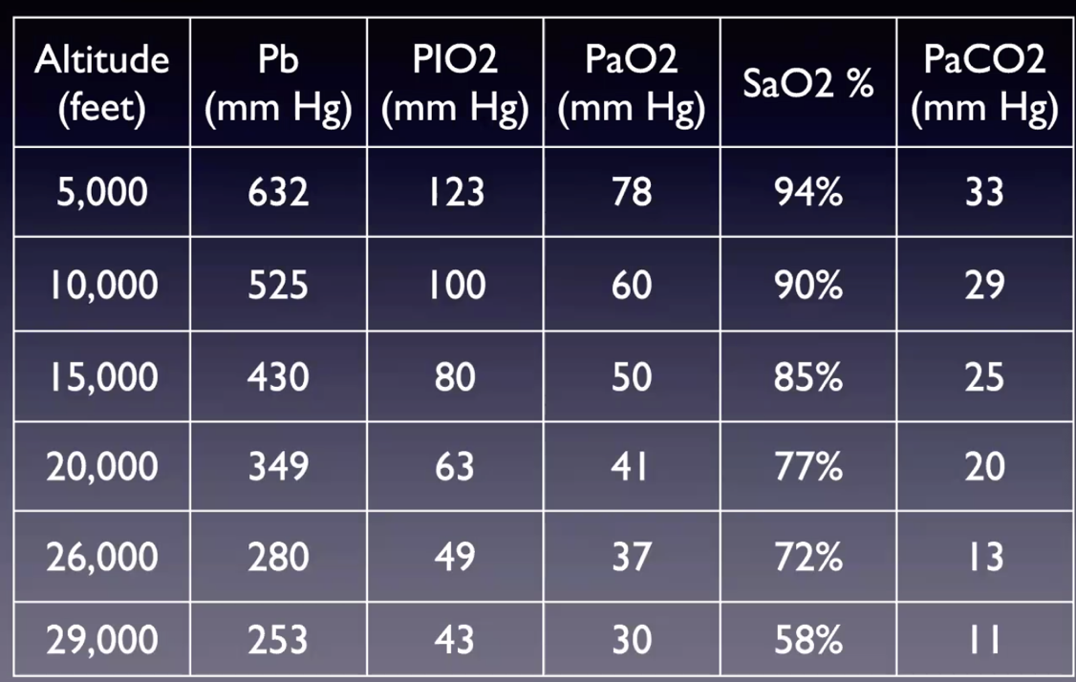

Slide 115
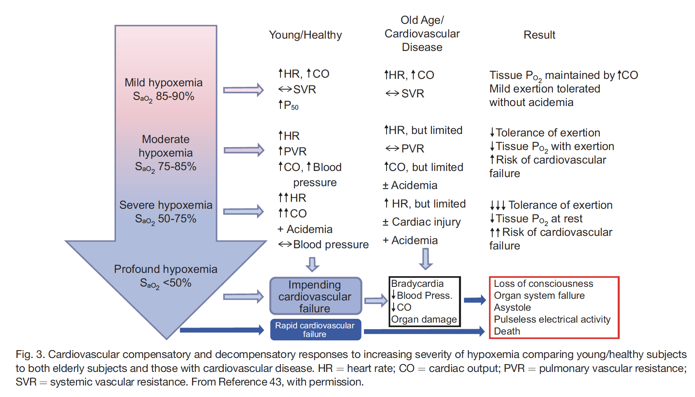
Hypoxemia Response - DOI: 10.4187/respcare.10075
Notes:
Historically, acute acclimatization hypoxic drive becomes the primary driver of ventilation only at an altitude of 13,000 ft when PaO2
reaches 45 mm Hg. Initial compensatory hyperventilation is mild, resulting in a PaCO2 35–38 mm Hg. Over time PaCO2
stabilizes at 30 mm Hg, causing PaO2 to stabilize at 55 mm Hg.22 A more recent study in experienced mountaineers produced similar data (pH 7.44 6 0.04, PaCO2
35 6 5 mmHg, PaO2 47 6 8 mmHg, SaO2 83 6 5%) without discernable alterations in breathing frequency, heart rate, and blood pressure.47
Citations 22 (= Nunn’s) and 47
47 Nakano T, Iwazaki M, Sasao G, Nagai A, Ebihara A, Iwamoto T,
et al. Hypobaric hypoxia is not a direct dyspnogenic factor in healthy
individuals at rest. Respir Physiol Neurobiol 2015;218:28-31.

Slide 116

https://doi.org/10.1089/ham.2015.0097
Est for compensated HCO3 – 1.5 Meq /L HCO3 change per 1000 meters.
Notes:
“titratable hydrogen ion concentration difference (THID, a more precise term, instead of the previously known base excess [BE]).”
Since the pH at any altitude has to be the same as at sea level, around 7.4, and the THID likewise has to be zero at any altitude, the pCO2 is the fundamental variable that changes at high altitude.
“Newcomers to high altitude can present respiratory alkalosis,
a transitory acid–base imbalance that has no ‘‘normal
values.’’ Furthermore, this is not a long lasting effect as line 3
in page 5 suggests by affirming ‘‘many years.’’ The respiratory
alkalosis is promptly corrected to a pH of 7.4 within
hours or just in one or 2 days.“
From Zubieta-Calleja G, Zubieta-DeUrioste N, Paulev PE. Letter to the Editor re:“Bicarbonate Values for Healthy Residents Living in Cities Above 1500 Meters of Altitude: A Theoretical Model and Systematic Review” by Ramirez-Sandoval et al.(High Alt Med Biol 2016; 17: 85-92). High Altitude Medicine & Biology. 2016 Sep 1;17(3):240-.

Slide 117

Relatedly, normal SpO2 values: https://thorax.bmj.com/content/73/8/776.abstract
“We have shown the expected reduction
of SpO2 with altitude, an effect that
is more evident at altitudes over 2500 m.
We have also shown increased variability
in the range of SpO2 measurements at
higher altitude”

Slide 118
Notes:
Lastly: PaCO2 increases exponentially as VE decreases linearly
As an analogy to understand why this is: consider the GFR (VE) to sCr (PaCO2) analogy. The difference between GFR of sCr 1 to 2 is a lot, 5 to 6 is not much. Small change in VE with someone who hypoventilates = bigger change in PaCO2 (and PaO2)
Picture from Nunn’s
Explains why patients with baseline hypercapnia would mathematically be more prone to severe hypercapnia.

Slide 119

‘CO2 Clearance’
Analagous to creatinine kinetics
Urine volume : VE (exhaled volume)
[U_cr] : FExhaled CO2
Implication: the further down on the ventilation axis or right on the PaCO2 axis you are, the larger the change in CO2 that will occur from a given change in Ve
similar to sCr 5 not being much diff than 6, 70 not much different than 80 as PaCO2 (just faster)
However, due to Dalton’s Law (Alveolar partial pressures), this will STILL have a large impact on hypoxemia – linear relationship described by P_{A}O₂ = FiO₂ (P_{B}-47)—(PaCO₂/R)
Or a smaller change in, say, deadspace leads to a bigger overall change in CO2 excretion
Thus, something that changes the HCVR will have a larger impact on CO2 in someone with a higher baseline CO2
Clinical implication: Susceptibility to ’exacerbations’ with a perturbation in the controller system or the respiratory systems ability to respond
Notes:
RESEARCH QUESTION: how often are acute hypercapneic ABGs at least partially compensated? (or known to be via prior bicarbonates)
'Kinetics' will be the same, but faster. Implication, similar to sCr 5 not being much diff than 6, 70 not much different than 80 as PaCO2
The above mentioned changes in the respiratory control system of OHS patients make them more vulnerable to acute deterioration of their ventilatory systems when faced with new insults, such as chest infection or mild worsening of cardiac function. This makes OHS patients more susceptible to acute ventilatory failure [126,154].
126. BaHamman A: Acute ventilatory failure complicating obesity hypoventilation: update on a ‘critical care syndrome’. Curr Opin Pulm Med 2010, 16:543–551.
154. Rabec C, de Lucas RP, Veale D: Respiratory complications of obesity. Arch Bronchoneumol 2011, 47(5):252–261.

Slide 120
Hypercapnia: indicates frailty of the respiratory system
Distance between ‘MVV’ and Ve required = strength of the control system to resist a stressor.
Might this be a metric of ‘frailty’ of the control system? – less reserve in respiratory system = more prone to this
Returning to the reason why we don’t live at PaCO2 70 and HCO3 44: there is only so much space in an alveoli – and already 79% of inhaled air is N2)
Converse situation of why it is advantageous to develop methods to hyperventilate at altitude: allow more room in the alveoli for oxygen = greater buffer.
Protective effect from hypercapnia? 10.1016/j.jcrc.2017.04.033 – acute respiratory failure (probably not – table 2 fallacy)
Notes:
Javaheri chapter.
based on Dalton’s law, a high PaCO2 imposes a low PaO2. Thus, perhaps the degree of N2 in the air (and thus, the pO2) provides the limit - the lower the CO2 set-point, the more O2 we have available but the higher work of breathing.
(Relatedly, the pH 7.4 in the blood seems to correspond ~6.8 intracellular pH, which is also the pKA of H2O - perhaps maximizes enzyme function?)

Slide 121
Resp System Frailty increased at altitude
CO2 above ~83 mmHg displaces O2 on room air down to ~20 mmHg PaO2 = lower limit of life
PaO2 = FIO2*(Patm-Pb) – (PCO2/R), thus for R 0.8, PaO2 will drop by 1.25 for each CO2 rise.
Thus, any CO2 higher than this must be artificially supported by supplemental oxygen.
Severe hypercapnia REQUIRES O2 to be administered.
Blue line being at elevation
At elevation, hypercapnia ought to be more apparent, because it will show up as hypoxemia faster
How much O2 should it take to fix?
Notes:
Precited O2: Predicted Pa_{O2} using our reference equation (Pa_{O2} = 0.1834 Pb − 0.2452 age − 31.453
Elevation: https://www.atsjournals.org/doi/full/10.1164/ajrccm.160.5.9806006
[ ] redo this calculation to find details of when exactly it ought to show up
653 mmHg in SLC today
Age / 4 = normal A-a.
653-43 = 610 * 21 = 128.
Normal A-a, say 15.
PaCO2 / 0.8 = 53… 43.
Thus, for a 60 year old, CO2 higher than 43 will lead to decrease in O2 enough for detectable changes in PaO2.
The anticipated effect of an NaHCO3 load of 1 mmol per kilogram of body weight is an increase in plasma [HCO3 − ] of w2 mEq/L if bicarbonate space is 50% of body weigh

Slide 122
“ submissive hypercapnia, an intelligent brain strategy to conserve the work of breathing when restoration of normocapnia becomes difficult or impracticable because of ventilatory or gas exchange limitations.”
https://www.ncbi.nlm.nih.gov/pmc/articles/PMC4568120/
Patients with milder COPD/CHF have ventilatory insufficiency and increased drive to breath that maintains eucapnia – what changes as disease worsens?
Respiratory controller “say’s uncle” when faced with insurmountable ventilatory limitation – tolerate hypercapnia when difficult to restore normocapnia due to ventilatory or gas exchange limitation
Notes:
From: https://www.atsjournals.org/doi/full/10.1513/AnnalsATS.201701-016FR
“Respiratory acidosis occurs either in the setting of suppression of respiratory drive (“won’t breathe”) or with a mechanical impediment to ventilation (“can’t breathe”) (58). Patients who “won’t breathe” have a reduced drive to breathe due to alkalemia or an abnormally low intrinsic respiratory drive, such as in obesity-hypoventilation syndrome or with respiratory depressant medications. In these patients, stimulants have a proper role to play. In contrast, patients who “can’t breathe” have mechanical impairment arising from severe obstructive, neuromuscular, or restrictive disease. They retain CO₂ because they have limited or no capacity to increase ventilation or the cost of doing so is too stressful or inefficient. In fact, “submissive hypercapnia” is not an unreasonable strategy when one cannot increase ventilation or it is too costly in metabolic terms (59). As long as arterial oxygenation can be maintained with supplemental oxygen, this strategy permits the patient to exhale more CO₂ per breath and maintain steady-state CO₂ elimination at lower metabolic expense.”

Slide 123
Clinical implication
Recurrent ‘exacerbations’ likely
How often are these admissions ‘acute on chronic’ by ABG?
How often are A-a gradients ‘normal’?
Quantifying the morbidity associated with respiratory failure at different elevations?

Slide 124

Symptoms of hypercapnia?
CO2 narcosis occur when CO2 rises above 90-120 mmHg
However, because it is not as lipid soluble as other compounds (e.g. N2) – the effects seem to be more closely mediated by intracellular pH, cerebral blood flow, metabolic processes than ‘narcosis’ in the same way.
Causes hypoxemia by a few mechanisms
Dalton’s law and alveolar oxygen displacement
Moves O2-Dissociation curve to the right
Changes V/Q matching (e.g. increased pulm artery pressure)
HA (HA correlated with FiCO2 on international space station https://pubmed.ncbi.nlm.nih.gov/24806559/)

Slide 125
To what extent is the ‘normal A-a gradient’ hypoventilation ABG a myth?
OHS – common to have elevated A-a gradient owing to atelectasis
Notes:
“The alveolar-arterial (A-a) gradient is usually normal and can differentiate pulmonary parenchymal disease as the cause of hypoventilation; however, owing to ventilation and perfusion mismatch in the lung bases of obese patients, it is not uncommon to have a modest elevation in A-a gradient.65 Serum bicarbonate can be used as a screening test, with levels less than 27 mEq/L having a 97% negative predictive value.1 A serum bicarbonate level of 27 mmol/L and higher gives sensitivity of 76.6% and specificity of 74.6%. A nadir oxygen saturation level (SpO2) less than 80% is also an independent predictor of the diagnosis of OHS with a sensitivity of 82.8% and specificity of 5.5%.66
“
[ ] 1 - . Mokhlesi B, Tulaimat A, Faibussowitsch I, et al. Obesity hypoventilation syndrome: prevalence and predictors in patients with obstructive sleep apnea. Sleep Breath 2007;11:117–24.
---this one may be important to feasibility of the A-a gradient proposal
65 . Rochester DS, Arora NS. Respiratory failure in obesity. In: Mancini M, Lewis B, Contaldo F, editors. Medical complications of obesity. London: Academic Press; 1980. p. 183. 66. Bingol Z, Pihtili A, Cagatay P, et al. Clinical predictors of obesity hypoventilation syndrome in obese subjects with obstructive sleep apnea. Respir Care 2015. [Epub ahead of print].
[ ] With these se:sp data, does the diagnostic algorithm make sense? LR+ 3, LR- 0.3 for Bicarb
=➔ study idea: hypoxemia with normal or near normal A-a gradient
VA population: how often are pure hypoventilation disorders misdiagnosed and mismanaged? (how often does an O2 consultation follow?)

Slide 126

DOI:https://doi.org/10.1016/j.chest.2017.11.010
Acute Hypercapnia
Notes:
CO2 increases cerebral blood fl ow (CBF) by 1 to 2 ml/100 g/minute per 1 mmHg in PaCO2 [25], Grubb RL, Jr, Raichle ME, Eichling JO, Ter-Pogossian MM: The eff ects of changes in PaCO2 on cerebral blood volume, blood fl ow, and vascular mean transit time. Stroke 1974, 5:630-639

Slide 127
Occupational Exposure Limits CO2
Outdoors: 420 ppm (0.042%)
Indoors (typically) 1,000 ppm (0.1%)
Cognitive function ~900 – 1400 pp (Jasen Allen, Pilots)
8-hour OEL 5,000 ppm (0.5%)
20,000 ppm (2%) – headache, dyspnea on exertion
15-minute 30,000 ppm (3%) OEL (leads to increased ventilation, weakly sedating, autonomic signs)

Slide 128

Hypercapnia symptoms in NASA experiments
Healthy astronauts rebreathe up to 8% (60mmHg) CO2 to be familiar with the symptoms

Slide 129

J Clin Sleep Med. 2022;18(1):245–254.
In SDB, relationship between cog impairment and hypoxemia (and thus sleep fragmentation) is inconsistent and weak
Patients with SDB who had no hypercapnia, night-time only, or nighttime+daytime hypercpapnia assess for cog performance:
Daytime hypercapnia: delayed processing speed and cognitive impairment
Nightime(only) hypercapnia: delayed processing speed
Small effect sizes…
Notes:
Beaudin AE, Raneri JK, Ayas NT, Skomro RP, Smith EE, Hanly PJ; on behalf of Canadian Sleep and Circadian Network. Contribution of hypercapnia to
cognitive impairment in severe sleep-disordered breathing. J Clin Sleep Med. 2022;18(1):245–254.

Slide 130
https://jcsm.aasm.org/doi/10.5664/jcsm.9558
Severe OSA -> PSG with TcCO2. Avg BMI 41ish. COPD more common in frank hypoventilation group
No hypovent (84), Isolated sleep hypovent (40), awake hypovent (122)
Lower MOCA and RAVLT scores in hypovent group
Also, independent association with PaCO2 and TcCO2 and lower MOCA & DSC
Sidebar: used PaCO2 over 40 as threshold at 1100m elevation
→ cognitive impairment is very common in patients with hypercapnia.

Slide 131
Hypoxemia due to hypoventilation
Thought of analogous to breath holding – degree of hypoxemia with sleep apneas depends on lung volume, blood O2/CO2 level at onset, and ability to ventilatory load compensate between apneas.

Slide 132
OHS pathophysiology – not all mechanical
Patients with OHS can achieve eucapnia during voluntarily hyperventilation, implying that impairments in respiratory system mechanics alone do not explain the hypoventilation [86].
Only 50% of those BMI 50+ manifest abnormalities in PaCO2
Not all mechanical. Also, obesity has only mild affect on lung mechanics (except ERV)
Yet, Chest wall restriction (via VC), BMI, and severity of OSA are all independent predictors. ERS suggests screening with "FVC <50% and venous bicarbonate >27 mmol (A)."
Notes:
The decrease in ventilatory response is attributed to an inadequate increase in tidal volume as a result of a blunt neural response to hypercapnia [73,95]
The hypoxic ventilatory response is also blunted in subjects with OHS. This abnormality is however not familial and improves with treatment as well [132,133]. Alterations in ventilatory
responsiveness are also not as homogenous as initially thought [132] and are related to the daytime vigilance [134]. Individuals with low HCVR exhibit more daytime sleepiness, which is directly related to a higher percentage of REM sleep spent in hypoventilation [134]. A lack of relationship between BMI, HCVR and plasma bicarbonate was reported by Raurich et al., and with PaCO2 by Kessler et al., which might indicate on the other hand that obesity acts as a trigger toward hypoventilation in those patients who already have physiological abnormalities [54,135]. Gas exchange abnormalities will initially be confined to REM sleep, but over time buffering of the raised carbon dioxide produces a secondary depression of respiratory drive that will further reduce ventilation not only during sleep but during wakefulness as well [82].
50% of BMI over 50 have abnormalities. (?in spirometry?)
Jones RL, Nzekwu MM. The effects of body mass index on lung volumes. Chest 2006;130:827–833.
Patients with OHS have lower vital capacity, total lung capacity and expiratory reserve volume compared to eucapnic obese patients
Determinants of hypercapnia in obese patients with obstructive sleep apnea: a systematic review and metaanalysis of cohort studies.
Kaw R, Hernandez AV, Walker E, Aboussouan L, Mokhlesi B
Chest. 2009 Sep; 136(3):787-796.
https://pubmed.ncbi.nlm.nih.gov/19567489/
86: Leech J, Önal E, Aronson R, Lopata M: Voluntary hyperventilation in obesity hypoventilation. Chest 1991, 100:1334–1338.
Patients who are morbidly obese (BMI ≥40 kg/m²) have increased respiratory rates as compared with normal subjects. In four studies, the mean respiratory rate of obese subjects ranged from 15.3 to 21 breaths per minute, while that of normal subjects ranged from 10 to 12 breaths per minute.²⁻⁵

Slide 133
Even spirometry abnormalities are not mech
Lung function impairment was associated with metabolic syndrome (prevalence = 15.0%) independently of age, sex, smoking status, alcohol consumption, educational level, body mass index, leisure-time physical activity, and cardiovascular disease history (odds ratio [OR] [95% confidence interval], 1.28 [1.20-1.37] and OR, 1.41 [1.31-1.51] for FEV(1) and FVC, respectively)
https://pubmed-ncbi-nlm-nih-gov.ezproxy.lib.utah.edu/19136371/
Fine print: appears that abdominal adiposity is -> perhaps this is the ‘mechanism’
Notes:
Overview of problems with BMI- https://pubmed-ncbi-nlm-nih-gov.ezproxy.lib.utah.edu/22485140/ - differential misclassification in women

Slide 134
Pathogenesis:
Increased metabolic burden (VCO2) of obesity, and mechanical loads are pre-requesite (necessary) pathophysiologic changes.
However, diminished ventilatory response to hypercapnia discriminates between very obese patients with and without hypercapnia, thus seems to be a required piece to develop the syndrome
or a result of another causally related process – such as bicarbonate retention.
Supporting evidence: the VE/VCO2 slope is decreased during exercise is morbidly obese men and women and is accompanied by signs of ventilatory limitation during exercise (increased PETCo2 at vent threshold) -> decreased ventilatory response - https://www.atsjournals.org/doi/pdf/10.1513/AnnalsATS.202006-746OC
Notes:
Nevertheless, it is well known that obesity presents a mechanical load to the thorax, and it is certainly possible that the progressive reduction in the V̇ E/V̇ CO2 slope could reflect various degrees of obesityrelated mechanical ventilatory constraints. Indeed, Zavorsky and colleagues (38) previously demonstrated that a blunted ventilatory response to exercise was reversed in individuals with morbid obesity after a period of weight loss over 2.5 months (z21 kg).
We demonstrated that despite an increase in ventilatory drive (via inspired CO2), it was only by alleviating mechanical ventilatory constraints via breathing a lowdensity gas mixture (i.e., heliox) that subjects could increase their ventilatory response to exercise (albeit above the VTH) (40, 41)

Slide 135
Work of breathing in obesity
VO2 declines 16% in obese vs <1% in lean when sedated/paralyzed (=estimate of work of breathing). 5:
FRC decrease (increased WOB due to ventilating on less compliant portion of P-V curve) seen in Kg to CM ratio > 0.7
Tidal expiratory flow-limitation -> air trapping
This occurs to some extent in all obese patients: the normal response is increased HCVR to maintain eucarbia despite the excess load.
Explains why HCVR response might lead to OHS but not lead to hypercapnia in normal weight individuals
Notes:
Summarized at: https://onlinelibrary.wiley.com/doi/full/10.1111/j.1440-1843.2011.02124.x

Slide 136
Drive to breath in OHS:
VO2 and VCO2 increase in obesity – similarly, the drive to breath (HVS and HVCPs) increase (by P0.1/Pimax) in eucapnic obese patients (and goes back to normal with weight loss).
In OHS, it appears that this increase in drive to breath does not occur for unknown reasons.
This may occasionally be mediated by the increase bicarbonate (from chloride depletion). An open question: how often are patients who are obese but eucapneic (or more properly, just nocturnal hypercapnia) started on loop diuretics, and then subsequently found to have ‘obesity hypoventilation’?
May have to do with leptin signaling – known to cause satiety and central resp stimulation – thus resistance may relate to obesity and decreased HCVR
Notes:
Why do some patients develop hypoventilation disorders while others do not? Several studies suggest that hypercapnic ventilatory response, i.e., the increase of ventilation to a given level of hypercapnia, can discriminate patients with OHS from those with nonhypercapnic OSA (11). It is unknown whether the reduced hypercapnic ventilatory response is caused by a reduced sensitivity of the chemoreceptors, a blunted brain stem reaction, or an impairment of the executive muscles.
However, the diminished response to hypercapnia suggests that the metabolic burden of obesity and its mechanical load on the upper airways are prerequisites of OHS, but hypercapnic ventilatory response is responsible for differences between patients with obesity with and without OHS.
[x] Javaheri S, Simbartl LA. Respiratory determinants of diurnal hypercapnia in obesity hypoventilation syndrome: what does weight have to do
with it? Ann Am Thorac Soc 2014;11:945–950.“
The possibility that chronic hypoxemia contributes to respiratory muscle dysfunction that leads to diurnal hypercapnia in OHS was recently laid to rest by Hollier et al.^{[35▪]} who demonstrated worsening PaCO₂ in patients treated with oxygen alone.
Hollier CA, Harmer AR, Maxwell LJ. Moderate concentrations of supplemental oxygen worsen hypercapnia in obesity hypoventilation syndrome: a randomized crossover study. Thorax 2014; 69:346–353
Hypercapnic patients were found to have an abnormally high work of breathing both sitting and supine, awake and asleep, compared to eucapnic patients with OSA
Work of breathing in eucapnic and hypercapnic sleep apnea syndrome.
Lee MY, Lin CC, Shen SY, Chiu CH, Liaw SF
Respiration. 2009; 77(2):146-53.
Obesity is normally associated with increased respiratory drive which helps to maintain eucapnia (Steier et al., 2009). Patients with OHS, however, fail to exhibit this augmented drive and ventilatory responsiveness to hypoxia and hypercapnia (Piper and Grunstein, 2011; Sampson and Grassino, 1983; Zwillich et al., 1975).
Leptin resistance theory:
Hyperleptinemia has been associated with a reduction in respiratory drive and hypercapnic response in obese individuals, irrespective of the amount of body fat (Campo et al., 2007).
“Leptin, a pleiotropic peptide hormone mainly secreted by adipocytes, acts on the hypothalamus to regulate energy metabolism, food intake, and satiety (534). In addition, leptin is a potent breathing stimulant, acting mainly on the central nervous system but also at the level of the CB (for a recent review see Ref. 535).” from https://journals-physiology-org.ezproxy.lib.utah.edu/doi/pdf/10.1152/physrev.00039.2019

Slide 137

Drive to breath and work of breathing
Notes:
2 citations from the above screenshot
14 https://thorax.bmj.com/content/64/8/719
15 https://www.jci.org/articles/view/106126

Slide 138
Hypothesized that lack of increase in respiratory drive increases risk of developing hypercapneic respiratory failure when load increases
Decreased HCVR not inherited (same in 1st degree rels - Jokic R, Zintel T, Sridhar G et al. Ventilatory responses to hypercapnia and hypoxia in relatives of patients with the obesity hypoventilation syndrome. Thorax 2000; 55: 940–5.)
A useful bedside test is to show that the patient voluntarily can easily and rapidly hyperventilate and within a minute normalize oxygenation and produce a PCO2 below 40 mm Hg.28 = Leech J, Onal E, Aronson R, Lopata M. Voluntary hyperventilation in obesity hypoventilation. Chest 1991;100:1334– 1338

Slide 139
OSA causes reversible decrease(?) in vent drive
Old data
https://www.atsjournals.org/doi/abs/10.1164/arrd.1987.135.1.144
Note: I think these patients mostly had OHS or some nocturnal hypoventilation, and thus the comparison is not strictly valid.

Slide 140

Sufficient-Component Cause Model
Sufficient cause: a set of factors that will cause disease when present
Component cause: a factor that, if not present, no disease would occur
Necessary cause: in all sufficient cause sets, this component must be present
3 Different Sufficient Causes
A = Necessary Cause
A – J = Component Cause
Notes:
Hypothesis
Rothman KJ. Am J Epidemiol 1976; 104: 587-592.
a sufficient cause as "...a complete causal mechanism" that "inevitably produces disease." Consequently, a "sufficient cause" is not a single factor, but a minimum set of factors and circumstances that, if present in a given individual, will produce the disease.

Slide 141
Causes of Hypercapnia
[Area represents a population of patients]
Severe COPD
Sufficient Cause
If PaCO2 > 52 mmHg, 2-4 weeks after exacerbation
*no other causes of ↑️ CO2
Notes:
Hypercapnic respiratory failure is uncommon and can be acute or chronic.
The symptoms are variable, and the diagnosis is frequently missed.
Each case of hypercapnic respiratory failure may have several necessary causes.
Prior research exclusively focused on sufficient causes
Perhaps effect modification?
Patients who develop hypercapnic respiratory failure have many comorbidities that may act as confounders

Slide 142
Causes of Hypercapnia
Obesity Hypovent
Sufficient Cause
BMI over 30, SDB, PaCO2>45
*no other causes of ↑️ CO2
Severe COPD

Slide 143
Causes of Hypercapnia
Obesity Hypovent
Severe COPD
ALS
Sufficient Cause
FVC <50%, nocturnal hypoventilation or sleep problems -> nocturnal ventilation improves outcomes
*no other causes of ↑️ CO2
Notes:
Hypercapnic respiratory failure is uncommon and can be acute or chronic.
The symptoms are variable, and the diagnosis is frequently missed.
Each case of hypercapnic respiratory failure may have several necessary causes.
Prior research exclusively focused on sufficient causes
Perhaps effect modification?
Patients who develop hypercapnic respiratory failure have many comorbidities that may act as confounders

Slide 144
Causes of Hypercapnia: Hypothesis
Obesity as Component Cause
Obesity Hypovent
COPD as Component Cause
Severe COPD
ALS
Muscular weakness as Component Cause
Notes:
This is my overall research goal to investigate

Slide 145
Causes of Hypercapnia: Hypothesis [ ] keep in
Sleep Apnea as Component Cause
Obesity as Component Cause
Obesity Hypovent
COPD as Component Cause
Loop Diuretics as Component Cause
Severe COPD
ALS
Opiates as Component Cause
Muscular weakness as Component Cause
Notes:
OSA: emphasize this
Hypercapnic respiratory failure is uncommon and can be acute or chronic.
The symptoms are variable, and the diagnosis is frequently missed.
Each case of hypercapnic respiratory failure may have several necessary causes.
Prior research exclusively focused on sufficient causes
Perhaps effect modification?
Patients who develop hypercapnic respiratory failure have many comorbidities that may act as confounders

Slide 146

Multicausality
Hypothetical patient with hypercapnic respiratory failure
Sufficient cause: a set of factors that will cause disease when present
Component cause: a factor that, if not present, no disease would occur
Necessary cause: in all sufficient sets, this component must be present
COPD
Obesity
Loop diuretic
Untreated
Sleep Apnea
Opiates
Notes:
“Perhaps the most important of these principles is self-evident from the model: A given disease can be caused by more than one causal mechanism, and every causal mechanism involves the joint action of a multitude of component causes”’
“The importance of multicausality is that most identified causes are neither necessary nor sufficient to produce disease. Nevertheless, a cause need not be either necessary or sufficient for its removal to result in disease
prevention. If a component cause that is neither necessary nor sufficient is blocked, a substantial amount of disease may be prevented."
Rothman and Greenland

Slide 147
Does hypercapnic respiratory failure ever occur before steady state hypercapnia develops?
In a large study of patients with OSAS, Laaban and Chailleux found 11% to be hypercapnic. Risk factors for hypercapnea in this study included higher BMI and reduced FVC
Though 7.2% of hypercapneic OSAS had BMI < 30. COPD was excluded.
BMI, VC, PaO2 only explain <10% PaCO2 variance.
Laaban JP, Chailleux E. Daytime hypercapnia in adult patients with obstructive sleep apnea syndrome in France, before initiating nocturnal nasal continuous positive airway pressure therapy. Chest 2005; 127: 710–15.

Slide 148
ERS defines 4 stages of obesity hypoventilation
0. Pure OSA (no hypoventilation)
1. Obesity sleep related hypoventilation - with morning=evening, with normal bicarbonate (<27) during the day
2. Obesity sleep related hypoventilation - with morning worse than evening, with abnormal bicarbonate (27+) during the day – CO2 not fully breathed off during inter-event period
2b. Awake base excess – HCO3 retention that occurs through the night not fully reversed
3 and 4. Awake hypoventilation / elevated PaCO2 – with our without comorbidity
Increased HCO3 lowers HCVR and causes frank hypoventilation.
Note: one unknown is whether Loop diuretics push patients from stage 2 to 3 to 4. Study idea: how many at each phase are on diuretics?
➔ research question: how many patients who have elevated bicarbonate do, actually, have transient nocturnal hypoventilation? This would be easily answerable with a cohort of newly diagnosed patients with HCO3 over 27 who prospectively add on TcCO2 and see how many have 10 mmHg increases in CO2.
Notes:
From: https://www.ncbi.nlm.nih.gov/pmc/articles/PMC3871022/
“However, should the CO2 level rise further, elevated bicarbonate level will blunt the ventilatory response to CO2 by reducing the change in pH associated with the change in CO2, and the chemosensory stimulus will be less for any given change in the level of CO2 [170]. This would ultimately result in a higher wake CO2 level [113,168]. In a recent study it was confirmed that patients with higher bicarbonate concentration had a more blunted CO2 response [135]. The development of decreased central respiratory drive and/or the greater ventilatory limitations imposed by more extreme central obesity may initiate the acute failure to compensate for OSA, but only if the renal compensatory mechanism is impaired [100,171]. In other words, whether or not daytime chronic hypercapnia develops depends on the individual’s ability to unload both CO2 and bicarbonate during the waking period [168].
From: doi: 10.1097/MCP.0000000000000210 https://pubmed.ncbi.nlm.nih.gov/26390338/
Over the last 30 years, the group at New York University has published a compelling series of studies making the case that nocturnal hypercapnia and compensatory increases in bicarbonate, developing as a result of reduced nocturnal CO₂ clearance, play a major role in the pathogenesis of OHS ^{[26–32]}. These investigations included the seminal finding that effective treatment of OSA associated with OHS can ameliorate diurnal hypercapnia ^{[26]}. Computer modeling subsequently demonstrated a temporal mismatch between CO₂ presentation at the alveolar/capillary interface because of periodic breathing that results in reduced CO₂ elimination ^{[27]}, and human studies confirmed that inter-event hyperventilation may not, in some patients, be of sufficient magnitude to maintain CO₂ homeostasis, thus leading to rising levels of PaCO₂ during the course of a night ^{[28–30]}. The combination of episodic (apnea/hypopnea related) and/or prolonged (hypoventilation related) nocturnal hypercapnia ^{[31]} stimulates renal reabsorption and generation of bicarbonate each night, which cannot be entirely eliminated during the course of each successive day ^{[32]}. Presumably, this process is made even worse by the increased CO₂ production in these patients already mentioned ^{[4▪▪]}. A sustained elevation of serum bicarbonate ensues, increasing CO₂ buffering capacity, attenuating the fall in cerebrospinal fluid pH that would normally result from hypercapnia and blunting the hypercapnic ventilatory response leading to diurnal hypercapnia
26. Rapoport DM, Garay SM, Epstein H, Goldring RM. Hypercapnia in the obstructive sleep apnea syndrome: a reevaluation of the ‘Pickwickian syndrome’. Chest 1986; 89:627–635.
27. Rapoport DM, Norman RG, Goldring RM. CO₂ homeostasis during periodic breathing: predictions from a computer model. J Appl Physiol 1993; 75:2302–2309.
28. Berger KI, Ayappa I, Sorkin IB, et al. CO2 homeostasis during periodic breathing in obstructive sleep apnea. J Appl Physiol 2000; 88:257–264.
29. Berger KI, Ayappa I, Sorkin IB, et al. Postevent ventilation as a function of CO₂ load during respiratory events in obstructive sleep apnea. J Appl Physiol 2002; 93:917–924.
30. Ayappa I, Berger KI, Norman RG, et al. Hypercapnia and ventilatory periodicity in obstructive sleep apnea syndrome. Am J Respir Crit Care Med 2002; 166:1112–1115.
31. Berger KI, Ayappa I, Chatr-Amontri B, et al. Obesity hypoventilation syndrome as a spectrum of respiratory disturbances during sleep. Chest 2001; 120:1231–1238.
32. Norman RG, Goldring RM, Clain JM, et al. Transition from acute to chronic hypercapnia in patients with periodic breathing: predictions from a computer model. J Appl Physiol 2006; 100:1733–1741.
There are data showing that metabolic alkalosis with alkalemia (pH, 7.45–7.55) can lead to a 10 to 20% depression of ventilation (74–78).
Pokorski M, Lahiri S. Relative peripheral and central chemosensory responses to metabolic alkalosis. Am J Physiol 1983;245:R873–R880.
…
Javaheri S, Shore NS, Rose B, Kazemi H. Compensatory hypoventilation in metabolic alkalosis. Chest 1982;81:296–301.
Pooled sensitivity of HCO3 27 or higher: 0.86, pooled specificity 0.77 among patients with high pre-test probability for OHS (e.g. sleep disordered breathing assessment).

Slide 149

https://doi.org/10.1016/j.sleep.2021.12.015
Patients referred for Sleep eval, BMI over 30
ABGs, TcCO2 at night, and BMP used to stratify
62 of 419 had some form of hypoventilation
29 stage 1
14 stage 2
5 stage 3
14 stage 4
PFT/Pleth, CPET, HCVR (rebreething) tested
Decreased HCVR independently predicts OHS, others don't though differ in univariate analyses

Slide 150
Is HCO3 elevation without hypovent part of the spectrum?
CHEST - https://journal.chestnet.org/article/S0012-3692(15)30169-0/fulltext
These data suggest that obese individuals with a raised BE, despite normocapnia while awake, should probably be regarded as having early obesity-related hypoventilation
SUSPECTED TO BE TRUE IN COPD TOO: Holmedahl NH, Øverland B, Fondenes O, et al. Sleep hypoventilation and daytime hypercapnia in stable chronic obstructive pulmonary disease. Int J Chron Obstruct Pulmon Dis 2014; 9: 265–275.

Slide 151
Diagnosing OHS using that classification
Data from India: They (Sivam, JCSM) found 19% of ORSH (class I and II) and 17% of OHS (class III and IV), which was similar to 21.6% and 10.8% seen in our study (Goyal, Sleep Med) in obese people (BMI >30 kg/m2), respectively.
Notes:
https://doi.org/10.5664/jcsm.7318 - Sivam
https://pubmed.ncbi.nlm.nih.gov/31837626/ - Goyal

Slide 152

OHS Mechanisms – proposed
CO2 production and alveolar dead space can’t be the whole story, because it doesn’t explain why only a minority of obese patients retain CO2
Either due to predisposition (e.g. blunted HCVR, though hasn’t been found)
OR long term adaptation as occurs in submariners rebreathing CO2
Proof would be in intervening on one of these steps
Notes:
https://journals.physiology.org/doi/full/10.1152/japplphysiol.00713.2009
Schema outlining some of the potential interactions involved in the development of hypoventilation in a subgroup of individuals with morbid obesity. The plus sign (+) denotes this factor, if normal or increased, has a positive influence on maintaining ventilation. The minus sign (−) denotes factors that, if reduced or blunted, would contribute to lowered ventilation and eventual hypercapnia. HCVR, hypercapnic ventilatory response.
However:
“In a previous study we showed that hypercapnia in OHS was correlated to ventilatory restriction but there was no relationship between PaCO2 and all parameters of fat distribution, including BMI”
Resta O, Foschino Barbaro MP, Bonfitto P, et al. Prevalence and mechanisms of diurnal hypercapnia in a sample of morbidly obese subjects with obstructive sleep apnoea. Respir Med 2000;94:240–246
Randerath W. More than obstruction: rethinking obesity hypoventilation? Ann Am Thorac Soc 2020;17:282–283.
Surprisingly, huge databases have shown that obesity only mildly affects parameters of lung mechanics (6). With the exception of expiratory reserve volume, all other parameters exceed the limits of normal only in extreme cases (6). High body weight is a prerequisite of OHS, but its mechanical influence on ventilation is almost negligible

Slide 153

OHS Mechanisms
Notes:
https://doi.org/10.1111/j.1440-1843.2011.02124.x

Slide 154

Why are obese patients fluid overloaded?
Frequently have HFpEF, ?Cor Pulmonale
Are obese patients always fluid overloaded due to an increase in pleural pressure -> CVP has to be higher for a given preload?
Additionally, a high bicarbonate level indicates a metabolic alkalosis but does not differentiate a primary from a compensatory one. Because obese patients are frequently hyperaldosteronemic and are often on diuretics, corticosteroids, or both, they are prone to develop primary metabolic alkalosis that triggers mild compensatory hypercapnia.⁷ ,⁸
Notes:
Could we look at people who meet diagnostic criteria for OHS – then look how many might be on diuretics -> make the bicarbonate (and/or acid-base status) misleading?
8 Schrier RW, Masoumi A, Elhassan E. Aldosterone: role in edematous disorders, hypertension, chronic renal failure, and metabolic syndrome. Clin J Am Soc Nephrol 2010;5:1132–40. (this wasn’t doesn’t actually have all that much useful information)
47. De Leeuw PW, Dees A: Fluid homeostasis in chronic obstructive lung disease. Eur Respir J 2003, 22(Suppl 46):33s–40s.
Additional pathophysiology citations
5. Piper AJ, Yee BJ. Hypoventilation syndromes. Compr Physiol 2014; 4:1639–1676.
19. Lin CK, Lin CC. Work of breathing and respiratory drive in obesity. Respirology 2012; 17:402–411.
Counterpoint: hypoxia causes diuresis and it appears to be mediated by peripheral chemoreceptors - https://journals.physiology.org/doi/abs/10.1152/jappl.1995.78.2.377

Slide 155
Verbraecken and McNicholas: Respiratory mechanics and ventilatory control in overlap syndrome and obesity hypoventilation. Respiratory Research 2013 14:132. doi:10.1186/1465-9921-14-132 https://link.springer.com/content/pdf/10.1186/1465-9921-14-132.pdf
“Peripheral edema can be present in the absence of right heart failure in COPD and is not diagnostic of cor pulmonale [46].”
Weitzenblum E, Apprill M, Oswald M, Chaouat A, Imbs JL: Pulmonary hemodynamics in patients with chronic obstructive pulmonary disease before and during an episode of peripheral edema. Chest 1994, 105:1377–1382.
Sodium retention is enhanced by hypercapnia and ameliorated by long-term oxygen therapy in hypoxemic patients [47].
De Leeuw PW, Dees A: Fluid homeostasis in chronic obstructive lung disease. Eur Respir J 2003, 22(Suppl 46):33s–40s.

Slide 156
Part 3 – other causes of hypercapneic respiratory failure - physiology
COPD
COPD, OSA overlap
CHF
Neuromuscular disease
Opiates? (To what extent does this cause chronic hypercapnia in isoluation?)
**Restrictive Thoracic Disease
CF? (ILD)
Lastly, epidemiologically – patients who are ventilated and undergoing permissive hypercapnia.

Slide 157
Ventilatory Failure in COPD – not due to the obstruction itself
Increase in resistance on 5-10 cmH2O/L/S in severe COPD – easily surmountable. 37
Modeling suggests virtually no stress on respiratory control system despite reductions in FEV1 to 50% of predicted. FEV1 to 50% of predicted (306). Even when FEV1 is reduced to 20% of predicted, the increase in respiratory motor output needed to maintain normocapnia is fairly small.
=> instead, it is the mechanical loading (elastic load from hyperinflation), threshold load from AutoPEEP, and functional weakness of the inspiratory muscles.
The work of breathing in severe COPD is 10 to 12 times greater than normal - Loring SH, Garcia-Jacques M, Malhotra A. Pulmonary characteristics in COPD and mechanisms of increased work of breathing. J Appl Physiol (1985) 2009:107:309–314. 15% of total oxygen consumption at rest, higher with exertion.
Notes:
In summary, the pathophysiology of COPD presents a curious paradox in that the name of the disease focuses on airway obstruction and the diagnosis is based on decreased airflow during expiration, yet the mechanical consequences occur during inspiration and consist of an elastic load (as a result of hyperinflation), a threshold load (as a result of autoPEEP), and functional weakness of the inspiratory muscles (as a result of hyperinflation) with only a small increase in inspiratory airway obstruction.
37. Burrows B, Saksena FB, Diener CF. Carbon dioxide tension and ventilatory mechanics in chronic obstructie lung disease. Ann Intern Med 65: 685-700, 1966
306 Younes M. Mechanisms of ventilatory failure. Current Pulmonology 14: 243-292, 1993a
However, CO2 retention is unlikely to occur when FEV1 is above 1 L (269 - Montes de Oca M, Celli B. Mouth occlusion pressure, CO2 response and hypercapnia in severe chronic obstructive pulmonary disease. Eur Respir J 12: 666-671, 1998) unless other factors such as severe obesity or sleep-disordered breathing come into play

Slide 158
Proportion developing Hypercapnia?
https://www.dovepress.com/getfile.php?fileID=53396
Also- Also -
Hypercapnia; Acute / Recurrent Acute / Acute on Chronic / Chronic; Various timecourses.

Slide 159
Spirometry is misleading for this
FVC depend on expiratory muscles, whereas work of breathing is achieved by the action of inspiratory muscles (FEV1 should be better, no?). Thus, doesn’t correlate well at all with development of hypercapnia

Slide 160
Due to airtrapping and mechanical loads
Instead, expiratory flow limitation: delays lung emptying with the result of inspiration starting before emptying has finished
Net: dynamic hyperinflation.
This worsens when demands are increased
And in sleep – NREM (increased upper airway resistance and blunted chemosensitivity) and REM (upper airway collapse and skeletal muscle atonia)
Dynamic Hyperinflation: operates on less compliant part of pressure/volume curve (more work of breathing), this increased VCO2, Vd?vt increases, mechanical disadvantage of the diaphragm
Load compensation takes place until late in the disease (309) during the DAY, but this falls apart at night (114,296)
Notes:
309 Younes M. Mechanisms of respiratory load compensation. In: Demsey JA, Pack AL, editors. Regulation of Breathing. New York: Marcel Dekker, Inc., 1995b, pp. 867-922.
296 Wilson PA, Skatrud JB, Dempsey JA. Effects of slow wave sleep on ventilatory compensation to inspiratory elastic loading. Respir Physiol 55: 103-120, 1984.
114 Iber C, Berssenbrugge A, Skatrud JB, Dempsey JA. Ventilatory adaptations to resistive loading during wakefulness and non-REM sleep. J Appl Physiol 52: 607-614, 1982

Slide 161
Drive to breath in COPD
Increased compared to patients without COPD - both by P0.1 and diaphragm activity.
Interestingly, differences in drive to breathe do not separate hypercapneic patients with COPD from normocapnic.
Persists essentially until respiratory system can’t eliminate further CO2, then bicarbonate compensation comes in to play

Slide 162
Sleep in COPD without OSA
https://www.dovepress.com/getfile.php?fileID=19163 Holmedal

Slide 163
Non-apnea related hypoventilation in COPD
Sleep disordered breathing in COPD has many non-apnea components – for examples ~30% decreased in Ve during REM sleep may be enough to significantly increase PaCO2, even after have left REM
Because patients with COPD have increased physiological dead space, the rapid shallow breathing that normally accompanies bursts of eye movements in REM sleep produces an even greater decrease in alveolar ventilation than in healthy subject. This can account for virtually all the hypoxaemia observed in REM sleep in patients with COPD.54
Significant hypoventilation during sleep is common in advanced COPD and was reported in 43% of 54 subjects with advanced COPD by O'Donoghue et al. 56
Compensatory renal retention of bicarbonate may then lead to impairment of ventilatory control and maintenance of daytime hypercapnia 55.
COPD - non-OSA sleep disordered breathing prevalence? (e.g. CSA, hypoventilation, sleep fragmentation). Overlap syndrome is actually a mix of separate pathophysiology: OSA, CSA, worsening airflow obstruction, hypoventilation, oxygen desaturation, and sleep fragmentation.
Notes:
54 - Catterall JR, Calverley PM, MacNee W, Warren PM, Shapiro CM, Douglas NJ, Flenley DC. Mechanism of transient nocturnal hypoxemia in hypoxic chronic bronchitis and emphysema. J. Appl. Physiol. (1985) 1985; 59: 1698–1703
(Because patients with COPD have increased physiological dead space, the rapid shallow breathing that normally accompanies bursts of eye movements in REM sleep produces an even greater decrease in alveolar ventilation than in healthy subject. This can account for virtually all the hypoxaemia observed in REM sleep in patients with COPD )
55. .55 Douglas NJ, Calverley PM, Leggett RJ, Brash HM, Flenley DC, Brezinova V. Transient hypoxaemia during sleep in chronic bronchitis and emphysema. Lancet 1979; 1: 1–4.
(Compensatory renal retention of bicarbonate may then lead to impairment of ventilatory control and maintenance of daytime hypercapnia )
56 56 O'Donoghue FJ, Catcheside PG, Ellis EE, Grunstein RR, Pierce RJ, Rowland LS, Collins ER, Rochford SE, McEvoy RD, Australian trial of Noninvasive Ventilation in Chronic Airflow Limitation investigators. Sleep hypoventilation in hypercapnic chronic obstructive pulmonary disease: prevalence and associated factors. Eur. Respir. J. 2003; 21: 977–984.
“During REM sleep there is generalised postural muscle atonia and the persistence of ventilation is primarily dependent on diaphragm activity and central drive”

Slide 164

REM paralysis not absolute.
However, some evidence that non-diaphragm REM atonia is not universal: after acute exacerbation of COPD, some able to recruit inspiratory muscles during REM -100
And parasternal intercostals remains activated in healthy indivs in REM sleep - 101
Notes:
100 Redolfi S, Grassion L, Rivals I, et al. Abnormal activity of neck inspiratory muscles during sleep as a
prognostic indicator in chronic obstructive pulmonary disease. Am J Respir Crit Care Med 2020; 201:
414–422.
101 Yokoba M, Hawes HG, Kieser TM, et al. Parasternal intercostal and diaphragm function during sleep.
J Appl Physiol 2016; 121: 59–65.

Slide 165
Pathogenesis of obstructive sleep apnea in individuals with the COPD + OSA Overlap syndrome versus OSA alone Physiological Reports. 2020;8:e14371. https://doi.org/10.14814/phy2.14371
OSA pathogenicity:
Anatomic factors: upper airway collapsibility (may stiffen when lung is hyper-inflated, but emphysema loss of elastic recoil may lessen this – hard to know a priori)
Neurologic / Physiologic factors: upper airway muscle response (worsened by ICS? Smoking?), respiratory-related arousability from sleep (may be lower in OVS due to frequent awakenings in the absence of upper airway collapse), control of breathing (respiratory drive generally increased)
Matched OSA (n=15) to OVS (n=15; most with moderate obstruction) on gender, age, BMI. Exclude: narcotics, sedatives, supp O2, recent exacerbation, BMI over 36, active smoking, heavy EtOH
PSG to determine Veupnea, Vpassive and Pcrit, Varousal/ArTh, Loop gain
“Consistent differences in key OSA traits were not observed between OVS and OSA alone.”. OVS: lower sleep efficiency, REM SpO2
Reduced upper airway response in those with air trapping; increased loop gain in those with worse airflow obstruction (contrary to expection; perhaps mediated by hypoxemia?). Somewhat lower arousal threshold – perhaps explains how hypercapnia can occur?
No difference in collapsibility: perhaps this is selection – if you have to have dx of OSA, then by definition the airway must be collapsable
Notes:
“
Veupnea: Ventilation during sleep in the absence of upper
airway obstruction (i.e., on therapeutic CPAP pressure),
such that ventilation should match baseline ventilatory
drive.
Vpassive and Pcrit: Both are measures of collapsibility of
the upper airway, determined at baseline ventilatory
drive (i.e., without accumulation of any additional drive
that might result from prolonged upper airway obstruction).
Vpassive measures ventilation at atmospheric pressure
(zero cm H2O) under such nonactivated airway
conditions, while Pcrit measures the pressure at which
inspiratory flow goes to zero under nonactivated airway
conditions.
Varousal and Ventilatory arousal threshold (ArTh): Both are
measures of the tendency to wake from sleep due to inspiratory
flow limitation. Varousal measures the minimum
ventilation that can be sustained without arousal during
steady-state conditions. Ventilatory drive accumulates
under such conditions, leading to increases in intrathoracic
pressure swings; a high Varousal indicates a tendency
to wake up with minimal increase in intrathoracic pressure
swings. The ArTh is a calculated value, using the LG and
Veupnea data to estimate the ventilatory drive that is present
at the ventilation measured by Varousal.
Vactive and Upper airway gain (UAG): Both are measures
of the ability of the upper airway to dilate in response to
increases in respiratory drive. Vactive measures ventilation
at atmospheric pressure (zero cm H2O) under maximally
tolerated increased respiratory drive (i.e., at the same
point in drive as Varousal and ArTh). The UAG is a calculated
value, using Vpassive, Vactive, Veupnea, and LG to determine
the increase (or decrease) in ventilation achieved
using an increase in respiratory drive.
Loop Gain (LG): Measures instability in ventilatory control,
by measuring the ratio of ventilatory response to a
steady-state ventilatory disturbance. The disturbance is
the increase in drive that results from steady-state inspiratory
flow limitation conditions, and response is determined
by suddenly alleviating the flow limitation.

Slide 166
Thus: nocturnal hypoxemia (due to unmeasured hypercapnia) is common in patients with advanced COPD even without OSA
One of the major puzzles in COPD is why do some patients develop hypercapnia and others do not (269).
Indeed, even when patients develop acute increases in PaCO2 as a result of severe progressive respiratory failure they develop increases in respiratory drive (173, 227, 277).
Notes:
269 - Tobin MJ, Gardner WN. Monitoring of the control of ventilation. In: TobinMJ, editor. Principles and Practice of Intensive Care Monitoring. New York: McGraw-Hill, Inc., 1998, pp. 415-464.
173 Montgomery AB, Holle RH, Neagley SR, Pierson DJ, Schoene RB. Prediction of successful ventilatorweaning using airway occlusion pressure and hypercapnic challenge. Chest 91: 496-499, 1987.
227 Sassoon CS, Te TT, Mahutte CK, Light RW. Airway occlusion pressure. An important indicator for successful weaning in patients with chronic obstructive pulmonary disease. Am Rev Respir Dis 135: 107-113, 1987.
277 Tobin MJ, Perez W, Guenther SM, Semmes BJ, Mador MJ, Allen SJ, Lodato RF, Dantzker DR. The pattern of breathing during successful and unsuccessful trials of weaning from mechanical ventilation. Am Rev
Respir Dis 134: 1111-1118, 1986.

Slide 167

COPD – OSA overlap (OVS) - pathogenesis
Similar to OHS, obstructive events cause CO2 loading, which the disadvantaged pulmonary system cannot compensate for.
Notes:
Chart from https://respiratory-research.biomedcentral.com/track/pdf/10.1186/1465-9921-14-132.pdf
Piper hypoventilation syndromes: PMID: 25428856 DOI: 10.1002/cphy.c140008
However, CO2 retention is unlikely to occur when FEV1 is above 1 L (269) unless other factors such as severe obesity or sleep-disordered breathing come into play –from

Slide 168
Chapman et al. demonstrated that in eucapnic morbid obesity without OSAS, the hypercapnic and isocapnic hypoxic ventilatory response fell after weight reduction surgery (gastroplasty) such that for a given oxygen saturation, the mean ventilation was significantly lower in the less obese state (Chapman KR, Himal HS, Rebuck AS. Ventilatory responses to hypercapnia and hypoxia in patients with eucapnic morbid obesity before and after weight loss. Clin. Sci. (Lond.) 1990; 78: 541–5.)
“disturbances in lung function and ventilatory control in obese eucapnic sleep apnoea patients are intermediate along a continuum from simple obesity to OHS” Gold AR, Schwartz AR, Wise RA et al. Pulmonary function and respiratory chemosensitivity in moderately obese patients with sleep apnea. Chest 1993; 103: 1325–9.

Slide 169
https://pubmed.ncbi.nlm.nih.gov/11917259/
Notes:
OVS has more CO2 retention (though Hypercanpic patients with OVS were not different than OVS patients who were normocapnic).

Slide 170
Chest 2021 Review O2 in SDB
Notes:
O2 for COPD: Overlap – NOTT trial

Slide 171
Additive effect of OSA to Obesity/COPD
“Sleep [apnea] can further exacerbate the dysfunction as it leads to reduced respiratory motor neuron output, increased upper airway resistance (ie, obstructive sleep apnea, OSA), and diminished chemoreceptor sensitivity.”
“Patients who have both obesity and obstructive airways disease contributing to their hypoventilation are often excluded from clinical trials—patients with a forced expiratory ratio < 0.7 are excluded from OHS trials,^{7–9} while the presence of obesity or OSA often results in exclusion in long-term BPAP trials in pure COPD”
Notes:
From: https://jcsm.aasm.org/doi/10.5664/jcsm.9506
McNicholas WT, Hansson D, Schiza S, Grote L. Sleep in chronic respiratory disease: COPD and hypoventilation disorders. Eur Respir Rev. 2019;28(153):190064.

Slide 172

https://jcsm.aasm.org/doi/10.5664/jcsm.9506
Prior lit: OHS lit excludes COPD, COPD lit excludes OHS. What to do with both?
N= 32 stable outpatients with chronic hypercapnic respiratory failure and concurrent obesity and COPD (req: PaCo2 over 45, bmi over 30, FEV1/FVC < 0.7, not on pap). Randomized; single blinded
BiPAP-S more effective at reducing PaCO2 than CPAP over 3 months; also increasing FEV1
Though no difference in functioning
Small driving pressure (6) compared to COPD lit.

Slide 173
Other Hypercapnic OSAS?
Thus, in order for hypercapnic OSAS to develop, other factors (e.g. chronic obstructive pulmonary disease, hypoxia, heart failure, kyphoscoliosis, infection, sedatives or diuretic therapy) need to be present to impair the acute ventilatory compensation for transient sleep hypercapnea.
What portion of patients who are hypercapnic with OSA meet OHS definition?
Spectrum from OHS -> pure OSA.. With OVS or other overlaps in the middle

Slide 174
CHF as a cause of hypercapnia
An increased respiratory load resulting from interstitial edema secondary to acute left-ventricular failure together with decreased blood flow to the respiratory muscles may markedly impair respiratory muscle performance and reduce the time to task failure (14).
Classically, Hypocapnia is anticipated:
1. Peripheral chemoreceptors are unregulated (thought related to 'stagnant hypoxia' at the carotid bodies - low shear stress, blood flow, and CO) and thus they are hypersensitive (both increased loop gain - CSR and periodic breathing in exercise - and baseline hyperventilate). 2. Transient Pulm HTN in exercise can also stimulate C fibers.
Notes:
14 Aubier M, Trippenbach T, RoussosC .Respiratory muscle fatigue during cardiogenic shock. J Appl Physiol 51: 499-508, 1981
pulmonary (alveolar, or interstitial) edema = stiffer lungs = lower FRC = rapid shallow breathing with relative increase in deadspace fraction.
Interestingly – in http://rc.rcjournal.com/content/respcare/64/12/1545.full.pdf an RCT of patients with OHS, ~10% had HFrEF, which seems to be a possible confounder to the initial diagnosis of obesity hypoventilation? (at least by chart review – in actuality, the physician could make a determination that the hear tfailure was not a major contributor.. but if someone is on loop diuretics, it becomes unclear)
➔ the extent to which patients are on loop diuretics might be problematic.

Slide 175
CHF
Stage 1: interstitial fluid (can be up to 500mL with minimal extra pressure)
Stage 2 Crescentic filling of the alveoli
Stage 3 Alveolar Flooding
Stage 4 Froth in air passages
Historically taught that hypoxemia and stimulation to vagal nociceptors results in hyperventilation – which may be true, until load is too great

Slide 176
CHF Physiology
Normally, enhanced peripheral chemoreflex responsiveness (both to hypoxia and to hypercapnia) -> upreg SNS and downreg PNS, sympathetic-respiratory coupling, irregular breathing.
VD/VT as well as increased chemoreflex sensitivity increase contributes to the pathologic increase in Ve/VCO2
Thus, it’s likely that hypercapnia must result from either an imposed load (edema) or some change in this upregulation (opiates?)
Would neurohormonal blockade block this (e.g. Losartan) upregulation and predispose to hypercapnic respiratory failure?
Notes:
Interestingly, patients with untreated hypertension also have increased peripheral chemoreflex sensitivity
---
https://erj.ersjournals.com/content/erj/51/2/1700860.full.pdf
In patients with CHF, there is heightened sympathetic activity and potentiated ventilatory responses when exposed to both hypercapnia [27, 29] and hypoxia [26, 30], indicating higher chemosensitivity [31]. Most studies have demonstrated that CHF patients have normal blood gases at rest and that PaCO2 either stays the same or declines from rest to peak exercise, similar to normal controls [8, 32–34]. Furthermore, PaCO2 at peak exercise is similar between patients with milder and more severe exercise impairment in CHF, while V′E/V′CO2 increases in proportion to the severity of disease [34].
==> likely also ergoreceptor mediated by tissue acidosis -> increase in ventilation indep. Of changes in PaCO2
CHF patients rarely desaturate during exercise, and are limited by impaired maximal cardiac output and O2 extraction, rather than ventilation [34] (table 1). Vasodilators such as sodium nitroprusside increase cardiac output and exercise capacity by improving overall O2 transport, despite increasing perfusion to low V′A/Q′ regions, which may worsen PaO2 [101]. As maximal ventilatory capacity is maintained in CHF, they can compensate for the high VD/VT, bringing the PaCO2 down to normal levels at peak exercise and maintaining a normal alveolar O2 tension. β-Blockers improve survival in CHF with reduced systolic function [102–104], but carvedilol (which has β- and α-blocker activity) also improves ventilatory efficiency by attenuating the influence of overactive chemoreceptor and ergoreceptor reflexes [105–110]. Diuretics reduce left ventricular filling pressure, improving the cardiac output, and also reduce VD/VT related to interstitial oedema

Slide 177
Opiate Induced Resp Depression
Mu receptor mediates pain relief and depression of respiration (normal RR drops first, then tidal volume reduced – HCVR and HVR reduced)
Partial agonists have a reduced effect on breathing
Equianalgesic doses of various opiates have same effect – though rapidity of onset determines whether apnea is caused, or just hypoventilation.
Degree of response is state dependent (co-ingestions, sex, physiologic state)

Slide 178

Depth of sedation =/= respirolysis
https://journals.lww.com/ccmjournal/fulltext/2021/12000/managing_patient_ventilator_dyssynchrony_.18.aspx
Notes:
Relationship between depth of sedation is not all that clear

Slide 179

Morphine in exercise
In health -> morphine decreased Ve by decreasing Vt primarily
While morphine decreased HCVR and HVR, it did not change the VeCO2 or O2 cost of exercise
Notes:
https://journals.physiology.org/doi/abs/10.1152/jappl.1979.47.1.112
Maybe also blunts ergoreceptor response?

Slide 180
Opiates during delivery
https://www.ingentaconnect.com/content/wk/ane/2017/00000124/00000003/art00029

Slide 181
Neuromuscular disease
The topic of respiratory muscle fatigue is complex and the interested reader is referred to a detailed review of the topic (Laghi F, Tobin MJ. Disorders of the respiratory muscles. Am J Respir Crit Care Med 168: 10-48, 2003.).
Respiratory muscle fatigue can develop whenever ventilation must be maintained at greater than 50% of maximal voluntary ventilation
Mador MJ, Magalang UJ, Rodis A, Kufel TJ. Diaphragmatic fatigue after exercise in healthy human subjects. Am Rev Respir Dis 1993;148:1571–1575.
Freedman S. Sustained maximum voluntary ventilation. Respir Physiol 1970;8:230–244.
Notes:
143 -
REM hypoventilation?

Slide 182

Neuromuscular disease
Corticospinal tracts connect resp centers to spinal motor neurons – ventilatory drive problems when abnormal.
MS – ventilation control problems and bulbar sx -> aspiration
SCI - https://breathe.ersjournals.com/content/12/4/328.short
ALS – NPPV suggested when FVC <50% pred, MIP < -60, SNIP less than 40, or sleep disordered breathing identified.
Dipharagmatic dsfxn – neuropathic, myopathic, or metabolic.
Duchenne/Becker/Myotonic Dystrophy – muscle weakness.
Graphic from: Geneva area NIV initation prev. CHEST
Notes:
https://journal.chestnet.org/cms/10.1016/j.chest.2020.02.064/attachment/b6c3b1f8-b826-4e55-8d6e-2255f6180fcb/mmc1.pdf

Slide 183
Neuromuscular hypoventilation
First occurs during REM sleep (lowest drive and muscle paralysis)- Base excess of 4 mEq correlates. - can be tested at home with ET CO2. For progressive conditions, often predates awake failure by years.
Can lead to blunted ventilatory responses in the day (perhaps predisposing to exacerbations, even beyond steady state failure)
NPPV likely improves survival in ALS
https://www.atsjournals.org/doi/10.1164/rccm.201210-1804CI

Slide 184
ILD? CF
https://www.karger.com/Article/Pdf/369862 In Germany NIPPV offered to patients with ILD and hypercapnia (30 w hypercap, 374 w/o)
Treated with NIPPV, in addition to pulmonary rehab. Improved 6 MW outcome (compared to at enrollment – not a comparative study)

Slide 185

Pleuroparenchymal Fibroelastosis (PPFE)
Bilateral upper lobe idiopathic interstitial pneumonia -> can cause more ventilatory failure due to affecting vent predom lung.
52 patients w PPFE by Reddy’s criteria received TcCO2 sleep: 53.8% had sleep hypoventilation. Associated with PaCO2 and HCO3; worse lung function
Worse prognosis, often comorbid COPD
HR 4.84 (only other predictors=GAP & BMI)
Yabuuchi et al. Respiratory Research (2022) 23:295
https://doi.org/10.1186/s12931-022-02224-1
Notes:
Sleep-related hypoventilation: citation 5 B.ing S, Randerath WJ. Chronic hypoventilation syndromes and sleeprelated
hypoventilation. J Thorac Dis. 2015;7:1273–85
TcCO2 accuracy : 12. Storre JH, Magnet FS, Dreher M, Windisch W. Transcutaneous monitoring
as a replacement for arterial PCO2
monitoring during nocturnal noninvasive
ventilation. Respir Med. 2011;105:143–50.

Slide 186
Part 4 - Epidemiology
Questions:
How often is the diagnosis of hypercapnic respiratory failure (or perhaps, a specific subtype) made during an acute exacerbation?
Of all blood gasses obtained within ED, 24h or admission to hospital or admission to ICU with respiratory acidosis and metabolic alkalosis (inferring, this is often compensation)– how many are acutely decompensated vs acute on chronic? How many have been labeled as having a cause of hypercapnia on discharge?
(what proportion of patients have some degree of blood gas compensation?
Review all labels of.. Say.. OHS and see how it was diagnosed (labor intensive)
Notes:
Classically, hypercapnic respiratory (more properly, ventilatory) failure has been thought of as mostly caused by COPD, neuromuscular disease or obesity hypoventilation syndrome. Yet, personal observation suggests that the cause is often multifactorial, and that many of these patients receive incorrect or overly broad syndromic diagnosis (think “COPD” in the absence of pulmonary function testing) that do not imply a correct line of treatment or the proper diagnostics. Many subpopulations (undiagnosed obesity hypoventilation, COPD and OSA overlap, or patients with unrecognized vascular congestion) have plausible mechanisms by which their management could be improved, and readmissions prevented, yet very little data exists to guide their treatment.

Slide 187
Other citations not yet reviewed:
Thorax 2001: data on all RICU admissions: https://pubmed.ncbi.nlm.nih.gov/11312406/
Thorax 2004: COPD Vent Failure readmissions: https://pubmed.ncbi.nlm.nih.gov/15563699/
BMJ Open 2017: https://bmjopen.bmj.com/content/7/6/e013924

Slide 188


Inpatients (ICU or Floor)
Identified by initial ABG PaCO2 over 45, “excluded iatrogenic causes/sedation”.
Notes:
https://www.atsjournals.org/doi/full/10.1164/rccm.202108-1912LE?af=R
Limitations: unable to assess comorbidities or causes
Blood gasses may undersampble

Slide 189
New Feb 2022: Australia, 1 hospital
12 month period prevalence; ’ Hospital from 1st January 2013 to 31st December 2017 whose first arterial blood gas (ABG) sample taken within 24 hours of presentation revealed PaCO2 >45 mmHg and pH ≤7.45. We excluded blood gas results where the SaO2 was at least 10% lower than the pulse oximetry SpO2, as these were assumed to be venous specimens
Also excluded out-of-hospital cardiac arrest, traumatic injury, or sedation.
Excluded 144 VBGs, 739 nosocomial cases => 1135 episodes from 891 persons.
Notes:
https://www.atsjournals.org/doi/abs/10.1164/rccm.202108-1912LE

Slide 190
Est prevalence 163 per 100,000 population
HR increased remarkably by age: “Compared to those aged 45 to 54 years, each successive decade of life conferred increases in HRF prevalence by 2.1, 6.2, 15.7 and 26.2”
Acidosis in 55%
“In the absence of a readily accessible screening tool in lieu of ABG sampling, our study provides valuable data on HRF prevalence estimates which should be considered minimum values in comparable populations.“➔ call for research

Slide 191



Further analysis of same data: DOI: 10.1111/resp.14388 New South Wales Group Chung et al
Review of diagnostic codes applied to the cohort
52.4% had Charlson Comorbidity index above 5
6% having OSA is not believable. Unclear how accurate diagnoses are (e.g. Obesity in 5%?)
Believability of those conclusions suspect
The in-hospital mortality rate was 12.8%. Most (94%) deaths occurred in patients aged 55 years and over.
NMD are likely to be under-diagnosed in prevalence-based estimates (due to worse trajectory)
Notes:
Registry-based outpatient NIV – “These studies are prone to selection bias and imprecise estimates for the prevalence of each cause due to exclusion of potentially relevant participants, especially if participants have been selected based on survival from their initial presentation”
We specified
the following conditions as potentially directly antecedent to
the development of HRF: obstructive lung disease (including
COPD and asthma), SDB (obstructive sleep apnoea and
obesity-related hypoventilation syndromes), CCF, lower
respiratory tract infection, neuromuscular disease (including
chest wall disorders) and complications from opioid and/or
benzodiazepine use.
Although not typically associated with hypercapnia, systolic
heart failure may lead to ventilatory failure by a number of
mechanisms including dynamic airflow obstruction which
resolves following the acute episode.16 Up to 44% of patients
requiring ventilatory support for HRF have cardiac dysfunction
and/or cardiogenic pulmonary oedema.1,3,17 and hypercapnia
occurs in up to 58% of patients with acute heart
failure.18,19
[REVIEWED ELSEWHERE HERE] 1 Adler D, Pépin JL, Dupuis-Lozeron E, Espa-Cervena K, Merlet-
Violet R, Muller H, et al. Comorbidities and subgroups of patients surviving
severe acute hypercapnic respiratory failure in the intensive
care unit. Am J Respir Crit Care Med. 2017 Jul 15;196(2):200–7.
[ ] 3 - Çiftci F, Çileda g A, Erol S, Kaya A. Non-invasive ventilation for acute
hypercapnic respiratory failure in older patients. Wien Klin
Wochenschr. 2017 Oct;129(19–20):680–6.
[ ] 17 Contou D, Fragnoli C, C ordoba-Izquierdo A, Boissier F, Brun-
Buisson C, Thille AW. Noninvasive ventilation for acute hypercapnic
respiratory failure: intubation rate in an experienced unit. Respir Care.
2013 Dec;58(12):2045–52.
https://pubmed.ncbi.nlm.nih.gov/23737546/
[ ] 18 Aliberti S, Rosti VD, Travierso C, Brambilla AM, Piffer F, Petrelli G,
et al. A real life evaluation of non invasive ventilation in acute
cardiogenic pulmonary edema: a multicenter, perspective, observational
study for the ACPE SIMEU study group. BMC Emerg Med
[Internet]. 2018 Dec 29 [cited 2021 Feb 24];18:61 Available from:
https://www.ncbi.nlm.nih.gov/pmc/articles/PMC6310941/
[REVIEWED ELSEWHERE HERE] 19 Konishi M, Akiyama E, Suzuki H, Iwahashi N, Maejima N,
Tsukahara K, et al. Hypercapnia in patients with acute heart failure.
ESC Heart Fail. 2015 Mar 1;2(1):12–9.
Our value of 6.0% is most
likely an underestimate due to incomplete recording of the
diagnosis, a well-recognized issue with detecting sleep disorders
using medical records.22
[] 22
McIsaac DI, Gershon A, Wijeysundera D, Bryson GL, Badner N, van
Walraven C. Identifying obstructive sleep apnea in administrative
data: a study of diagnostic accuracy. Anesthesiology. 2015 Aug;123(2):
253–63.
Implication Future studies performed on patients who survive
an episode of HRF should also consider the potential
selection bias resulting from overrepresentation of patients
with chronic cardiopulmonary disease and underrepresentation
of neuromuscular conditions.

Slide 192

https://www.atsjournals.org/doi/pdf/10.1164/rccm.201608-1666OC
N=78 patients, consecutive; Geneva. Recruited at ICU discharge after surviving PaCO2 over 6.3 kpa and requiring invasive or NIV. Exclude NM dz, iatrogenic, or with persisting confusion
21% had been hospitalized in the last yr for resp failure. 67% had COPD. 81 percent of patients without COPD were obese. 29% had OSA known (mostly untreated); 66% of those tested had mod-severe OSA. 51% had COPD&OSA. 44% had HFpEF, ~16%ish had pHTN
Patients who were not treated for OSA had higher readmissions (similar with others)

Slide 193

Readmission after Hypercapneic Resp Failure
https://link.springer.com/content/pdf/10.1007/s00408-019-00300-w.pdf UVM
202 patients admitted with acute hypercapneic resp failure
Identified by ICD code. (Study question: comparison of ICD code to ABG?)
Comorbs: 29% CHF, 24% OSA, 6% OHS, 46% COPD, 10% Asthma
Admission reason: 50% resp failure, 11% pneumonia, 23% AECOPD, 5% overdose, 12% sepsis, 29% cardiac disease
23% readmission within 30 days; higher with peripheral vascular disease, active smoking, ILD and Bronchiectasis; increased with compensation (bicarb 40-49 vs 20-29)
Notes:
ICD 10 diagnostic codes [J96.02 (acute HRF), J96.22 (acute and chronic respiratory failure with hypercapnia), J96.92 (respiratory failure unspecifed with hypercapnia), J96.12 (chronic respiratory failure with hypercapnia), E66.2 (morbid obesity with hypoventilation)]

Slide 194
Timing of NIV: COPD vs OHS
“Guidelines for chronic hypercapnic COPD recommend a 2- to 4-week recovery period following hospitalization for COPD exacerbation before assessing for noninvasive ventilation to confirm that chronic hypercapnia is persistent (eg, PaCO₂ ≥ 52 mm Hg)”
This recommendation is derived from the fact that 21% of patients with COPD recruited for the Home Oxygen Therapy-Home Mechanical Ventilation (HOT-HMV) trial were excluded because the hypercapnia on discharge resolved after 2 to 4 weeks.
Conversely, the guidelines for OHS suggest hospitalized patients with OHS be continued on PAP therapy following hospital discharge until they undergo polysomnography, ideally within the first 3 months of discharge.⁶
This recommendation is driven by a mortality difference at 3 months postdischarge between patients with OHS discharged without PAP (16.8%) and with PAP (2.3%).¹⁴
Notes:
From:
https://jcsm.aasm.org/doi/10.5664/jcsm.9710
COPD guideline: Macrea M, Oczkowski S, Rochwerg B, et al.. Long-term noninvasive ventilation in chronic stable hypercapnic chronic obstructive pulmonary disease. An official American Thoracic Society clinical practice guideline. Am J Respir Crit Care Med. 2020;202(4):e74–e87.
OHS guideline Mokhlesi B, Masa JF, Brozek JL, et al.. Evaluation and management of obesity hypoventilation syndrome. An official American Thoracic Society clinical practice guideline. Am J Respir Crit Care Med. 2019;200(3):e6–e24.
14: Mokhlesi B, Masa JF, Afshar M, et al.. The effect of hospital discharge with empiric noninvasive ventilation on mortality in hospitalized patients with obesity hypoventilation syndrome. An individual patient data meta-analysis. Ann Am Thorac Soc. 2020;17(5):627–637.

Slide 195
Rationale for better clarifying chronicity:
Bayesian pretest probability during workup of an undifferentiated patient.
Data suggesting that morbidity is high regardless of etiology – clarifying where efforts might be best targeted.
Begin differentiating the hypercapnia itself from being causally harmful from it being an indication of respiratory system failure.
Though: note that 1 abg cannot tell you chronicity. - https://emcrit.org/ibcc/hypercapnia/
Notes:
Study 1: review of admission with compensated hypercapnia - random sample chart review
Inpatient and ICU admissions with a blood gas suggesting a.) acute on chronic hypercapnia and b.) chronic compensated hypercapnia
If looking at chronic / compensated hypercapnia, could look at whether there was a prior presentation during which the pathology was/should have been identified.
--Random sample of those patients: n=300?, need a second reviewer probably to help and double-check
--could do at U of U, or VA system?
-determine discharge diagnoses
-determine medication changes and referrals placed on discharge (particularly, sleep)
-stratify by admission RR? Initiation of BiPAP while inpatient (billing restriction suggests almost no-one is going home with it)

Slide 196
How often is there ‘pure’ hypoventilation
Study 0: Normal A-a gradient and hypoxemia? How often ‘pure’ hypoventilation?
Obesity physiology - https://onlinelibrary.wiley.com/doi/full/10.1111/j.1440-1843.2011.02096.x
In the two previously mentioned studies, the subjects with BMIs of 49–50 were free of pulmonary disease and had A-aO₂ gradients of 22.6 ± 2.8³⁸ and 19 ± 9 mm Hg,⁴⁰ respectively. Therefore, although obesity can cause a mild widening of the A-aO₂ gradient, this is not sufficient to cause frank hypoxaemia.
38. https://pubmed.ncbi.nlm.nih.gov/7212333/ ABG+PFTs before and after weight loss showed that ERV improved and the A-a gradient decreased with weight loss
40. https://pubmed.ncbi.nlm.nih.gov/17296634/ - prop bari surg - Twenty-five morbidly obese individuals (mean [SD] age, 3910 years; mean BMI,49.7 kg/m2; mean body fat, 50.6%; mean waist circumference, 13515 cm; mean W/H ratio,0.970.11). the alveolar-arterialoxygen pressure difference (P[A-a]O2) was 199 mm Hg (range, 1 to 37 mm Hg); inear regression showed that 32% and 36%,respectively, of the variance in the P(A-a)O2and PaO2
VA population: how often are pure hypoventilation disorders misdiagnosed and mismanaged? (how often does an O2 consultation follow?)
Notes:
“The alveolar-arterial (A-a) gradient is usually normal and can differentiate pulmonary parenchymal disease as the cause of hypoventilation; however, owing to ventilation and perfusion mismatch in the lung bases of obese patients, it is not uncommon to have a modest elevation in A-a gradient.65 Serum bicarbonate can be used as a screening test, with levels less than 27 mEq/L having a 97% negative predictive value.1 A serum bicarbonate level of 27 mmol/L and higher gives sensitivity of 76.6% and specificity of 74.6%. A nadir oxygen saturation level (SpO2) less than 80% is also an independent predictor of the diagnosis of OHS with a sensitivity of 82.8% and specificity of 5.5%.66
“
[ ] 1 - . Mokhlesi B, Tulaimat A, Faibussowitsch I, et al. Obesity hypoventilation syndrome: prevalence and predictors in patients with obstructive sleep apnea. Sleep Breath 2007;11:117–24.
---this one may be important to feasibility of the A-a gradient proposal
[ ] With these se:sp data, does the diagnostic algorithm make sense? LR+ 3, LR- 0.3 for Bicarb

Slide 197
Current classification scheme: chronic = OHS
When OSA occurs in conjunction with chronic hypercapnia – it is termed obesity hypoventilation syndrome if there are no other contributing factors. (it should be noted, that 10% of patients meeting OHS criteria do not have diagnosable OSA)
However, there are no unique symptoms that differentiate OHS from OSA. Can be considered as a spectrum of abnormality as in the ERS classification system.
Vs Component cause chronic hypercapnia
Vs Acute (or acute recurrent hypercapnia; or acute on chronic?)

Slide 198
Why might hypercapnic respiratory failure commonly result from sleep disordered breathing?
1. Loss of the wakefulness drive to breath
2. Lower chemoreflex sensitivity *** OVS data contradicts this. [] reconcile
Numerous studies have documented blunted responsiveness to CO2 during sleep attributable to both an increase in the set point for CO2 and to a decrease in the ventilatory response slope to increasing PCO2. 7–11 (from doi:10.1016/j.jsmc.2014.05.014 )
In addition to changes in body mechanics making the reserve smaller
This occurs first/mostly in REM (both because drive and mechanics are most altered)
REM sleep hypoventilation is the first to develop, as ventilation in this stage of sleep is dependent on only the diaphragm and the central drive to breath. (normal PaCO2 increased 4-6 mmHg)
So more properly, anything cause daytime hypercapnia is likely to show up as nocturnal hypercapnia first.
Notes:
Relation of sleep to overall hypercapneic failure: (https://onlinelibrary.wiley.com/doi/full/10.1111/resp.12376)
the main reason for the particular vulnerability to hypoventilation during sleep is that sleep is associated with diminished ventilatory drive, particularly during rapid eye movement (REM) sleep

Slide 199
Sufficient-Component Cause Model
Sufficient cause: a set of factors that will cause disease when present
Component cause: a factor that, if not present, no disease would occur
Necessary cause: in all sufficient cause sets, this component must be present
3 Different Sufficient Causes
A = Necessary Cause
A – J = Component Cause
Notes:
Hypothesis
Rothman KJ. Am J Epidemiol 1976; 104: 587-592.
a sufficient cause as "...a complete causal mechanism" that "inevitably produces disease." Consequently, a "sufficient cause" is not a single factor, but a minimum set of factors and circumstances that, if present in a given individual, will produce the disease.

Slide 200
Causes of Hypercapnia: Hypothesis
Sleep Apnea as Component Cause
Obesity as Component Cause
Obesity Hypovent
COPD as Component Cause
Loop Diuretics as Component Cause
Severe COPD
ALS
Opiates as Component Cause
Muscular weakness as Component Cause
Notes:
Hypercapnic respiratory failure is uncommon and can be acute or chronic.
The symptoms are variable, and the diagnosis is frequently missed.
Each case of hypercapnic respiratory failure may have several necessary causes.
Prior research exclusively focused on sufficient causes
Perhaps effect modification?
Patients who develop hypercapnic respiratory failure have many comorbidities that may act as confounders

Slide 201
Multicausality
Hypothetical patient with hypercapnic respiratory failure
Sufficient cause: a set of factors that will cause disease when present
Component cause: a factor that, if not present, no disease would occur
Necessary cause: in all sufficient sets, this component must be present
COPD
Obesity
Loop diuretic
Untreated
Sleep Apnea
Opiates
Notes:
“Perhaps the most important of these principles is self-evident from the model: A given disease can be caused by more than one causal mechanism, and every causal mechanism involves the joint action of a multitude of component causes”’
“The importance of multicausality is that most identified causes are neither necessary nor sufficient to produce disease. Nevertheless, a cause need not be either necessary or sufficient for its removal to result in disease
prevention. If a component cause that is neither necessary nor sufficient is blocked, a substantial amount of disease may be prevented."
Rothman and Greenland

Slide 202
Hypercapnic Resp Failure Diagnosis/Epi
Study 5:
How frequently are patients with hypercapneic respiratory failure admitted? Either with the label applied, or a determination by blood gas (in a way, the relation between those two groups would be strengthened by the result of study 1).
-Clinical outcomes: readmission, cost, mortality (done in UMich paper)
- identify those at high risk of re-admission (by CPAP use or referral?
How often is an acute exacerbation caused by something known to decrease controller gain / chemoreflex? (Opiates, oxygen) -> vs what portion are due to some inability in the respiratory system to cope (worsening underlying physiology, reduced plant gain)
What happens after the exacerbation? Particularly in patients where the problem was in the controller gain / sensing portion (won’t breathe) – do they immediately go back to the ‘normal’ set point. If not, why not?

Slide 203


Cavalot et al. 1 yr acute hypercap RF in ED
Notes:
https://doi.org/10.1080/15412555.2021.1990240
At least 35% of patients in
our cohort had overlapping chronic diseases that likely
contributed to their hypercapnia

Slide 204
Ambiguity in terms: Respir Care 2019;64(12):1545–1554
OHS = obesity, hypercapnia, and absence of other causes. Does CHF count?
Lyon France, 4 ICUs, resp ward, sleep center: Resp failure w/ acidosis <7.35, PaCO2 of 45+, and need for ventilatory support + prior or later dx of OHS
72% had OSA, 54% had “CHF” causing their acute respiratory failure.
=➔ implication: clinicians apply label of OHS to patients with CHF

Slide 205



Reasons for Home NIV
Percentage of users in each disease category by country (see Methods section for an explanation of disease categories). ▪: lung/airways; : thoracic cage; □: neuromuscular.
Euroven: 6.6 per 100k DOI: 10.1183/09031936.05.00066704
Canada (Canuvent): DOI: https://doi.org/10.4187/respcare.03609
AUS/NZ: DOI: 10.1183/09031936.00206311
S. J. Lloyd-Owen et al. Eur Respir J 2005;25:1025-1031

Slide 206


Trends- DOI: https://doi.org/10.1016/j.chest.2020.02.064
“The population of patients under chronic NIV has also changed, from the initial predominantly restrictive indications (sequelae of TB, postpolio syndrome, chest wall disorders, and neuromuscular disorders) to a progressive increase of patients with chronic respiratory failure (CRF) because of obesity hypoventilation syndrome (OHS), COPD, and overlap syndromes which started in the late 1990s”
Obesity was highly prevalent: BMI was $ 30 kg/m2 in 270 patients (55%), $ 35 kg/m2 in 180 patients (37%), and $ 40 kg/m2 in 106 patients (22%).
NIV was initiated electively in 247 subjects (50%) vs in an emergency setting for 220 (45% of all patients; not specified for 22 patients; 5%). Most patients were started on NIV as inpatients (n ¼ 400; 82%) vs 73 (15%) as outpatients (not specified for 16 patients; 3%)

Slide 207
Home mechanical ventilation: Is there a change in prescription patterns in the last 10 years?
ERJ Open Research 2022 8: 41; DOI: 10.1183/23120541.RFMVC-2022.41
1 clinic in portugal: 2011 (175), 2016 (257), 2021 (495 patients)
More men, older patients.
45% in latest are OHS. COPD is also most common.

Slide 208
OHS - Epidemiology
ERS summary: https://err.ersjournals.com/content/28/151/180097
Either diagnosed at:
1. 30-70% diagnosed during respiratory decompensation, often not at the first one. (Reportedly, affects 50% of hospitalized patients with BMI over 50) 9, 26, 29, 60, 69
2. Or at the time of escalation outpatient care to a pulmonologist or sleep medicine physician. (Presentation resembles OSAS)
The cohorts (depending how they are identified) seem to have significant differences
Notes:
9. Nowbar S, Burkart KM, Gonzales R, et al. Obesity-associated
hypoventilation in hospitalized patients: prevalence, effects, and
outcome. Am J Med. 2004;116(1):1-7.
26. Marik PE, Desai H. Characteristics of patients with the “malignant
obesity hypoventilation syndrome” admitted to an ICU. J Intensive
Care Med. 2013;28(2):124-130.
29. Castro-Añón O, Pérez de Llano LA, De la Fuente Sánchez S, et al.
Obesity-hypoventilation syndrome: increased risk of death over
sleep apnea syndrome. PLoS One. 2015;10(2):e0117808.
60. Priou P, Hamel J-F, Person C, et al. Long-term outcome of
noninvasive positive pressure ventilation for obesity hypoventilation
syndrome. Chest. 2010;138(1):84-90.
69. Pérez de Llano LA, Golpe R, Ortiz Piquer M, et al. Short-term and
long-term effects of nasal intermittent positive pressure ventilation
in patients with obesity-hypoventilation syndrome. Chest. 2005;
128(2):587-594.
“Thus significant COPD, untreated hypothyroidism, use of opiates (including methadone), and use of sedating or psychoactive medications are, in our experience, often found in patients with hypercapnia and OSAHS. Unfortunately, as the drugs frequently are hard to discontinue it is difficult to prove their role in the hypercapnia other than conceptually.”
“These patients frequently come to the attention of the clinician after an episode of severe acute respiratory decompensation or an intercurrent unrelated hospitalization leading to iatrogenic suppression of ventilation with oxygen, sedatives, or overdiuresis”
Berger, K., Goldring, R., & Rapoport, D. (2009). Obesity Hypoventilation Syndrome. Seminars in Respiratory and Critical Care Medicine, 30(03), 253–261. doi:10.1055/s-0029-1222439

Slide 209
OHS likely to track obesity
Updated obesity updates and forcasts - https://www.ajpmonline.org/article/S0749-3797(12)00146-8/fulltext
OSA trends - Peppard PE, Young T, Barnet JH, Palta M, Hagen EW, Hla KM. Increased prevalence of sleep-disordered breathing in adults. Am J Epidemiol. 2013;177(9):1006-14.

Slide 210
OHS prevalence – Enriched populations
Bariatric surgery screening - 67.8% - https://www.atsjournals.org/doi/10.1513/AnnalsATS.202002-135OC
Admitted to ICU due to hypercapneic respiratory failure – very high rate of missed diagnosis (previously diagnosed with COPD or CHF, for example)
BMI over 50 and hospitalized or undergoing surgery (Kaw et al)
Between 10% to 20% of patients referred to sleep laboratories have OHS (76, 242, 267), with the incidence increasing as the BMI range increases (265,283) - https://doi.org/10.1002/cphy.c140008
Simulation based on those prevalences: “Although not well known, the prevalence of OHS increases as the prevalence of obesity increases (7, 8), with an estimated prevalence of 0.3–0.4% in the general population, 10–20% in patients with sleep-related breathing disorders, and nearly 50% among hospitalized patients with BMI greater than 50 kg/m².” - Mokhlesi B. Obesity hypoventilation syndrome: a state-of-the-art review. Respir Care 2010; 55:1347–1362.
Notes:
Bariatric surgery screening for OHS:
Tran, Wang, Gharaibeh, et al.: Bariatric Surgery Risk in Obesity Hypoventilation - A total of 1,718 patients undergoing polysomnography with end-tidal CO2 monitoring prior to bariatric surgery at Cleveland Clinic from September 2011 to September 2018 were included.”
Key Findings: “OHS prevalence was 68.4%. Unadjusted analyses revealed a 1.5% increased odds of OHS (1.01; 1.00-1.03) per 1-unit BMI increase, 1.7% (1.02; 1.01-1.02) per 1% increase in sleep time Sa_{O2} < 90%, 12% increase (1.12; 1.03-1.22) per 1-U increase in hemoglobin A1c, and 3.4% increased odds (1.03; 1.02-1.05) per 5-U increase in apnea-hypopnea index. The association of apnea-hypopnea index with OHS persisted after adjustment for age, sex, race, and BMI and its comorbidities (1.02; 1.01-1.04)”
“In a single-center retrospective study of morbidly obese patients admitted to the intensive care unit because of hypercapnic respiratory failure due to obesity hypoventilation, 75% had been erroneously diagnosed and treated for COPD, and 86% were being treated for congestive heart failure (36).”
“Marik and Desai reported that 8% of all admissions to a general ICU with acute-on-chronic hypercapnic respiratory failure met diagnostic criteria for OHS (22). “
Marik PE, Desai H. Characteristics of patients with the “malignant obesity hypoventilation syndrome” admitted to an ICU. J Intensive Care Med 2013;28:124–130.
BMI over 50+ - high rates
Kaw R, Bhateja P, Paz y Mar H, et al. Postoperative complication in patients with unrecognized obesity hypoventilation syndrome undergoing elective noncardiac surgery. Chest 2015; doi: 10.1378/chest.14-3216. [Epub ahead of print].
The CDC estimated that 7.6% of the adult U.S. population has a BMI ≥40 kg/m² (https://pubmed.ncbi.nlm.nih.gov/29922829/).

Slide 212
OHS Diagnosis
Review OHS diagnoses – how many of them meet objective criteria for obesity hypoventilation syndrome? Look at the converse: people with BMI 35 and compensated CO2 over 52 and see how many have the diagnoses vs other explenations vs no further workup. (this would represent a subset of all patients – as it would primarily include those who have had blood gas assessments, which would bias towards those that came in during exacerbations).
All ABG based work is going to have some hyperventilation. Has there been research into this?
Notes:
From https://www.atsjournals.org/doi/full/10.1513/AnnalsATS.201711-888WS
“To be diagnosed with OHS, the patient should have a body mass index of 30 kg/m2 or greater an arterial partial pressure of carbon dioxide of 45 mm Hg or greater during wakefulness, and exclusion of other causes of hypercapnia (44). Approximately 90% of patients with OHS have concomitant OSA (45). OHS is estimated to occur in 1/160 adults (46). OHS should be suspected in very obese patients (46), obese patients with an increased serum bicarbonate (≥27 mEq/L) (47), room air hypoxemia while resting, persistent hypoxemia during PSG, or when a restrictive ventilatory defect is present. An elevated serum bicarbonate or base excess may be a better marker of prolonged hypoventilation as opposed to daytime arterial blood gases (patients may hyperventilate during the sampling) (48). The use of serum bicarbonate in addition to the STOP-Bang questionnaire may identify potential patients with OHS (49).”
→The diagnosis of OHS (‘exclusion of other causes’) is interesting, as it implies overlap syndromes cannot exist – yet presumably whatever physiology drives OHS can also be present in someone with coexisting factors

Slide 213

OHS diagnosis
(interestingly, it seems like loop diuretic use likely can predispose to nocturnal -> daytime hypercapnia re: diagnosis of OHS. This seems like an area where renal physiology might get in the way… perhaps look in to this?)
What proportion of ‘OHS’ patients have loop diuretics on board?
“ OHS being more likely in the presence of morbid obesity, greater severity of pulmonary hypertension (dependent oedema more common) and more severe nocturnal oxygen desaturation”
- Banerjee D, Yee BJ, Piper AJ, Zwillich CW, Grunstein RR. Obesity hypoventilation syndrome: hypoxemia during continuous positive airway pressure. Chest 2007; 131: 1678–1684.
[ ] research question: how often is it that these patients are on a loop diuretic?
Notes:
Study 4: simultaneous transcutaneous capnography vs blood gas in ICU? Does the delta between them vary by whether there is sedation on board?
Multiple authors have argued for expanding OHS diagnostic criteria to include calculated serum bicarbonate values of greater than 27 mEq/l from arterial blood gas readings and/or calculated base excess of greater than 2 mmol/l ^{[20▪▪,21–23]}. Not only are bicarbonate and base excess longer term measures of exposure to elevated levels of PaCO₂, these metrics are also less sensitive to the transient changes in PaCO₂ and PaO₂ often engendered by the anxiety and pain that accompany arterial puncture. Not surprisingly, opinions are mixed and many have legitimate concerns about using calculated bicarbonate values derived from arterial blood draws. Using cutoff values of greater than 27 mEq/l, calculated bicarbonate from arterial blood gases has 90% sensitivity but perhaps only 50% specificity for making a diagnosis of OHS ^{[24]},
Patients with OHS have higher healthcare utilization than comparable eucapnic obese patients - The use of health-care resources in obesity-hypoventilation syndrome.Berg G, Delaive K, Manfreda J, Walld R, Kryger MH Chest. 2001 Aug; 120(2):377-83.

Slide 214
However, even among the morbidly obese (BMI >40 kg/m²) with OSA, less than one quarter develop OHS. (Laaban JP, Chailleux E. Daytime hypercapnia in adult patients with obstructive sleep apnea syndrome in France, before initiating nocturnal nasal continuous positive airway pressure therapy. Chest 2005; 127: 710–715.)
Notes:
References from CHEST Summary on impact of OHS
http://refhub.elsevier.com/S0012-3692(21)01484-7/sref1 Nowbar
http://refhub.elsevier.com/S0012-3692(21)01484-7/sref2 Budwiser
http://refhub.elsevier.com/S0012-3692(21)01484-7/sref3 Carillo
http://refhub.elsevier.com/S0012-3692(21)01484-7/sref4 Castro-Anon
http://refhub.elsevier.com/S0012-3692(21)01484-7/sref5 Marik

Slide 215
HCO3 utility in diagnosis:
a prevalence of 5% is typically seen in patients with SDB with BMI of 30 to 34.9 kg/m², 10% is typically seen in patients with BMI of 35 to 40 kg/m², and 20% is seen in patients with BMI >40 kg/m²
Balachandran JS, Masa JF, Mokhlesi B. Obesity hypoventilation syndrome epidemiology and diagnosis. Sleep Med Clin. 2014;9:341–347.
Pooled sensitivity of HCO3 27 or higher: 0.86, pooled specificity 0.77 among patients with high pre-test probability for OHS (e.g. sleep disordered breathing assessment).
+LR 3.7, -LR 0.18
https://www.ncbi.nlm.nih.gov/pmc/articles/PMC6680300
Notes:
Of note, not known if SpO2 can be used to augment this

Slide 216

Arterial (calculated) vs Venous (measured)
DOI 10.1515/cclm-2015-0333
Comparison of measured venous carbon dioxide and calculated arterial bicarbonates according to the PaCO2 and PaO2 cut-off values of obesity hypoventilation syndrome
41% of all patients presented a bias > 1 mmol/L between the two methodologies, and 52% of the selected patients (Table 1).
Respectively, these proportions were 11.5% and 24% if considering a bias > 2 mmol/L.
Calculated bicarbonate concentrations were increased compared to the measured ones. A previous study also showed higher calculated bicarbonate values compared to measured ones (+0.36±1.23 mmol/L)
Notes:
[ ] 8 => other study showing that arterial blood gasses ar egenerally higher
it must be
underlined that the MVt CO2 concentration is subject to
non-negligible variations, mainly inter- and intra-subject
biological variations (coefficients of variation – CV%
– from 4.0% to 4.8%) [9],
Note: that the compensation formula is blood-gas analyzer specific; variable pKa (some take in to account pH, some don’t)
9. Ric.s C, Alvarez V, Cava F, Garc.a-Lario JV, Hern.ndez A,
Jim.nez CV, et al. Current databases on biological variation:
pros, cons and progress. Scand J Clin Lab Invest 1999;59:
491–500.
10. Kirschbaum B. Loss of carbon dioxide from serum samples
exposed to air. Effect on blood gas parameters and strong ions.
Clin Chim Acta 2003;334:241–4.
11. Blood gas and pH analysis and related measurements;
Approved guideline. NCCLS (CLSI) document C46-A2, Vol. 29
No. 8. CLSI: Wayne, PA, 2009.

Slide 217

Comparison of arterial and venous blood gases in patients with obesity hypoventilation syndrome and neuromuscular disease DOI: 10.4103/atm.ATM_29_19
2017, Turkey. STABLE adult outpatients with NMD (46, most commonly ALS, muscular dystrophy, ) or OHS (32)
ABG and VBG w/n 5 minutes; 14 (38.9%) had hypercapnia at the time; 86.1% were on NIMV
“When all patients who had pCO2 >45 mmHg in ABG were analyzed, the cutoff value was found to be >50 mmHg for VBG (sensitivity 87.5% and specificity 72.4%).” HCO3 has higher concordance.
Regressions
pH artery = 3.393 + 0.545 * pH vein
PCO2 artery = 8.940 + 0.663 * pCO2 vein
HCO3 artery = 6.844 + 0.739 * HCO3 vein.
Notes:
Hypercapnic respiratory
failure is an important cause of mortality,
especially in rapidly progressive NMD.[5,6]
There are many known complications and risks of ABG
analysis such as pain, hemorrhage, hematoma, embolism,
thrombosis, ischemia, and infection of health personnel.[11]

Slide 218

Peripheral venous and arterial blood gas analysis in adults: are they comparable? A systematic review and metaanalysis Respirology (2014) 19, 168–175 doi: 10.1111/resp.12225
SRMA; paired ABG VBG. 18 studies. 1750 subjects (for co2 and ph)
pH mean diff 0.033 (0.029 – 0.038) – high degree of heterogeneity. Summary limits of agreement -0.023 to 0.09.
Across a range (studies) of mean 29.6 – 79.5 mmHg paco2, -4.15 mmHg higher (2.77 – 5.54) in VBG. -> suggests 95% LOA of 55 mmHg would be needed
Notes:
The Bland–Altman analysis is the most common
method to assess the comparability of methods of
measurement, in this instance PVBG and ABG.9
With the availability of paired PVBG and ABG individual
patient data, a consistent tendency for one method to
exceed another is denoted as the bias and estimated
by the mean difference ( d) of paired values; the
preferred bias is zero. The SD ( sd ) of these differences
defines the limits of agreement (LOA)
Our analysis shows that the PCO2 and PO2 obtained
from PVBG are not sufficiently comparable nor do
they have a stable relationship with the ABG to allow
the use of a conversion factor, as is proposed by some
authors.17,27
The PVBG might be useful in determining that the
venous blood has a very low amount of CO2 and a very
high O2 to exclude hypercapnia and hypoxia, respectively,
and this is the subject of a separate formal
Cochrane diagnostic test accuracy review.33

Slide 219
Cochrane Review 2014: VBG for T2 RF https://www.ncbi.nlm.nih.gov/pmc/articles/PMC6353148/
Differentiate “respiratory acidosis” as more analogous to “ventilatory failure” – acidosis when the resp system is unable to meet the demand.
[ ] never completed? Nice bbackground from authors who have thought about this

Slide 220


Inpatient Diagnostic Pathway for S.D.B. w Hypoventilation
“Because arterial blood gas (ABG) was not available on all patients, we utilized a broad definition of hypoventilation defined as ABG during index admission with partial pressure of carbon dioxide (PCO₂) ≥ 45 mmHg or end-tidal CO₂ (ETCO₂)/transcutaneous CO₂ (TCCO₂) during PSG ≥ 50 mmHg for at least 10 minutes”; inpatient sleep study requested by medicine team or pulm/cards consult.
Retrospective Review
Most frequently OHS or HFpEF
Admitted with CHF exac, COPD exac, or other
90-day readmission was 19.5% in patients who were adherent to PAP therapy vs 55.5% in nonadherent patients (a 65% reduction). 20 of 45 (44.4%) excluded patients with hypoventilation had 90-day readmission.
Minimal matching and control for healthy adherer bias

Slide 221


Stewart approach; Respir Care 2010;55(11):1453–1463 – may be better than corrected ion gap at identifying metabolic processes in hypercapnia
Non-respiratory disorders related to high strong ion difference were observed in 12% of patients with elevated HCO3–
Non-respiratory disorders related to low strong ion difference were observed in 9% of patients with non-elevated HCO3-
Stewart approach detected high effective strong ion difference in 13% of normal standardized base excess, and in 20% of normal anion gap corrected for albuminemia, and low effective strong ion difference in 22% of non-elevated HCO3
Notes:
Group 1: stable condition and elevated bicarbonate
Group 2: stable condition and non-elevated bicarbonate
Group 3: unstable condition and elevated bicarbonate
Group 4: unstable condition and non-elevated bicarbonate
Mostly patients with COPD
Apparent strong ion difference mM Na K
2 Ca 2 Mg – Cl– lactate (9)
The effective strong ion difference was calculated13 as:
Effective strong ion difference mM HCO3
–
albumin– Pi–
However, diuretics
and steroids, which are commonly used in these
patients, may contribute to the elevated plasma bicarbonate.
1
[x] get this citation for bicarb study
Bear R, Goldstein M, Phillipson E, Ho M, Hammeke M, Feldman R,
et al. Effect of metabolic alkalosis on respiratory function in patients
with chronic obstructive lung disease. Can Med Assoc J 1977;117(8):
900-903.
alkalosis-induced
acute profound hypophosphatemia.4
Hypoalbuminemia is a cause of metabolic
alkalosis and may thereby limit respiratory or metabolic
acidosis.

Slide 222
Frequency of missed diagnoses
“It is a condition underappreciated by clinicians; with one study showing among patients admitted to internal medicine services with OHS, only 23% were diagnosed and only 13% commenced on appropriate therapy”
- Nowbar S, Burkart KM, Gonzales R, Fedorowicz A, Gozansky WS, Gaudio JC, Taylor MR, Zwillich CW. Obesity-associated hypoventilation in hospitalized patients: prevalence, effects, and outcome. Am J Med 2004;116:1–7.
Characteristics of patients with the "malignant obesity hypoventilation syndrome" admitted to an ICU.
Marik PE, Desai H J Intensive Care Med. 2013 Mar-Apr; 28(2):124-30.
Marik and Desai found that 8% of all admissions to a general ICU met criteria for OHS. All OHS patients had been admitted with acute on chronic hypercarbic respiratory failure, and of these patients, nearly 75% were misdiagnosed and treated for obstructive lung disease despite having no evidence of obstruction on pulmonary function testing.
Notes:
30 Nowbar S, Burkart KM, Gonzales R et al. Obesity-associated hypoventilation in hospitalized patients: prevalence, effects, and outcome. Am J Med 2004;116:1-7
Nowbar: Of 277 patients with a BMI ≥35 kg/m² admitted to an inpatient medical service, Nowbar and colleagues⁴ found that 31% met criteria for OHS. when a subgroup of patients with BMI greater than 50 kg/m² was examined, OHS was found in 48%. Of particular concern, (though likely representative of many hospitals), effective therapy for hypoventilation was only instituted in 13% of these patients.
Predicting OHS
32 Bulbul Y, Ayik S, Ozlu T, Orem A. Frequency and predictors of obesity hypoventilation in hospitalized patients at a tertiary health care institution. Ann Thorac Med 2014;9:87-91.
45. Javaheri S, Simbartl LA. Respiratory determinants of diurnal hypercapnia in obesity hypoventilation syndrome. What does weight have to do with it? Ann Am Thorac Soc. 2014;11:945-950

Slide 223
Obesity – Airway disease missed dx
Veterans (5000) in PNW - DOI: 10.1378/chest.13-2759
BMI category increase = reduced likelihood of airflow limitation
In each higher category, likelihood of an inappropriate diagnostic label increased as did likelihood of being started (and remaining a year later) on inhalers, inappropriately.
Gershon and colleagues studied the healthcare burden of COPD overdiagnosis and demonstrated that individuals with overdiagnosed COPD had 89% higher rates of hospitalizations, 42% higher rates of emergency department visits, and 52% higher rates of ambulatory care visits compared with people without COPD after adjustment for age and sex (10).
Notes:
10 - Martinez CH, Mannino DM, Jaimes FA, Curtis JL, Han MK, Hansel NN, et al. Undiagnosed obstructive lung disease in the United States: associated factors and long-term mortality. Ann Am Thorac Soc 2015;12:1788–1795.
Narrative review - https://www.atsjournals.org/doi/10.1164/rccm.201804-0621CI
Scoping review of missed diagnosed of COPD appendix summarizing - https://www.resmedjournal.com/action/showFullTableHTML?isHtml=true&tableId=undtbl1&pii=S0954-6111%2817%2930157-9
Why important? Similar to other studies, a large proportion of patients were misdiagnosed as having COPD or left heart failure and likely received inappropriate therapy (including systemic steroids and inhalers)
(36). - Collins BF, Ramenofsky D, Au DH, Ma J, Uman JE, Feemster LC. The association of weight with the detection of airflow obstruction and inhaled treatment among patients with a clinical diagnosis of COPD. Chest 2014;146:1513‐1520.
“dyspneic obese patients are frequently misdiagnosed with asthma or COPD
and treated with inappropriate pharmacologic agents (37).”
Sin DD, Jones RL, Man SF. Obesity is a risk factor for dyspnea but not for airflow obstruction. Arch Intern Med 2002;162:1477‐1481.

Slide 224
Obesity physiology - https://onlinelibrary.wiley.com/doi/full/10.1111/j.1440-1843.2011.02096.x
In the two previously mentioned studies, the subjects with BMIs of 49–50 were free of pulmonary disease and had A-aO₂ gradients of 22.6 ± 2.8³⁸ and 19 ± 9 mm Hg,⁴⁰ respectively. Therefore, although obesity can cause a mild widening of the A-aO₂ gradient, this is not sufficient to cause frank hypoxaemia.
38. https://pubmed.ncbi.nlm.nih.gov/7212333/
40. https://pubmed.ncbi.nlm.nih.gov/17296634/

Slide 225
OHS patients:
More cardiovascular disease if they have milder OSA https://pubmed.ncbi.nlm.nih.gov/26923627/
OHS patients are able to voluntary hyperventilate to eucapnia whereas patients with hypercapnia and obstructive airway disease cannot https://pubmed.ncbi.nlm.nih.gov/1935291/

Slide 226
OHS EMR phenotype
Study 3: Develop an EMR phenotype for OHS
(Challenge: identify patients from EMR) https://www.ncbi.nlm.nih.gov/pmc/articles/PMC6318047/
—use structured data (dx codes, labs, etc.) vs unstructured (would need NLP - my thought is to avoid this for now)
—Likely would need to initially establish PPV and NPV of the algorithm, ideally (maybe with random sampling / review of negatives): this seems likely to be it’s own small publication
“Alternatively, sensitivity (true positive rate) and specificity (true negative rate) can be calculated by applying the algorithm to already curated or gold-standard data. “
Notes:
Develop methods to identify these patients in clinical data: develop EMR phenotypes (= algorithms to identify patients) who have conditions that cause hypercapneic respiratory failure, starting with obesity hypoventilation (due to high likelihood of inaccurate and missed diagnoses by virtue of the need for follow-up testing), followed-by COPD/OSA overlap. This would involve developing an algorithm (likely rule based, though natural language processing could be considered) to identify cases and performing a limited manual chart review to establish its accuracy.
[ ] look in to informatics literature - different EMR computable phenotypes (“These can also be referred to as EHR condition definitions, EHR-based phenotype definitions, or simply phenotypes.”) to identify patients:
https://rethinkingclinicaltrials.org/chapters/conduct/electronic-health-records-based-phenotyping/definitions/
Marik and Chen 2012 used:
“adult patients meeting the following criteria: (i) age > 18 and <90 years; (ii) a BMI ≥ 40 kg m−2; (iii) a daytime PaCO2 > 45 mmHg and (iv) an admission HCO3 > 28 mEq L−1. Patients were excluded if they had (i) intrinsic lung disease, (ii) thoracic musculoskeletal/neuromuscular disease, (iii) a greater than 20‐pack year smoking history or (iv) evidence of obstructive lung disease on pulmonary function testing.”
“Patients with severe OHS met all of the following criteria at the time of diagnosis: (1) obesity with a BMI of > 30 kg/m²; (2) hypercapnic respiratory failure (PaCO₂ ≥ 6.7 and PaO₂ < 8.0 kPa); (3) FEV1/FVC ratio of ≥ 70%; (4) the absence of any respiratory disorder that could account for gas-exchange disturbances (eg, kyphoscoliosis or diaphragmatic paralysis). We decided to exclude patients with mild hypercapnia to be sure that we were dealing with “real pickwickian patients”. We and other authors believe that there is a wide range of severity among patients with OHS, so prognosis and response to therapy may vary between individuals“ - https://journals.plos.org/plosone/article?id=10.1371/journal.pone.0117808
Alternative causes: such as under-lying obstructive respiratory disease, mechanical respiratory limitations (eg, kyphoscoliosis), neuro-pathic and myopathic conditions, and central causes (eg, cerebrovascular disease, severe hypothyroidism)
-Opiates?
venous serum bicarbonate threshold of 27 mEq/L, suggestive of chronic respiratory acidemia from hypoventilation, could be used for OHS diagnosis. Their data demonstrated that among obese patients with OSA, a serum bicarbonate level less than 27 mEq/L had a 97% negative predictive value for excluding a diagnosis of OHS.
In fact, even among patients with an apnea-hypopnea index ≥100/h and serum bicarbonate ≥27 mEq/L, 24% do ≥ not meet criteria for OHS,
Obesity hypoventilation syndrome: prevalence and predictors in patients with obstructive sleep apnea.
Mokhlesi B, Tulaimat A, Faibussowitsch I, Wang Y, Evans AT
Sleep Breath. 2007 Jun; 11(2):117-24

Slide 227
Issues around case definition Hx Discussed here: https://breathe.ersjournals.com/content/17/3/210089
awake hypoventilation (Pa_{CO2} > 45 mm Hg at sea level; 42 mmHg at elevation)
➔ how should we adjust this for our elevation? Yes, possible instrumental variable
Is this known? We do lessen the ‘hypoxemic’ buffer
Should we include VBGs suggesting compensation (e.g. using the Farkas transformation)?
‘We propose that the definition of OHS should be based on obesity, plus a PaCO 2 ≥45 mm Hg (6 kPa) OR an arterial base excess >3 mmol/L OR a standard HCO 3− >27 mmol/L (in the absence of another cause for a metabolic alkalosis)’
--https://thorax.bmj.com/content/thoraxjnl/69/1/83.full.pdf
Should bicarb 27 be used? (also can be quantified as base excess over 2 mmol/l - In this prospective observational cohort study, we have demonstrated that obese subjects with a raised BE, but with a normal daytime Pa co 2 , have a ventilatory response between those of normal obese subjects (with-out evidence of awake hypoventilation) and those with hypercapnia and, thus, conventionally defi ned OHS.
Effect of ABG on hyperventilation - https://www.heartandlung.org/article/S0147-9563(16)30304-1/fulltext - Respiratory rate increased slightly during arterial puncture without any change in P_{ET}CO₂. Hence, acid–base status must be interpreted without the assumption of procedure induced hyperventilation.
Notes:
OHS Diagnostic Criteria:
Box 1 Diagnostic features of OHS
Obesity
BMI ≥30 kg/m²
Chronic hypoventilation
Awake daytime hypercapnia (sea-level arterial P_{CO2} ≥45 mm Hg, P_{O2}<70 mm Hg)
Possible role of serum venous bicarbonate or calculated capillary blood gas bicarbonate greater than 27 mEq/L*
Sleep-disordered breathing†
Obstructive sleep apnea (apnea-hypopnea index [AHI] ≥5 event/h)
Nonobstructive sleep hypoventilation (AHI <5 events/h, P_{CO2} increases by ≥7 mm Hg during sleep or oxygen saturation ≤88% for at least 5 min without obstructive respiratory events)
Exclusion of other causes of hypoventilation
Severe obstructive respiratory disease
Severe interstitial lung disease
Severe chest-wall disorders (eg, kyphoscoliosis)
Severe hypothyroidism
Neuromuscular disease
Congenital hypoventilation syndromes
* Serum bicarbonate level assessment is not part of the definition but advocates suggest using this for screening.
† OSA is present in 90% of cases, with the remaining cases featuring nonobstructive sleep hypoventilation.

Slide 228
OHS treatment
BiPAP (quicker blood gas normalization)
CPAP also usually works, and probably no long term difference
Bariatric Surgery: unknown,
Study idea: use our bariatric cohort (not known precisely how many have OHS) to see if bicarbonate improved significantly after.
Study 6: how many are inappropriately prescribed oxygen (hypercapnia with normal A-a gradient)? ERS: Monotherapy with oxygen reduces ventilation and increases hypercapnia. Oxygen should only be applied as an adjunct to NIV
ATS 2019 guideline: “ Should screening for comorbidities associated with OHS (i.e., metabolic syndrome, pulmonary hypertension, coronary artery disease) vs. no such screening be used in patients with OHS at the time of diagnosis?”
“ Should a bariatric procedure vs. no bariatric procedure be used as first-line therapy for OHS?”
Notes:
From Mark and Chen 2015
“Non-invasive positive pressure ventilation is considered an important therapeutic intervention in patients with OHS (5). The benefits of NIPPV include an improvement in gas exchange, lung volumes and central respiratory drive to carbon dioxide (13,27,28,39,40). NIPPV may reduce the
short-term mortality of OHS (5,29). Oxygen therapy is potentially hazardous in patients with OHS as it may cause hyperoxia, which will promote further hypercapnia (41–43). Priou et al. demonstrated that supplemental oxygen therapy was an independent predictor of mortality in patients with OHS (44). As OHS is frequently misdiagnosed as COPD or ‘chronic asthma’ and the vast majorities of patients never undergo formal polysomnography (which is required for NIPPV therapy in the US), it is likely that many patients are inappropriately treated with supplemental oxygen and corticosteroids while few are treated with NIPPV (30,32,45).

Slide 229
OHS Readmissions
ATS 2019: Short-term rates of hospitalization were reduced by PAP, but the event rate was low and data were reported in only one RCT (19). Longer-term data suggest high rates of hospitalization in patients with OHS on PAP but without a comparison group (data from five observational studies: 10% at 3 mo to 49% at 5 yr) (20, 22, 65, 70, 74).
Notes:
19 – Masa, thorax: https://www.ncbi.nlm.nih.gov/pubmed/27406165/
20 – Masa, lancet https://www.ncbi.nlm.nih.gov/pubmed/30935737/
22 - https://www.ncbi.nlm.nih.gov/pubmed/27852952/
65 https://www.ncbi.nlm.nih.gov/pubmed/16100142/
70 https://www.ncbi.nlm.nih.gov/pubmed/26648713/
74
https://scholar.google.com/scholar_lookup?journal=Eur+Respir+J&title=Results+of+non-invasive+ventilation+in+patients+with+acute+hypercapnic+ventilatory+failure+and+obesity+hypoventilation+syndrome+(OHS)&author=JF+Sanchez+Gomez&author=A+Pacheco&author=G+Zamora&author=JM+Benitez+Moya&author=A+Valido+Morales&volume=40&publication_year=2012&pages=2042&

Slide 230
If OHS diagnosed at exacerbation:
1162 hospitalized patients, 119 (10%) were discharged on NIV, 90% discharged without PAP.
90d mortality: “After adjusting for age, sex, and baseline Pa_{CO2}, the odds ratios (ORs) for mortality were significantly lower in the group discharged on PAP (adjusted OR, 0.16; 95% CI, 0.08–0.33; P < 0.0001; estimated risk difference: 136 fewer deaths per 1,000 patients, with 95% CI from 105 fewer to 152 fewer deaths). ”
In the subgroup with baseline/hospitalization ABGs: “After adjusting for age and sex, the OR for mortality was lower in the group discharged on PAP (adjusted OR, 0.48; 95% CI, 0.19–1.24; estimated risk difference, 44 fewer deaths per 1,000 patients, with 95% CI from 72 fewer to 19 more).”
https://www.ncbi.nlm.nih.gov/pmc/articles/PMC6680300/ (ATS guideline)

Slide 231
PAP for OHS: 2 largest trials
Masa JF AJRCCM 2015
Masa JF Thorax 2016
Observational: http://refhub.elsevier.com/S0012-3692(21)01484-7/sref10 , http://refhub.elsevier.com/S0012-3692(21)01484-7/sref14
Notes:
Compared with patients with OHS
discharged without PAP therapy, Mokhlesi et al10 reported a
decreased 3- and 6-month mortality in patients with OHS
initiated on BPAP S/T at time of discharge (3-month
mortality rate, 2.3% treated vs 16.8% untreated [P < .0001];
6-month mortality rate, 4.9% treated vs 22.7% untreated
[P < .0001). In a retrospective observational cohort study,
Berg et al14 found that in the 2 years following a diagnosis of
OHS and the initiation of PAP treatment, there was a
significant reduction in outpatient physician costs and days
of hospitalization per year (5 years prior, 7.9 days per patient
per year; 2 years following, 2.5 days per patient per year; P .
.01).

Slide 232
OHS Treatment
OHS: supplemental oxygen will increase CO2 and decrease pH
58-59
Hollier 2013: RCT of 0.28 vs 0.5 fio2 for 20m – n=14 w untreated OHS. Fio2 50 increased acidemia, vd/vt, and decreased Ve
Wijesinghe RCT of 100% fio2 vs room air for 20 mins – ptco2 increased 5, decreased Ve 1.4 l/min, increased Vd/Vt 0.067
Would ABGs with supraphysiologic high PaO2 make a reasonable surrogate for quality of care? (presumably only some period after presentation to the ED – where O2 levels ought to be titrated).
How accurate is inpatient HSAT? https://pubmed.ncbi.nlm.nih.gov/27992566/ , https://www.ncbi.nlm.nih.gov/pmc/articles/PMC6045781/
Notes:
Hollier CA, Harmer AR, Maxwell LJ, et al. Moderate concentrations of supplemental oxygen worsen hypercapnia in obesity hypoventilation syndrome: a randomised crossover study. Thorax 2014; 69: 346–353.
https://thorax.bmj.com/content/69/4/346
https://www.sciencedirect.com/science/article/abs/pii/S0012369211602250
44. Priou P, Hamel JF, Person C et al. Long-term outcome of noninvasive positive pressure ventilation for obesity hypoventilation syndrome. Chest 2010;138:84-90.
N=135 patients either receiving immediate or delayed NIPPV. No difference, but receiving oxygen was only independent assoc. with mortality.
Inclusions for HSAT
In CHF: ’medically stabilized, euvolemic, weaned off supplemental oxygen, and receiving a stable diuretic regimen on which they would be discharged. Exclusion criteria were as follows: current treatment for sleep apnea; oxygen use; right-sided heart failure without left-sided failure; systolic blood pressure less than 80 mm Hg; COPD exacerbation; status post–heart transplant or implantation of a left ventricular assist device; chronic hemodialysis; or uncorrected valvular heart disease. Patients could not be receiving standing sedative-hypnotic medication while in the hospital, and, specifically, patients could not take any sedative-hypnotic medication on the night of the sleep recordings.’

Slide 233
OHS treatment
Current criteria encourage home ventilator when BiPAP S/T would suffice.
dOffice of Inspector General. Escalating Medicare Billing forVentilators Raises Concerns.https://www.oversight.gov/sites/default/files/oig-reports/oei-12-15-00370.pdf. 2016. AccessedMay 11, 2021.

Slide 234
OHS weight loss bariatric surgery
https://www.ncbi.nlm.nih.gov/pubmed/25702144/. n=63, BMI 35+ and OSA or OHS; lap gastric band vs nutritional care. 25 with OHS/Mixed synd. 35% in surgery group (vs 13%) able to discontinue PAP; reduction in AHI 13 greater at 3 years.
https://www.ncbi.nlm.nih.gov/pubmed/28971973/ BMI 30+ and CO2 45. 37 patients, all NIV, but +/- intensive lifestyle or usual care (NO bariatric surgery). Similar reductions in PaCO2 at 3 months.
Observational data: Improvements in PaO2 and PaCO2 sustained up to 5 years. RVSP decreased 13 mmHg.
Notes:
Observational studies;
https://pubmed.ncbi.nlm.nih.gov/17953247/ N=105 patients – bypass
At 1 year after RYGBP, patients presented significant weight loss and improvement of hypoxemia (from 73.3 +/- 10.6 to 90.5 +/- 11.5, P = 0.000), hypercarbia (from 44.5 +/- 5.7 to 40.6 +/- 4.9, P = 0.005), and in spirometric (P = 0.004) and polysomnographic results (P = 0.001). CPAP-BiPAP treatment after weight loss was necessary in only 14% of patients (P = 0.001).
https://pubmed.ncbi.nlm.nih.gov/15603656/ N= 30 patients band gastroplasty
Evidence of pulmonary disease was absent in all patients 1 year after surgery. Forced vital capacity, inspiratory and expiratory forces, tidal volume, SaO(2), and PaCO(2) significantly improved after weight reduction.
https://pubmed.ncbi.nlm.nih.gov/2503905/ n = 29
After weight loss had been induced the smokers showed mild hyperinflation and air trapping. Resting arterial blood gas tensions improved, with a rise in arterial oxygen tension from 10.63 to 13.02 kPa and a fall in arterial carbon dioxide tension from 5.20 to 4.64 kPa. There was no correlation between weight loss and the changes in blood gas tensions or lung volumes.

Slide 235



OHS study summaries from ERS supplement

Slide 236
Overlap syndrome epidemiology
Key source: CHEST 2017; 152(6):1318-1326
Frequency: Thus based on established prevalence figures, both disorders should coexist in about 1% of the adult general population, with even higher figures likely depending on the definitions used for diagnosis. Phenotypically, emphysema seems protective while chronic bronchitis predisposing. Overall, the relationship has been unclear whether COPD predisposes to OSA or vice versa.
[ ] is the risk of having overlap syndrome, given an admission for hypercapneic respiratory failure and COPD, known?

Slide 237
Chest 2021 Noct o2 rev - DOI: https://doi.org/10.1016/j.chest.2021.02.017
29-66 % of patients with COPD have OSA 37-41
Conflicting results about O2 effect OSA generally – no direct evidence to overlap
O2 therapy doesn’t seem to increase risk of hypercapnia - NSO therapy at 2 L/min reduced the episodes of desaturation per hour and the time spent in desaturation, but there were no differences between air and oxygen in episodes of SDB per hour, the duration of episodes of SDB, baseline sleeping PaCO2 , or PaCO2 during episodes of desaturation or SDB (https://www.sciencedirect.com/science/article/abs/pii/S0012369216310984) , 44. (Goldstein RS, Ramcharan V, Bowes G, McNicholas WT, Bradley D, Phillipson EA. Effect of supplemental nocturnal oxygen on gas exchange in patients with severe obstructive lung disease. N Engl J Med. 1984;310(7):425-429.)
In one study, elevated venous bicarbonate, a surrogate of hypercapnia, was noted in patients with OSA (not just overlap) receiving NSO - https://www.atsjournals.org/doi/10.1164/rccm.201802-0240OC
Notes:
Furthermore, hypercapnia alone can induce sympathetic activation and BP elevations.46,47
46. https://www.tandfonline.com/doi/abs/10.3109/10641968809075998 – general physiology
47. https://erj.ersjournals.com/content/35/1/132 – specifically in OSA-COPD overlap
37-41
37 37. Lopez-Acevedo MN, Torres-Palacios A, Elena Ocasio-Tascon M, Campos-Santiago Z, Rodriguez-Cintron W. Overlap syndrome: anindication for sleep studies?: a pilot study. Sleep Breath. 2009;13(4): 409-413. chestjournal.
38 38. Soler X, Gaio E, Powell FL, et al. High prevalence of obstructive sleep apnea in patients with moderate to severe chronic obstructive pulmonary disease. Ann Am Thorac Soc. 2015;12(8):1219-1225.
39. 39. Sanders MH, Newman AB, Haggerty CL, et al. Sleep and sleepdisordered breathing in adults with predominantly mild obstructive airway disease. Am J Respir Crit Care Med. 2003;167(1):7-14.
40 40. Owens RL, Malhotra A. Sleep-disordered breathing and COPD: the overlap syndrome. Respir Care. 2010;55(10):1333-1344; discussion 1344-1336.
41. 41. Marin JM, Soriano JB, Carrizo SJ, Boldova A, Celli BR. Outcomes in patients with chronic obstructive pulmonary disease and
obstructive sleep apnea: the overlap syndrome. Am J Respir Crit Care Med. 2010;182(3):325-331.

Slide 238
Overlap syndrome diagnosis
What is the sensitivity and specificity of STOP bang different in this population? Or other ways to identify high risk patients (either to identify undiagnosed OSA or OHS)
—could you identify patients who have overlap syndrome based on the pattern of desaturation on PSG / HSAT + smoking? (PPV for also having COPD seems like it’d be pretty good)
do patients with overlap syndrome develop daytime hypercapnia at less obstructive levels than matched people without OSA? Yes, see Resta et al below
Meta-analysis on factors on predicting OSA in COPD
➔ https://doi.org/10.1016/j.smrv.2016.10.004
Although data are lacking, Resta and colleagues (71 - Resta O, Foschino Barbaro MP, Brindicci C, Nocerino MC, Caratozzolo G, Carbonara M. Hypercapnia in overlap syndrome: possible determinant factors. Sleep Breath 2002;6:11–18.) have demonstrated hypercapnia with relatively preserved lung function in patients with OSA–COPD compared with patients with COPD alone, a finding that may help clinicians recognize those patients. (From ATS guideline https://www.atsjournals.org/doi/10.1164/rccm.202006-2382ST)
Notes:
Is the comorbidity profile of patients diagnosed with OHS known? Does it differ from OSA/COPD overlap?
[ ] could do this relatively simply with TrinetX database if it hasn’t been done (though OSA/COPD overlap might be difficult, as diagnostic codes might not be as reliable
Resta O, Foschino Barbaro MP, Brindicci C, Nocerino MC, Caratozzolo G, Carbonara M. Hypercapnia in overlap syndrome: possible determinant factors. Sleep Breath 2002;6:11–18.
“In the comparison between overlap and OSA patients, the overlap group had a significantly higher PaCO2 (44.59 vs. 39.22 mm Hg; p < 0.01), in the presence of a similar AHI (40.46 vs. 41.59/h). Comparing overlap to COPD patients, overlap showed a significantly higher PaCO2 value (44.59 vs. 39.63 mm Hg; p < 0.005) and had significantly less severe obstructive impairment (FEV 162.93 vs. 47.31%; FEV1 /FVC ratio 66.71 vs. 59.25%; p < 0.005).“” “In conclusion, the occurrence of hypercapnia in overlap patients is only partially explained by the combination of overweight and reduced respiratory function, supporting the hypothesis of a multifactorial genesis.”"

Slide 239
Nocturnal oximetry cannot be used to diagnose or predict OVS in mod-sev COPD
https://pubmed.ncbi.nlm.nih.gov/31995805/

Slide 240
Resta O, Foschino Barbaro MP, Brindicci C, Nocerino MC, Caratozzolo G, Carbonara M. Hypercapnia in overlap syndrome: possible determinant factors. Sleep Breath 2002;6:11–18 https://pubmed.ncbi.nlm.nih.gov/11917259/
Overlap patients vs OSA patients: higher PaCO2 (44.59 vs. 39.22 mm Hg; p < 0.01), similar AHI (40.46 vs. 41.59/h).
Overlap patients vs COPD patients: higher PaCO2 value (44.59 vs. 39.63 mm Hg; p < 0.005), less severe obstructive impairment (FEV 162.93 vs. 47.31%; FEV1 /FVC ratio 66.71 vs. 59.25%; p < 0.005)
Confounder: Obesity -> OSA; while severe COPD -> cachexia (another feature, in addition to tracheal traction, that may be protective); smoking may be a risk factor for poor control of OSA.
Obesity in COPD outside of OSA?
Smoking and OSA? [citation 33]
“In the Wisconsin Sleep Cohort Study it was found that an AHI of at least 5/hour was three times more likely in current smokers than in never-smokers. Heavy smokers (≥40 cigarettes/d) had an OR of 6.74 for AHI of at least 5/hour” [32].
Notes:
Perhaps a DAG of major confounders?

Slide 241

123: Malhotra A, Schwartz AR, Schneider H, et al. Research priorities in pathophysiology for sleep-disordered breathing in patients with chronic obstructive pulmonary disease. An official American Thoracic Society research statement. Am J Respir Crit Care Med 2018; 197: 289–299.
”Overlap syndrome” – where does this term come from? ***
No definitive evidence of increased incidence beyond what is expected by two common conditions. (26, 27) – most evidence only pertains to mild COPD though
Both conditions are increasing – right? – due to aging population, historical smoking trends, obesity
However, the traditional definition of OSA (based on AHI) may not adequately capture the disordered breathing in COPD, particularly as increased upper airways resistance, hypoventilation, (+/- REM hypoxemia) and sleep fragmentation may occur independent of hypopneas and apneas. [citation 20]
This disorder sleep, in turn, can worsen daytime HRQOL – increased time in bed, more naps
Pathophysiology: smoking, rostral fluid shift, upper airway muscle weakness, inhaled corticosteroids.
Loss of drive to breath -> increased airflow resistance, decreased load compensation => hypoventilation. While not causing apnea, this may lead to systemic effects where similarly severe OSA (by AHI) would not -> thus, the COPD ‘enables’ deleterious effects of OSA (normal gas exchange can occur in healthy individuals, but can’t in COPD due to unmasking of some of the ways that the body compensates
Emphysema: protective due to traction that occurs with dynamic hyperinflation.
Notes:
In sum, the diseases co-occur at roughly their expected rates. However, the pathophysiology of the two (OSA vs OVS) may differ enough that effects are heterogenous and that the two are not truly independent (some patients would not have OSA, were it not for their COPD; some patients only have OSA because of their COPD – these two roughly cancel. Additionally, OSA does not seem to create as clearly a defined syndrome as in the case of non-COPD indivuals: instead, the diagnostic criteria exist on a spectrum with sleep hypoventilation, poor sleep architecture, and other gas exchagnge abnormalities – thus, it remains to be seen if the current conception of OSA is valuable in this case). Importantly, the consequences of co-occurrence appears synergistic – particularly with respect to CV outcomes, readmissions, etc.

Slide 242
Adler D, Bailly S, Benmerad M, Joyeux-Faure M, Jullian-Desayes I, Soccal PM, et al. (2020) Clinical presentation and comorbidities of obstructive sleep apnea-COPD overlap syndrome. PLoS ONE 15(7): e0235331. https://doi.org/10.1371/journal.pone.0235331 https://www.ncbi.nlm.nih.gov/pmc/articles/PMC7347183/pdf/pone.0235331.pdf
OVS: less snoring, morning headaches, and EDS including sleepiness while driving.
More common nocturia.
OVS has more comorbidities (HLD, HTN, Stroke, CAD/MI, PVD, CHF) – largely mediated by increased smoking.
Leads to more profound hypoxemia, higher Risk of pHTN and right heart failure.
Description of pathophysiology:
However: Overlap syndrome is actually a mix of separate pathophysiology: OSA, CSA, worsening airflow obstruction, hypoventilation, oxygen desaturation, and sleep fragmentation. - often a conflation of SDB and ‘OSA’, though there are some shared pathophysiologic constraints.
NREM: increased upper airway resistance, impaired load compensation, blunted chemosensitivity
REM: propensity for upper airway collapse and hypovenlation related to skeletal muscle atonia (loss of rib cage intercostal muscle contribution to ventilation.
Likely have different manifestations in COPD vs OSA.
Notes:
Particular limitations of the AHI in the case of overlap syndrome: hypopneas – duration of hypoxemia is not considered, arousals for other reasons (cough, poor quality sleep, hyperinflation) lead to irregular breathing patterns that meet the criteria for hypopneas, active smokers have misleading SpO2 values that may mask clinically important hypopneas.
COPD specific abnormalities:
Expiratory snoring associated with flow limitation:
52. Alchakaki A, Riehani A, Shikh-Hamdon M, Mina N, Badr MS, Sankari A.
Expiratory snoring predicts obstructive pulmonary disease in patients
with sleep-disordered breathing. Ann Am Thorac Soc 2016;13:86–92.
53. Owens RL, Edwards BA, Malhotra A, Wellman A. Expiratory resistance
increases end-expiratory lung volume during sleep. Am J Respir Crit
Care Med 2012;185:e10–e11.
Dynamic hyperinflation Figures E2-4 supp.ement.

Slide 243
Consequences of OVS – summarized from: Verbraecken and McNicholas: Respiratory mechanics and ventilatory control in overlap syndrome and obesity hypoventilation. Respiratory Research 2013 14:132. doi:10.1186/1465-9921-14-132 https://link.springer.com/content/pdf/10.1186/1465-9921-14-132.pdf
“Kwon et al. reported that increased severity of hyperinflation, which is the ratio of inspiratory capacity to total lung capacity (IC/TLC), is associated with worse sleep efficiency in overlap, independent of apnea and nocturnal hypoxemia [56,57].”
Argues that it may be not OSA mechanisms that are responsible for symptoms worsening.
Minute ventilation decreases with increasing depth of sleep in healthy individuals; this is mediated by decreased HCVR [64, 65]. With the addition of apneas, acute hypercapnia causing increased ventilation occurs. In OVS (or OHS) – if mechanical impairment is such that ventilation can’t compensate OR the HCVR becomes blunted, then hypercapnia develops [51,66,67].
[ ]What factors are known to explain why some become hypercapnic and some don’t?
Event severity and frequency “However, a correlation between hypercapnia and the frequency and duration of respiratory events during the night could not be observed [72,73].”
2. Degree of ventilatory limitation
3. Resetting of chemoreceptor set points (LTF?)
4. “Finally, also constitutional or genetic factors may be responsible for lowered HCVR in hypercapnic patients [75].”
Notes:
51. Verbraecken J, De Backer W, Willemen M, De Cock W, Wittesaele W,
Van de Heyning P: Chronic CO2 drive in patients with obstructive sleep
apnea and effect of CPAP. Respir Physiol 1995, 101:279–287.
56. Kwon JS, Wolf LF, Lu B, Kalhan R: Hyperinflation is associated with lower
sleep efficiency in COPD with co-existent obstructive sleep apnea.
J Chron Obstr Pulm Dis 2009, 6:441–445.
57. Tsai SC, Lee-Chiong T: Lung hyperinflation and sleep quality in the overlap
syndrome. J Chron Obstr Pulm Dis 2009, 6:419–420.
64. Douglas NJ, White DP, Pickett CK, Weil JV, Zwillich CW: Respiration during
sleep in normal man. Thorax 1982, 37:840–844.
65. Douglas J, White DP, Weil JV, Pickett CK, Zwillich CW: Hypercapnic ventilatory
response in sleeping adults. Am Rev Respir Dis 1982, 126:758–762.
66. Berger KI, Ayappa I, Sorkin IB, Norman RG, Rapoport DM, Goldring RM: CO
(2) homeostasis during periodic breathing in obstructive sleep apnea.
J Appl Physiol 2000, 88(1):257–264.
67. Berger KI, Norman RG, Ayappa I, Oppenheimer BW, Rapoport DM, Goldring
RM: Potential mechanism for transition between acute hypercapnia
72. Garay SM, Rapoport D, Sorkin B, Epstein H, Feinberg I, Goldring RM:
Regulation of ventilation in the obstructive sleep apnea syndrome.
Am Rev Respir Dis 1981, 124:451–457.
73. Lopata M, Onal E: Mass loading, sleep apnea, and the pathogenesis of
obesity hypoventilation. Am Rev Respir Dis 1982, 126:640–645.
75. Mountain R, Zwillich CW, Weil JV: Hypoventilation in obstructive lung
disease. The role of familial factors. N Engl J Med 1978, 298:521–525

Slide 244


Overlap syndrome mediates the relationship between obesity and COPD readmission
PubMed: 34624200
Notes:
https://www.thoracic.org/members/assemblies/assemblies/srn/journal-club/effects-of-obstructive-sleep-apnea-and-obesity-on-30-day-readmissions.php
Critiques: no ability to tease out severity relationship which may differ.
Are some of the patients diagnosed with COPD actually OHS or similar

Slide 245
Overlap syndrome(?) missed diagnosis
https://www.atsjournals.org/doi/full/10.1513/AnnalsATS.202005-425RL
In patients admitted to ICU with hypercapneic respiratory failure - severe sleep apnea was ultimately diagnosed in a majority - may be an opportunity to decrease re-admissions
“Consistent differences in key OSA traits were not observed between OVS and OSA alone.” - https://physoc.onlinelibrary.wiley.com/doi/full/10.14814/phy2.14371

Slide 246
Pathogenesis of obstructive sleep apnea in individuals with the COPD + OSA Overlap syndrome versus OSA alone Physiological Reports. 2020;8:e14371. https://doi.org/10.14814/phy2.14371
OSA pathogenicity:
Anatomic factors: upper airway collapsibility (may stiffen when lung is hyper-inflated, but emphysema loss of elastic recoil may lessen this – hard to know a priori)
Neurologic / Physiologic factors: upper airway muscle response (worsened by ICS? Smoking?), respiratory-related arousability from sleep (may be lower in OVS due to frequent awakenings in the absence of upper airway collapse), control of breathing (respiratory drive generally increased)
Matched OSA (n=15) to OVS (n=15; most with moderate obstruction) on gender, age, BMI. Exclude: narcotics, sedatives, supp O2, recent exacerbation, BMI over 36, active smoking, heavy EtOH
PSG to determine Veupnea, Vpassive and Pcrit, Varousal/ArTh, Loop gain
“Consistent differences in key OSA traits were not observed between OVS and OSA alone.”. OVS: lower sleep efficiency, REM SpO2
Reduced upper airway response in those with air trapping; increased loop gain in those with worse airflow obstruction (contrary to expection; perhaps mediated by hypoxemia?). Somewhat lower arousal threshold – perhaps explains how hypercapnia can occur?
No difference in collapsibility: perhaps this is selection – if you have to have dx of OSA, then by definition the airway must be collapsable
Notes:
“
Veupnea: Ventilation during sleep in the absence of upper
airway obstruction (i.e., on therapeutic CPAP pressure),
such that ventilation should match baseline ventilatory
drive.
Vpassive and Pcrit: Both are measures of collapsibility of
the upper airway, determined at baseline ventilatory
drive (i.e., without accumulation of any additional drive
that might result from prolonged upper airway obstruction).
Vpassive measures ventilation at atmospheric pressure
(zero cm H2O) under such nonactivated airway
conditions, while Pcrit measures the pressure at which
inspiratory flow goes to zero under nonactivated airway
conditions.
Varousal and Ventilatory arousal threshold (ArTh): Both are
measures of the tendency to wake from sleep due to inspiratory
flow limitation. Varousal measures the minimum
ventilation that can be sustained without arousal during
steady-state conditions. Ventilatory drive accumulates
under such conditions, leading to increases in intrathoracic
pressure swings; a high Varousal indicates a tendency
to wake up with minimal increase in intrathoracic pressure
swings. The ArTh is a calculated value, using the LG and
Veupnea data to estimate the ventilatory drive that is present
at the ventilation measured by Varousal.
Vactive and Upper airway gain (UAG): Both are measures
of the ability of the upper airway to dilate in response to
increases in respiratory drive. Vactive measures ventilation
at atmospheric pressure (zero cm H2O) under maximally
tolerated increased respiratory drive (i.e., at the same
point in drive as Varousal and ArTh). The UAG is a calculated
value, using Vpassive, Vactive, Veupnea, and LG to determine
the increase (or decrease) in ventilation achieved
using an increase in respiratory drive.
Loop Gain (LG): Measures instability in ventilatory control,
by measuring the ratio of ventilatory response to a
steady-state ventilatory disturbance. The disturbance is
the increase in drive that results from steady-state inspiratory
flow limitation conditions, and response is determined
by suddenly alleviating the flow limitation.

Slide 247
Overlap syndrome - outcomes
Key source: CHEST 2017; 152(6):1318-1326
When OSA present, associated with deeper desaturations than non COPD matched controls – associated with increased risk of cor pulmonale. The oxygen desaturation index provides ameasure of intermittent hypoxemia, which is particularlyimportant in the generation of systemic inflammation,52and appears to be superior to the AHI in predictingcardiovascular comorbidity
Patients with both COPD and OSA are more likely to develop hypercapnia, pulmonary hypertension and right-sided heart failure than patients with COPD alone. Bradley TD, Rutherford R, Grossman RF, Lue F, Zamel N, Moldofsky H, Phillipson EA. Role of daytime hypoxemia in the pathogenesis of right heart failure in the obstructive sleep apnea syndrome. Am. Rev. Respir. Dis. 1985; 131: 835–839.
Notes:
COPD with hypoxemia but no OSA – no evidence for (or really against) nocturnal oxygen https://www.nejm.org/doi/full/10.1056/NEJMoa2013219

Slide 248

Differentiating OVS and OHS
doi:10.1186/1465-9921-14-132 Cite this article as: Verbraecken and McNicholas: Respiratory mechanics and ventilatory control in overlap syndrome and obesity hypoventilation. Respiratory Research 2013 14:132.
https://link.springer.com/content/pdf/10.1186/1465-9921-14-132.pdf
Notes:
Are they diff? However, they are also quite distinct from each other in a sense that obesity is not always present in overlap syndrome, and chemical drive can be preserved, while OSA is not always present in obesity hypoventilation, and COPD is an exclusion criterion in the definition of OHS.
Meta-analysis on factors on predicting OSA in COPD
➔ https://doi.org/10.1016/j.smrv.2016.10.004
From above citation:
“Chronic daytime hypercapnia would emerge if both the acute ventilatory compensation for transient nocturnal hypercapnia is compromised, as well as the bicarbonate excretion, as might be seen under condition of hypoxia (f.i. chest infection), diuretic therapy, or heart failure [170,178]. This makes both patient categories more susceptible to acute ventilatory failure [126]. Despite this, the diagnosis of overlap syndrome and of OHS appears to be often overlooked, especially in a clinical setting when dealing with the other illnesses of these patients [189].
“
In subjects with chronic hypercapnia, there is an increased blood bicarbonate concentration, which may inhibit the ventilatory response to CO2 and decreases mouth occlusion pressure response during wakefulness and sleep [50]. When normocapnic, overlap patients can however have a normal or even enhanced ventilatory response to CO2 [51]. This is in contrast to the data on decreased hypercapnic (HCVR) and hypoxic (HVR) ventilatory response in OHS, as compared to obese, non-hypercapnic subjects [52].
Hypoxemia and hypercapnia are however less severe in patients with overlap than in patients with OHS [54].
Effectively, daytime hypercapnia is more common in overlap syndrome as compared to simple OSA [23]. However, a correlation between hypercapnia and the frequency and duration of respiratory events during the night could not be observed [72,73].
23 Bradley TD, Rutherford A, Lue F, Moldofsky H, Grossmann RF, Zamel N, Phillipson EA: Role of diffuse airway obstruction in the hypercapnia of obstructive apnea. Am Rev Respir Dis 1986, 134:920–924.
50 Radwan L, Maszczyk Z, Koziorowski A, Koziej M, Cieslicki J, Sliwinski P, Zielinski J: Control of breathing in obstructive sleep apnoea and in patients with the overlap syndrome. Eur Respir J 1995, 8:542–545
51 Verbraecken J, De Backer W, Willemen M, De Cock W, Wittesaele W, Van de Heyning P: Chronic CO2 drive in patients with obstructive sleep apnea and effect of CPAP. Respir Physiol 1995, 101:279–287.
52 Zwillich CW, Sutton FD, Pierson DJ, Greagh EM, Weil JV: Decreased hypoxic ventilatory drive in the obesity hypoventilation syndrome. Am J Med 1975, 59:343–348.
54 Kessler R, Chaouat A, Schinkewitch P, Faller M, Casel S, Krieger J, Weitzenblum E: The obesity-hypoventilation syndrome revisited: a prospective study of 34 consecutive cases. Chest 2001, 120:369–376
72 Garay SM, Rapoport D, Sorkin B, Epstein H, Feinberg I, Goldring RM: Regulation of ventilation in the obstructive sleep apnea syndrome. Am Rev Respir Dis 1981, 124:451–457.
73 Lopata M, Onal E: Mass loading, sleep apnea, and the pathogenesis of obesity hypoventilation. Am Rev Respir Dis 1982, 126:640–645.

Slide 249
OVS outcomes
[ ] —Review: https://www.sciencedirect.com/science/article/pii/S0012369217307420
-Importantly, PAP is reported to improve daytime blood gases and reduce mortality, morbidity and exacerbation rates in patients with overlap syndrome [57, 58].’
Reduced all cause mortality (at 9.4 yrs) and time to COPD exacerbation. **Methodology of Marin study?
57 Marin JM, Soriano JB, Carrizo SJ, et al. Outcomes in patients with chronic obstructive pulmonary disease and obstructive sleep apnea: the overlap syndrome. Am J Respir Crit Care Med 2010; 182: 325–331.
58 Schreiber A, Surbone S, Malovini A, et al. The effect of continuous positive airway pressure on pulmonary function may depend on the basal level of forced expiratory volume in 1 second. J Thorac Dis 2018; 10: 6819–6827
-Clinical cohort studies indicate that exacerbation rate and mortality is reduced in subjects compliant with PAP treatment [57].
No robust studies of the effect of oxygen in this population.
Machado et al DOI: 10.1183/09031936.00192008 , CPAP treated with 71% survival vs 26% in untreated in LTOT COPD clinic in Brazil

Slide 250
How do you differentiate whether COPD is severe enough to explain hypoventilation (and thus diagnose with OVS) vs not? With respect to diagnosis of OHS
What proportion of patients with overlap syndrome have hypercapnia?
“most trials evaluating NIV in COPD excluded patients with OSA and/or high body mass index (BMI), thus precluding subgroup analysis”
Study idea: how does the exclusion trials for known indications for use of NIV compare to the population presenting with hypercapneic respiratory failure?

Slide 251
Overlap syndrome diagnostic performance
Similar to other studies, a large proportion of patients were misdiagnosed as having COPD or left heart failure and likely received inappropriate therapy (including systemic steroids and inhalers)
(36). - Collins BF, Ramenofsky D, Au DH, Ma J, Uman JE, Feemster LC. The association of weight with the detection of airflow obstruction and inhaled treatment among patients with a clinical diagnosis of COPD. Chest 2014;146:1513‐1520.
“dyspneic obese patients are frequently misdiagnosed with asthma or COPD and treated with inappropriate pharmacologic agents (37).”
Sin DD, Jones RL, Man SF. Obesity is a risk factor for dyspnea but not for airflow obstruction. Arch Intern Med 2002;162:1477‐1481.
Notes:
“Questionnaires to screen and determine the probability of OSA, such as the Epworth Sleepiness Scale, the STOP BANG or the Berlin questionnaire, have not been specifically validated for patients with coexisting COPD and should therefore be used with some caution [41]. Specific sleep-related questionnaires for COPD patients have been developed but clinical experience is limited [42, 43].”
41 Faria AC, da Costa CH, Rufino R. Sleep Apnea Clinical Score, Berlin Questionnaire, or Epworth Sleepiness Scale: which is the best obstructive sleep apnea predictor in patients with COPD? Int J Gen Med 2015; 8: 275–281.
42 Soler X, Liao SY, Marin JM, et al. Age, gender, neck circumference, and Epworth sleepiness scale do not predict obstructive sleep apnea (OSA) in moderate to severe chronic obstructive pulmonary disease (COPD): the challenge to predict OSA in advanced COPD. PLoS One 2017; 12: e0177289.

Slide 252
Pure stable hypercapnic chronic obstructive pulmonary disease (COPD)
Hypercapnea associated with dyspnea, decreased QOL, more frequent hospitalizations, and increased mortality:
Costello R, Deegan P, Fitzpatrick M, McNicholas WT. Reversible hypercapnia in chronic obstructive pulmonary disease: a distinct pattern of respiratory failure with a favorable prognosis. Am J Med 1997;102:239–244
Yang H, Xiang P, Zhang E, Guo W, Shi Y, Zhang S, et al. Is hypercapnia associated with poor prognosis in chronic obstructive pulmonary disease? A long-term follow-up cohort study. BMJ Open 2015;5:e008909.
Ahmadi Z, Bornefalk-Hermansson A, Franklin KA, Midgren B, Ekström MP. Hypo- and hypercapnia predict mortality in oxygen dependent chronic obstructive pulmonary disease: a population based prospective study. Respir Res. 2014;15(1):30.
HFNC might be an alternative: https://twitter.com/doc_BLocke/status/1544124929875910656?s=20&t=hE6zlpMaxGbuJyg_LNlL8A

Slide 253
Sleep Related Hypovent in Stable CODP
https://www.dovepress.com/getfile.php?fileID=19163
Pulm rehab hospital, pts with COPD enrolled => PSG w PetCO2
Daytime hypercap n=24 vs not n=76-> greater increase at night. Likely on O2, worse spiro.
Sleep hypovent n=15 vs not n=85 -> greater O2, higher median PaCO2 and BE, same spiro.
Notes:
In COPD this hypoventilation is more pronounced, especially during REM sleep, as a consequence of obstructed airflow, hyperinflation, respiratory muscle dysfunction, blunted ventilatory responses to hypercapnia and hypoxemia, ventilation/perfusion mismatch, and medications.11
Prior research: sleep hypoventilation common in patients with hypercapnic RF on LTOT. Unknown of SH predicts daytime PaCO2 inc.
N=100 TcCO2 w PSG and daytime ABG. Lots had overlap
SH -> higher PaCO2, Base excess. Day hypercap -> greater delta TcCO2 w sleep. But, not all daytime hypercap had SH by AASM definition.
Change in TcCO2 explained little of the daytime PaCO2
Overlap: no difference in frequency of SH vs non-overlap.
Sleep hypoventilation and daytime hypercapnia in stable chronic obstructive pulmonary disease International Journal of COPD 2014:9 265–275

Slide 254
Medicare analysis (retrospective, claims)
https://www.sciencedirect.com/science/article/pii/S0954611122001858#bib7
Readmission, Utilization, and Mortality benefit in hypercapnic RF (not hypoxic or unspecified – though it’s not clear to me why these people would be on NIV?)
Better if started right away.
Concerns re: accuracy of billing codes (group determination) and ability to match on healthy-recipient bias
Excludes OSA

Slide 255
COPD demographics / changes
The number of patients worldwide affected by moderate-to-severe chronic obstructive pulmonary disease (COPD) was estimated to be 174.5 million individuals in 2015, and increased by 44.2% from 1990 to 2015.1 Between 2016 and 2040, COPD is forecasted to rise from the ninth to the fourth leading cause of life-years lost.2
COPD patients who have persistent hypercapnia after an episode of acute hypercapnic respiratory failure have a poor prognosis: almost half do not survive the first year after the index hospitalization, 80% require readmission to hospital and nearly two-thirds will have another life-threatening event.11
Notes:
1. GBD 2015 Chronic Respiratory Disease Collaborators. Global, regional, and national deaths, prevalence, disability-adjusted life years, and years lived with disability for chronic obstructive pulmonary disease and asthma, 1990-2015: a systematic analysis for the Global Burden of Disease Study 2015. Lancet Respir Med. 2017;5(9):691– 706. doi:10.1016/S2213-2600(17)30293-X
2. . Foreman KJ, Marquez N, Dolgert A, et al. Forecasting life expectancy, years of life lost, and all-cause and cause-specific mortality for 250 causes of death: reference and alternative scenarios for 2016-40 for 195 countries and territories. Lancet. 2018;392(10159):2052– 2090. doi:10.1016/S0140-6736(18)31694-5
11. Chu CM, Chan VL, Lin AW, Wong IW, Leung WS, Lai CK. Readmission rates and life threatening events in COPD survivors treated with noninvasive ventilation for acute hypercapnic respiratory failure. Thorax. 2004;59(12):1020–1025. doi:10.1136/thx.2004.024307

Slide 256


BMJ 2022 Review of NIV for COPD https://bmjmedicine.bmj.com/content/1/1/e000146
Notes:
⇒ How should clinicians screen for suitable candidates for chronic hypercapnic
respiratory failure and non-invasive
ventilation among patients with chronic
obstructive pulmonary disease? Does targeted screening help to improve
outcomes?
⇒ What is the best method (protocol, location, and logistics) to titrate non-invasive
ventilation settings?
⇒ Can high intensity ventilation be provided via devices without a backup rate?
⇒ How can information from device downloads be used to refine initial settings
either directly or by telemedicine?

Slide 257

HOMEVENT Registry in Germany 2016-17
Among GOLD ¾ Patients who did not have acute acidosis (AECOPD) or already on NIV: 58/231 patients (25%) had PaCO2 ≥45 mmHg, and 20 (9%) had PaCO2 ≥50 mmH.
BMI (OR 2 for 5 BMI increase), forced vital capacity (FVC) and bicarbonate (HCO3 − ) levels were identified as being significantly associated with the presence of hypercapnia (defined as PaCO2 ≥45 mmHg).
Notes:
Quotes from https://www.dovepress.com/getfile.php?fileID=53396 – Home vent 2016-2017, Germany
==> how much of this is decreased
BMI has been shown to be an independent predictor of mortality in patients with stable severe COPD and chronic hypercapnia,23,25
23. 23. Budweiser S, Jorres RA, Riedl T, et al. Predictors of survival in COPD patients with chronic hypercapnic respiratory failure receiving noninvasive home ventilation. Chest. 2007;131(6):1650–1658. doi:10.1378/chest.06-2124
25. 25. Celli BR, Cote CG, Marin JM, et al. The body-mass index, airflow obstruction, dyspnea, and exercise capacity index in chronic obstructive pulmonary disease. N Engl J Med. 2004;350(10):1005–1012. doi:10.1056/NEJMoa021322
It is also possible that patients with a high BMI might have had coexisting obesity hypoventilation syndrome, which results in hypercapnia27,28 -➔ does not really support this… definitional problem.
NEW ZEALAND
Indications for home ventilation: Garner DJ, Berlowitz DJ, Douglas J, Harkness N, Howard M, McArdle N, Naughtin MT, Neill A, Piper A, Yeo A et al. Home mechanical ventilation in Australia and New Zealand. Eur. Respir. J. 2013; 41: 39–45.

Slide 258
ATS 2020 Home NIV guideline – Stable COPD
Fev1/FVC < 0.7 & PaCO2 45+ not during exacerbation
Screen for OSA first
Do NOT start at hospitalization; wait 2-4 weeks to see if acute on chronic becomes chronic.
Rec not using titration in lab PSG
Attempt to normalized CO2
Notes:
NIPPV is now standard of care:
21. Macrea M, Oczkowski S, Rochwerg B, et al. Long-term noninvasive ventilation in chronic stable hypercapnic chronic obstructive pulmonary disease. an official american thoracic society clinical practice guideline. Am J Respir Crit Care Med. 2020;202(4):e74–e87. doi:10.1164/rccm.202006-2382ST
22. Ergan B, Oczkowski S, Rochwerg B, et al. European Respiratory Society guidelines on long-term home non-invasive ventilation for management of COPD. Eur Respir J. 2019;54(3):1901003. doi:10.1183/13993003.01003-2019
23. Murphy PB, Rehal S, Arbane G, et al. Effect of home noninvasive ventilation with oxygen therapy vs oxygen therapy alone on hospital readmission or death after an acute COPD exacerbation: a randomized clinical trial. JAMA. 2017;317(21):2177–2186. doi:10.1001/jama.2017.4451
24. Wilson ME, Dobler CC, Morrow AS, et al. Association of home noninvasive positive pressure ventilation with clinical outcomes in chronic obstructive pulmonary disease: a systematic review and meta-analysis. JAMA. 2020;323(5):455–465. doi:10.1001/ jama.2019.22343

Slide 259

Reasons it might work (ERS 2022)
Unloading the diaphragm
Reduction in dynamic hyperinflation during the day
Reduction in V/Q Mismatching from small airway/alveoli collapse
Reseting central chemosensitivity/drive to breath
Notes:
CHEST - https://journal.chestnet.org/article/S0012-3692(15)38963-7/fulltext obese pre-bariatric surgery patients had shunting and failure of hypoxemic vasoconstriction (perhaps due to need to maintain higher CO?) compared to post-surgery

Slide 260
Meta-analysis from ATS guideline on NIV in COPD
13 RCTs; NIV vs std care
Mortality risk was reduced by 14% in the NIV group compared with those receiving usual care (RR, 0.86; 95% CI, 0.58 to 1.27; low certainty)
decrease in hospitalizations (MD, 1.26 fewer; 95% CI, 2.59 fewer to 0.08 more hospitalizations; low certainty)
improved QOL (standard MD [SMD], 0.48; 95% CI, 0.09 to 0.88; low certainty; improvement in dyspnea (SMD, −0.51; 95% CI, −0.95 to −0.06; moderate certainty)
NIV reduced awake Pa_{CO2} (MD, 3.49 mm Hg lower; 95% CI, 1.3–5.67 mm Hg lower; moderate certainty), increased awake Pa_{O2} (MD, 3.1 mm Hg; 95% CI, 1.45–4.74; moderate certainty
Notes:
“ research is needed into which patients (i.e., phenotypes) would be expected to benefit the most from NIV therapy”
2 week delay – predicting who will have chronic hypercapnia?
‘improved health-relatedquality of life, reduced sleep hypoventilation and improved daytime lung function‘ – ERS 2022 Review
In 2019, the Agency for Healthcare Research andQuality contracted for a technology assessment of NIVin the home. Based on a systematic review of theliterature, the task force concluded that for COPD,BPAP reduced dyspnea and mortality and increasedactivities of daily living, whereas both BPAP and HMVreduced hospitalizations
Wilson ME, Dobler CC, Morrow AS, et al. Association of home
noninvasive positive pressure ventilation with clinical outcomes in
chronic obstructive pulmonary disease: a systematic review and
meta-analysis. JAMA. 2020;323(5):455-465.

Slide 261
Kohnlein RCT
In 2014, Kohnlein et al7published a landmark prospective, multicenter, randomized controlled trial of BPAP ventilation compared with optimized standard therapy in patients with chronic stable hypercapnic COPD. Patients had stage IV COPD and a mean age of 64.4 years, with resting PaCO2$51.9 mm Hg and pH>7.35. BPAP ventilation was targeted to reduce baseline PaCO2by at least$20%, or to achieve values<48 mm Hg, using high inspiratory pressures and a backup rate. The difference in 1-year all-cause mortality was profound, with 12% in the BPAP group and 33% in the control group
Notes:
The effect of BPAP onoverall survival in patients with chronic hypercapnicCOPD was believed to be related to the use of a highinspiratory pressure and backup rate (termed high-intensity ventilation). The rationale for the backup rateis that it helps to sustain nocturnal ventilation in the faceof physiological suppression of respiratory drive duringsleep, which, combined with diaphragm dysfunctionrelated to hyperinflation, can lead to hypoventilationand failure to trigger, especially during rapid eyemovement sleep.
Another similarly designed study by Struik et al12found no significant differences in readmissions ormortality, although these patients did not manifestpersistent hypercapnia.
12. Struik FM, Sprooten RT, Kerstjens HA, et al. Nocturnal non-invasive
ventilation in COPD patients with prolonged hypercapnia after
ventilatory support for acute respiratory failure: a randomised,
controlled, parallel-group study. Thorax. 2014;69(9):826-834.

Slide 262
Timing of NIV
four RCTs (maintaly RESCUE and HOT-HMV trials) evaluating the use of long-term NIV after an episode of acute hypercapnic respiratory failure. …no major differences in
mortality (RR, 0.92; 95% CI, 0.67 to 1.25; low certainty
exacerbations (MD, 0.3 fewer; 95% CI, 1.17 fewer to 0.57 more; low certainty)
the need for hospitalization (RR, 0.61; 95% CI, 0.30 to 1.24; very low certainty)
There was a significant reduction in Pa_{CO2} (MD, 3.41 mm Hg lower; 95% CI, 4.09 to 2.73 mm Hg lower; moderate certainty), but there was no improvement in Pa_{O2} (MD, 1.53 mm Hg lower; 95% CI, 4.24 mm Hg lower to 1.17 mm Hg higher; very low certainty)
“Indeed, these trials are complementary in that many (nearly 21%, and the largest reason for exclusion) potential HOT-HMV patients who were hypercapnic at hospital discharge were no longer hypercapnic 2–4 weeks later.”
Study idea: predicting who will normalize CO2? And over what time course?
Notes:
RESCUE, 201 patients with COPD admitted to the hospital with acute hypercapnic respiratory failure who had persistent hypercapnia more than 48 hours after ventilatory support were randomly assigned to NIV or to no NIV.
---> no benefit in primary outcome of resp readmission or death at 12 months (though it did reduce CO2 and improve gas exchange)
--Struik FM, Sprooten RT, Kerstjens HA, Bladder G, Zijnen M, Asin J, Cobben NA, Vonk JM,
Wijkstra PJ. Nocturnal non-invasive ventilation in COPD patients with prolonged
hypercapnia after ventilatory support for acute respiratory failure: a randomised,
controlled, parallel-group study. Thorax 2014; 69: 826-834
HOT-HMV, 116 patients with severe COPD who received NIV during acute hypercapnic respiratory failure and who remained hypercapnic (defined as Pa_{CO2} > 53 mm Hg) 2–4 weeks afterward assigned to HOT + NIV vs HOT alone.
https://pubmed.ncbi.nlm.nih.gov/28528348/
“Patients with known or suspected OSA were excluded from many of these studies and should be considered separately, as reviewed above in PICO question 2. These recommendations would not apply to those who remain persistently hypercapnic and cannot be “weaned” from NIV in the hospital. In such patients, in-hospital continuation and transition to long-term NIV may be required.”
All from ATS 2019 Guidance Statement.

Slide 263
Est 25% presenting with AECOPD have hypercapnia (?Not entirely clear what the source of this statistic is)
Moreover, 75-80% of patients hospitalized with hypercapnic respiratory failure due to AECOPD have persistent hypercapnia 6 weeks after discharge(4, 5) and hypercapnia is a strong predictor of re-hospitalization.(6)
Prognostic difference between AECOPD w/ hypercap -> resolution vs continued hypercapnia? - https://onlinelibrary.wiley.com/doi/10.1111/resp.12652
Notes:
4. HOT-HMV, Murphy, JAMA
5. Yang H, Xiang P, Zhang E, Guo W, Shi Y, Zhang S, Tong Z. Is hypercapnia associated with poor
prognosis in chronic obstructive pulmonary disease? A long-term follow-up cohort
study. BMJ Open 2015; 5: e008909.
177 patients with AECOPD+Hypercapnia vs 98 with AECOPD+Normocapnia; excluding OSA, OHS, NMD.
Normocapnia group: 13 subsequently had an episode of acute hypercapnia, 2 developed hypercapnia
Patients with hypercapnia had progressive increase in CO2, larger fluctuations
5.1% of patients with normocapnia and 13.3% of patients with reversible hypercapnia developed chronic hypercapnia during follow-up.
Kessler R, Faller M, Fourgaut G, Mennecier B, Weitzenblum E. Predictive factors of
hospitalization for acute exacerbation in a series of 64 patients with chronic obstructive
pulmonary disease. Am J Respir Crit Care Med 1999; 159: 158-164.
https://pubmed.ncbi.nlm.nih.gov/9217591/
Costello et al –N=85 Stratified into eucapnic (27), temporarily hypercapnic (22) or persistently hypercapnic (19) during an index hospitalization for AECOPD. 24% with reversible hypercapnia developed chronic hypercapnia during followup; 18% of them had a subsequent admission with a normal CO2. Reversible hypercapnia had similar mortality to eucapnia, but persistent hypercapnia had a worse prognosis.
Used PaO2 <60 as resp failure, PaCO2 over 50 as resp failure

Slide 264
Phenotypes of patients underoing NIV for COPD - DOI: 10.1159/000525865
NIV in Geneva suggests that population undergoing NIV in the community do not match well with patients enrolled in trials (higher rates of overlap and obesity)
Phenotypes: “respiratory copd” (severe spiro; worse mortality) vs ”systemic copd” obesity/comorbidities
Notes:
Lake Geneva Cohort
Phenotyped based on: age, gender, overlap?, spiro, Comorbidities (htn, dyslipiedemia, diabetes, CHF, CVA, anxiety, pHTN),
Phenotypes parsimony evaluated with BID

Slide 265
CHF as a cause of hypercapnia
https://www.ncbi.nlm.nih.gov/pmc/articles/PMC5746960/
arterial blood gas analysis in 193 consecutive AHF patients (73 ± 12 years, 61% men) - Hypercapnia (PaCO₂ at admission >45 mmHg) and hypocapnia (PaCO₂ < 35 mmHg) were observed in 33.7% and 32.6%, respectively. Patients with hypercapnia are more likely to be in the New York Heart Association Class IV (96.9% vs. 78.9%, P < 0.001), to have acute onset within 6 h (50.8% vs. 25.0%, P < 0.001), and to have radiographic pulmonary oedema (84.6% vs. 57.8%, P < 0.001) than those with hypo‐normocapnia. Acute pulmonary edema > acute decompensated heart failure. No difference in pack years of smoking between hypo and hypercapnic groups. More likely to be treated with oxygen (unclear if this is cause or confounder). in: Konishi M, Akiyama E, Suzuki H, Iwahashi N, Maejima N, Tsukahara K, et al. Hypercapnia in patients with acute heart failure. ESC Hear Fail. 2015;2(1):12–9. https://doi.org/10.1002/ehf2.12023.
Of 106 patients included with pre-hospital Acute Heart Failure or Acute Pulmonary Edema – 58% had hypercapnia. https://bmcemergmed.biomedcentral.com/articles/10.1186/s12873-021-00411-9
RESEARCH QUESTION: Reverse probability is not known: how often does cardiogenic hydrostatic edema contribute to hypercapnia?
Notes:
The pathophysiology of respiratory failure during CPE includes an increase in extravascular lung water, a reduction in lung volume and in respiratory system compliance, and an increase in airway resistance
Sharp JT, Griffith GT, Bunnell IL, et al. Ventilatory mechanics in pulmonary edema in man. J Clin Invest 1958;37:111-7
In addition, around 50% of patients with severe APE are hypercapnic when admitted to the hospital and hypercapnia is a strong predictor of immediate airway intubation
➔ of note, in this study mortality seemed to be primarily related to LVEF and not respiratory failure (which in some ways makes sense – it’s the root of the dysfunction)
Masip J, Paez J, Merino M, et al. Risk factors for intubation as a guide for noninvasive ventilation in patients with severe acute cardiogenic pulmonary edema. Intensive Care Med 2003; 29:1921–1928.

Slide 266
https://pubmed.ncbi.nlm.nih.gov/30594135/
Pulm edema NIV in ED cohort

Slide 267
CHF as a cause of hypercapnia
Miñana et al. retrospectively investigated arterial blood gas in 588 patients with ADHF, but they excluded 258 APE patients. In these authors' cohort, 9.2% of patients had hypercapnia (defined as PaCO₂ at admission >50 mmHg)
Minana G, Nunez J, Banuls P, Sanchis J, Nunez E, Robles R, Mascarell B, Palau P, Chorro FJ, Llacer A. Prognostic implications of arterial blood gases in acute decompensated heart failure. Eur J Intern Med 2011;22:489–494.
Notes:
In contrast to current belief that blood pH is typically normal or slightly alkaline in pulmonary edema, acidemia (pH below 7.36) was found in 38 of the 46 patients studied before treatment – mostly metabolic acidosis, but also frequently with frank respiratory acidosis (n=11), or at least insufficient compensation (ie. ventilatory failure)
The Metabolic and Respiratory Acidosis of Acute Pulmonary Edema
ARNOLD ABERMAN, M.D., C.M., MILFORD FULOP, M.D., F.A.C.P.
https://doi.org/10.7326/0003-4819-76-2-173

Slide 268

CHF CO2
As demonstrated by a recent prospective study [33▪], patients with hypercapnia were more likely to be in severe functional class [New York Heart Association (NYHA) class IV], to have abrupt onset and to present with an usual ‘radiologic’ appearance of APE compared with hyponormocapnic patients
Konishi M, Akiyama E, Suzuki H, et al. Hypercapnia in patients with acute heart failure. ESC Heart Failure 2015; 2:12–19
https://academic.oup.com/ehjacc/article-abstract/9/5/399/6125564 – base excess (esp w CO2 over 40) correlated with mortality. Of 472, 95 (20%) were acidemic (either resp or met), 24.4% had high base excess. – perhaps related to compensation or excess diuresis?

Slide 269
CHF CO2 significance
Miñana et al.¹⁰ demonstrated that hypercapnia (PaCO₂ >50 mmHg) was not associated with increased mortality in AHF patients. - Miñana, Gema, et al. "Prognostic implications of arterial blood gases in acute decompensated heart failure." European journal of internal medicine 22.5 (2011): 489-494.
N=588; 9.2 with pCO2 over 50 – Female, DM, COPD, and peripheral edema associated.
elevated PCWP and/or pulmonary congestion induces hyperventilation and consequently, reduces PaCO₂¹⁷ by stimulating pulmonary vagal afferents. Kasai, Takatoshi, et al. "Contrasting effects of lower body positive pressure on upper airways resistance and partial pressure of carbon dioxide in men with heart failure and obstructive or central sleep apnea." Journal of the American College of Cardiology 61.11 (2013): 1157-1166.
Notes:
Pulm edema - The pathophysiology of respiratory failure during CPE includes an increase in extravascular lung water, a reduction in lung volume and in respiratory system compliance, and an increase in airway resistance
Sharp JT, Griffith GT, Bunnell IL, et al. Ventilatory mechanics in pulmonary edema in man. J Clin Invest 1958;37:111-7
In addition, around 50% of patients with severe APE are hypercapnic when admitted to the hospital and hypercapnia is a strong predictor of immediate airway intubation
➔ of note, in this study mortality seemed to be primarily related to LVEF and not respiratory failure (which in some ways makes sense – it’s the root of the dysfunction)
Masip J, Paez J, Merino M, et al. Risk factors for intubation as a guide for noninvasive ventilation in patients with severe acute cardiogenic pulmonary edema. Intensive Care Med 2003; 29:1921–1928.
As demonstrated by a recent prospective study [33▪], patients with hypercapnia were more likely to be in severe functional class [New York Heart Association (NYHA) class IV], to have abrupt onset and to present with an usual ‘radiologic’ appearance of APE compared with hyponormocapnic patients
Konishi M, Akiyama E, Suzuki H, et al. Hypercapnia in patients with acute heart failure. ESC Heart Failure 2015; 2:12–19

Slide 270
Hypercapnia lung water clearance [ ] read
“Permissive hypercapnia allows for a lower tidal volume strategy in patients
with acute respiratory distress syndrome. However, recent translational studies have
suggested that elevated carbon dioxide (CO2) levels may impair clearance of
alveolar edema. Specifically, hypercapnia attenuated the maturation of the
regulatory β-subunit of sodium-potassium ATPase, which is responsible for the
proper assembly and delivery of sodium-potassium ATPase to the plasma
membrane to facilitate the clearance of alveolar fluid [39]. Although the downstream
signaling pathways for the loss of sodium-potassium ATPase have been illuminated,
the mechanism for CO2 sensing that initiated these pathways remains unclear [40].”
From DOI 10.1164/rccm.202202-0247UP
Notes:
39. Kryvenko V, Wessendorf M, Tello K, et al (2021) Hypercapnia Induces Inositol-
Requiring Enzyme 1α-Driven Endoplasmic Reticulum-associated Degradation
of the Na,K-ATPase β-Subunit. Am J Respir Cell Mol Biol 65:615–629.
https://doi.org/10.1165/RCMB.2021-0114OC
40. Baloğlu E, Mairbäurl H (2021) In Search of a Sensor: How Does CO 2
Regulate Alveolar Ion Transport? Am J Respir Cell Mol Biol 65:571–572.
https://doi.org/10.1165/RCMB.2021-0270ED

Slide 271
CO2 Kinetics - [ ] read
If CO2 removal is a potentially viable tool in the management of respiratory
failure, clarifying the kinetics of CO2 elimination becomes important. In preclinical
study in piglets, it was demonstrated that the majority of CO2 is stored in theslow
compartment (i.e. tissues) [41]. After a period of hypoventilation, extracorporeal
carbon dioxide removal (ECCO2R) was more effective at unloading the CO2 stores
than alveolar ventilation alone. This work clarifies the therapeutic rationale for how
intermittent ECCO2R or nocturnal noninvasive ventilation could unload CO2 stores
over time in patients with chronic respiratory failure [42].
From DOI 10.1164/rccm.202202-0247UP
Notes:
41. Giosa L, Busana M, Bonifazi M, et al (2021) Mobilizing Carbon Dioxide Stores.
An Experimental Study. Am J Respir Crit Care Med 203:318–327.
https://doi.org/10.1164/rccm.202005-1687OC
42. Cove ME, Pinsky MR (2021) Rethinking Alveolar Ventilation and CO(2)
Removal. Am J Respir Crit Care Med 203:277–278.
https://doi.org/10.1164/rccm.202008-3306ED

Slide 272
OIRD mechanism
---Opioid action at both mu and delta receptors has been linked to respiratory depression. Opioids produce this effect through two different mechanisms; decreased sensitivity of chemoreceptors and decreased activity in the central respiratory centers [34].
34. White JM, Irvine RJ (1999) Mechanisms of fatal opioid overdose. Addiction 94:961–972
Chronic use daytime hypoventilation is mild; effects on sleep disordered breathing predominate (10% OSA, 8% CSA; hypoxemia common) – Chest Opiates and SDB
Decreased RR; decreased chemoreflex responses; reduced brain arousability
The most opioid sensitive aspect of respiration is rhythm generation, and changes in the respiratory pattern are observed at lower opioid doses than change in tidal volume.64
2 patterns: cluster breathing (=cycles of deep breaths) and Biot’s breathing (vs. ataxic breathing “Ataxic breathing and Biot respiration are sometimes referred to interchangeably, although generally ataxic breathing is characterized by irregular frequency and tidal volume interspersed with unpredictable pauses in breathing or periods of apnea,¹⁹whereas Biot respiration refers to a high frequency and regular tidal volume breathing interspersed with periods of apnea.”)
Notes:
Tolerance to analgesia develops more profoundly than the tolerance to respiratory depression
Teichtahl H, Wang D, Cunnington D, et al. Ventilatory responses to hypoxia and hypercapnia in stable methadone maintenance treatment patients. Chest 2005; 128: 1339–1347
opioids may even further obtund ventilatory responses and exacerbate hypoventilation in these individuals. Although we do not know of any work that has studied this in detail, it is interesting to note that COPD is, in fact, a known risk factor for opioid-induced respiratory depression following surgery [Gupta K, Prasad A, Nagappa M, et al. Risk factors for opioid-induced respiratory depression and failure to rescue: a review. Curr Opin Anaesthesiol 2018; 31: 110–119.
].
Treatment of opioids-induced sleep apnea is reviewed
elsewhere (80,126).
Clinical effects:
-decreased HCVR, HVR
-increased central apneas
-ataxic breathing
Females are more susceptible to opiate respiratory depression, for reasons that remain to be established (Romberg et al., 2003).
The likelihood of the above clinical effects manifesting as respiratory failure depends greatly on the underlying load and reserve of the respiratory system (increased risk in elderly, COPD/ILD, obese)
-→ Research aim: does chronic opiate use cause chronic hypercapnia? Or just susceptibility to acute decompensation based on decreased chemoreflex sensitivity?

Slide 273

OIRD
the substantial variability in the observed respiratory effects of opioids in patients with OSA (61–64), where both harmful (62) and beneficial (63) effects on apnea severity during sleep have been demonstrated
Notes:
Image from CHEST 2016 150934-944DOI: (10.1016/j.chest.2016.05.022)
Finally, older sedatives—benzodiazepines and neuroleptics—are well-known respiratory depressants that can exacerbate chronic hypercapnia or cause acute-on-chronic hypercapnia in these patients. However, studies examining the impact of these medications on sleep apnea may have been confounded by concurrent use of continuous positive airway pressure, so no definitive conclusions can be drawn (30).
Mason M, Cates CJ, Smith I. Effects of opioid, hypnotic and sedating medications on sleep-disordered breathing in adults with obstructive sleep apnoea. Cochrane Database Syst Rev 2015;7:CD011090
From: https://journals.physiology.org/doi/pdf/10.1152/jn.00017.2021
One factor underlying variability in OIRD is that the respiratory response to opioids is state dependent. Opioid sensitivity is heightened during different neurological and physiological states including concurrent drug administration, such as anesthesia (8–10) and benzodiazepines (11), as well as sleep disordered breathing (SDB, Ref. 12). Indeed, SDB is prevalent among opioid users (13–15), and this clinical population is particularly vulnerable to OIRD since hypercapnic (16, 17) and hypoxic (18, 19) conditions present during SDB exaggerate opioid responses
12 Lam KK, Kunder S, Wong J, Doufas AG, Chung F. Obstructive sleep apnea, pain, and opioids: is the riddle solved? Curr Opin Anaesthesiol 29: 134–140, 2016. doi:10.1097/ACO.00000000000 00265.
16 Bailey PL, Lu JK, Pace NL, Orr JA, White JL, Hamber EA, Slawson MH, Crouch DJ, Rollins DE. Effects of intrathecal morphine on the ventilatory response to hypoxia. N Engl J Med 343: 1228–1234, 2000. doi:10.1056/NEJM200010263431705.
17 Potter JV, Moon RE. Commentaries on viewpoint: why do some patients stop breathing after taking narcotics? Ventilatory chemosensitivity as a predictor of opioid-induced respiratory depression. J Appl Physiol (1985) 119: 420–422, 2015. doi:10.1152/japplphysiol. 00034.2015.
Note Opiate-induced respiratory depression (OIRD) and OSA have an interesting relationship, varies by endotype: In support of this hypothesis is also the substantial variability in the observed respiratory effects of opioids in patients with OSA (61–64), where both harmful (62) and beneficial (63) effects on apnea severity during sleep have been demonstrated.
Finally, older sedatives—benzodiazepines and neuroleptics—are well-known respiratory depressants that can exacerbate chronic hypercapnia or cause acute-on-chronic hypercapnia in these patients. However, studies examining the impact of these medications on sleep apnea may have been confounded by concurrent use of continuous positive airway pressure, so no definitive conclusions can be drawn (30).
Mason M, Cates CJ, Smith I. Effects of opioid, hypnotic and sedating medications on sleep-disordered breathing in adults with obstructive sleep apnoea. Cochrane Database Syst Rev 2015;7:CD011090.

Slide 274
OIRD prevalence
“There is evidence that with chronic opioid use, the balance between hypoxic and hypercapnic ventilatory drive changes, such that while the hypoxic ventilatory drive may recover or be augmented, depression of hypercapnic ventilation remains” (Ventilatory responses to hypoxia and hypercapnia in stable methadone maintenance treatment patients.Chest. 2005; 128: 1339-1347)
in this prospective study, mean (awake) Pco₂ was 44.8 ± 4.1 mg, with a median Pco₂ of 44.9 mg in the 24 included patients.²⁶
Although the mean Pco₂ was at the high end of the normal range, nine of the participants were reported to have hypercapnia (defined as Pco₂ ≥ 45 mg) on daytime arterial blood gas (ABG) measurement, whereas two had even more pronounced hypercapnia.^{26,} ²⁷
Notes:
26. Rose A.R. Catcheside P.G. McEvoy R.D. et al.0
Sleep disordered breathing and chronic respiratory failure in patients with chronic pain on long term opioid therapy.J Clin Sleep Med. 2014; 10: 847-852
27 Mador M.J. Henderson J.
Effect of opioids on sleep and breathing in chronic pain patients.J Clin Sleep Med. 2014; 10: 853-854
“The OIRD produced by opioids is most sensitively detected during sleep and is manifested as apnea/hypopnea, or central sleep apnea (CSA). Approximately 2% of the 51 million U.S. surgery patients and 40 - 50% of patients on chronic opioid therapy for pain management have CSA, which is the major risk factor for opioid overdose and lethality.”
https://academic.oup.com/sleep/article/40/suppl_1/A212/3781884

Slide 275

https://doi.org/10.1016/B978-0-12-822963-7.00117-1
Manifestations of OIRD: breathing, ataxia, bradypnea ,central apneas, and hypoxemia
Thus, ‘hypoventilation’ is probably part of the abnormality, and part of the pathophysiology leading to adverse outcomes
Fatal apnea = ultimate cause of death; ataxia contributes or predates? (analogous to hyperkalemia)
Notes:
Correa et al 2015
Accordingly, opioids can have a global effect and suppress
all parameters of respiration: breathing frequency, tidal volume, chest and abdominal wall compliance, upper airway patency,
cough reflex, and chemoresponses to hypercapnia and hypoxia
Pattinson
“OIRD, a term usually applied to the respiratory effects of acute opioid toxicity occurring in the perioperative environment, is
a potentially lethal state traditionally recognized by a constellation of properties including bradypnea, hypoxemia and sedation
(Macintyre et al., 2011; Montandon and Horner, 2019; Pattinson, 2008). Other established properties of OIRD that are not
routinely incorporated into clinical management are decreased ventilatory responses to hypoxia and hypercapnia, reduced chest
wall compliance, decreased hypoglossal nerve output, upper airway obstruction, obstructive apneas, central apneas and the presence
of ataxic breathing patterns (Hajiha et al., 2009; Phua et al., 2017; Weil et al., 1975).
“

Slide 276
PubMed: 31184503
https://www.atsjournals.org/doi/10.1513/AnnalsATS.201902-100OC
Conclusions: In adults admitted with acute heart failure and found to be at high risk of SDB, opiate use in the hospital was highly prevalent and was associated with a greater likelihood of escalation of care

Slide 277
https://doi.org/10.1016/B978-0-12-822963-7.00117-1
Ventilation effects
Decreases hypercapnic and hypoxemic resp response
Tolerence eventually builds up
Daytime SpO2 lower in wakefulness in general patients – perhaps due to decreased ventilation?
Notes:
In awake normal individuals, acute administration of opioids reduces overall respiratory drive manifest by decreased hypoxic
and hypercapnic ventilatory responses. In a study of 8 patients receiving methadone, chronic hypercapnia unrelated to pulmonary
impairment developed that persisted for at least 8 months (Marks and Goldring, 1973). Of note, the responses of central and
peripheral chemoreceptors may change depending upon the duration and type of opioid exposure. Based upon studies of former
heroin addicts undergoing therapy in methadone maintenance treatment programs, partial tolerance to the suppressive effect of
opioids developed (Santiago et al., 1977).
Walker observed
that the SpO2 in the opioid patients was significantly lower during both wakefulness (difference 2.1%, p < 0.001) and NREM sleep
(difference 1.2%, p < 0.001) but not during REM sleep (difference 1.2%) (Walker et al., 2007).

Slide 278

OIRD - respiratory response to opioids is state dependent (sensitized by anesthesia, benzos, SDB)
J Neurophysiol 125: 1899–1919, 2021. First published April 7, 2021; doi:10.1152/jn.00017.2021
Distinct mechanism suggest that bradypnea and ataxic patterns are distinct. Ataxic breathing may be an early manifestation.
Notes:
Ataxic breathing of OIRD occurs in NREM sleep – which is when breathing is usually most exclusively dependent on metabolic chemoresponse

Slide 279
SDB and OIRD
Sensitivity to opioids heightened - https://journals.lww.com/co-anesthesiology/Fulltext/2016/02000/Obstructive_sleep_apnea,_pain,_and_opioids__is_the.22.aspx
Effects exaggerated because of baseline hypoxemia and hypercapnia at night. https://journals.physiology.org/doi/full/10.1152/japplphysiol.00034.2015
Epidemiology of OIRD/CSA - Walker, J.M., Farney, R.J., Rhondeau, S.M., Boyle, K.M., Valentine, K., Cloward, T.V., Shilling, K.C., 2007. Chronic opioid use is a risk factor for the development of central sleep apnea and ataxic breathing. J. Clin. Sleep Med. 3 (5), 455–461

Slide 280
https://journals.physiology.org/doi/full/10.1152/japplphysiol.00034.2015
Exogenous administration of opioids causes a dose-dependent decrease in sensitivity to hypoxia and hypercarbia via inhibition of central and peripheral chemoreceptor activity
Hypoxic vent response several fold in normal, but hypercapnic vent response varies even more. However, both are more constant day to day (interindividual variation > day to day variation)
Hypercapnic vent response decreases with physical training.
Baseline hypercap vent response may predict OIRD

Slide 281
Review article ARJCCM 2022

Slide 282

Ampakines
Enhance glutaminergic transmission (hoped to increase cognitive capacity) but has effect on PreBotC neurons.
Double blind cross-over randomized design, alfentil admin – ampakine (CX717) administered prior. Reverses blunting from opiate but do not effect baseline breathing.
Notes:
Note: the PreBotC neurons also express GABA – mechanism that propofol, benzos, alcohohol etc suppress respiratory drive.
https://academic.oup.com/sleep/article/40/suppl_1/A212/3781884

Slide 283

Neuromuscular disease
In addition to weak muscles-> hypoventilation, bulbar weakness also leads to sleep apneas.
3 areas: vent func/muscles, cough funct (also glottic control), swallowing/airway protection.
Cochrane; moderate certainty of evidence for an improvement of QoL with ALS.
Most common reason to start: Hypercapnia. Most common goal? QoL
Notes:
https://www.annualreviews.org/doi/10.1146/annurev-med-043021-013620
Depending on how strictly “ventilator support” is defined,
it is estimated that approximately 11,000–48,000 patients in the United States receive some
variant of home ventilation, using Medicare claims data from 2010 (2).
King AC. 2012. Long-term home mechanical ventilation in the United States. Respir. Care 57(6):921–32
Frequent episodes of nocturnal PaCO2 elevation can
result in renal compensation with increased bicarbonate ion and, if untreated, can lead to daytime
elevation in PaCO2 (11).
Perrin C,Unterborn JN, D’Ambrosio C, et al. 2004. Pulmonary complications of chronic neuromuscular
diseases and their management. Muscle Nerve 29(1):5–27
Disease
at any point in this pathway can lead to respiratory failure. In addition, chest wall diseases (e.g.,
kyphoscoliosis, flail chest, pectus excavatum) leading to restrictive physiology can contribute to
chronic respiratory failure (17).
17. Tzelepis GE. 2018. Chest wall diseases: respiratory pathophysiology. Clin. Chest Med. 39(2):281–96
“A prospective trial
compared outcomes in patients with ALS randomized to either NPPV or standard care when
the patients developed orthopnea or symptomatic hypercapnia (36).The use of NPPV prolonged
survival overall, but particularly in the subgroup with better bulbar function.
“
36. Bourke SC, Tomlinson M,Williams TL, et al. 2006. Effects of non-invasive ventilation on survival and quality of life in patients with amyotrophic lateral sclerosis: a randomised controlled trial. Lancet Neurol. 5(2):140–47
The guidelines for initiation of NPPV inNMDand chest wall disorders proposed
by various societies and committees are summarized byHilbert (13).
Hilbert J. 2018. Sleep-disordered breathing in neuromuscular and chest wall diseases. Clin. Chest Med. 39(2):309–24

Slide 284



Neuromuscular disease often overlaps w SDB
Hypovent & noct desat are from reduced lung volumes and SDB. Worst in REM sleep
NIV reverses; PSG recommended to diagnose and titrate.
Notes:
DOI: 10.1164/rccm.201412-2224CI on February 27, 2015

Slide 285
General Hypercapnia Epidemiology
Question: how often is each type of pathophysiology playing a roll?
How often is hypoventilation ‘pure’, ie normal-ish A-a gradient?
How often is the cause of hypercapneic respiratory failure identified?
How often is action taken based on this?
How often is it misdiagnosed (e.g., specifically OHS)
Should we be screening everyone with acute (on chronic) presentations of hypercapnia for sleep disordered breathing?
If so, how severe does SDB need to be for treatment to help? How do you treat?
Dx of asleep apnea after hypercapnic respiratory failure - https://www.atsjournals.org/doi/full/10.1513/AnnalsATS.202005-425RL

Slide 286
How well do we do at identifying causes of hypercapnia?

Slide 287
Part 5: Outcomes and management for patients with hypercapnia
Quantify the impact of the problem: Establish an estimate of the re-admission rate and healthcare expenditures for patients with acute on chronic hypercapnic respiratory failure.
UMich paper – Mortality and healthcare utilization of patients with compensated hypercapnia - https://www.atsjournals.org/doi/abs/10.1513/AnnalsATS.202009-1197OC
Notes:
should hypercapnic respiratory failure be thought in a similar vein to decompensated cirrhosis? Indicative of a need to intensify management due to prognostic significance (not necessarily a reflection of the causality of a decompensation event)
Ie. there is nothing – per-se – unique about decompensation of cirrhosis… other, than that it portends a much worse prognosis.
Hypothesis: -By virtue of the pathophysiology of hypercapnia (being both a cause of limited reserve, and in being a reflection of systemic respiratory system failure), many patients with chronic hypercapnic respiratory failure present to the hospital with recurrent acute exacerbations of their ventilatory failure. The underlying causes of the chronic hypercapnia is likely commonly not diagnosed correctly. Particularly: ‘classic’ causes of opiate, COPD, OHS are often not the cause, and when they are they are usually part of a multifactorial problem (e.g. obesity, heart failure/fluid retention)

Slide 288

DAG showing the differences between causal hypotheses
Notes:
Fundamental crux: is it the comorbidity / circumstances leading to respiratory failure, or the respiratory failure itself that is the cause of morbidity? Does fixing the hypercapnia improve morbidity?
Hypothesis: This high morbidity may be partly because it occurs in patients with limited physiologic reserve and partly because effective treatments either do not exist or are underutilized – current evidence here is scant
Important regardless, as even if associated =➔ should hypercapnic respiratory failure be thought in a similar vein to decompensated cirrhosis? Indicative of a need to intensify management due to prognostic significance (not necessarily a reflection of the causality of a decompensation event)
dag {
"Cerebrovascular Events" [pos="-0.111,0.691"]
"Lack of Pulmonary Reserve" [latent,pos="-0.692,-0.439"]
"Metabolic Syndrome" [pos="-1.302,0.618"]
"Obesity Hypoventilation Syndrome" [exposure,pos="-1.075,0.025"]
Hypercapnia [exposure,pos="-0.335,-0.001"]
Mortality [outcome,pos="1.248,0.046"]
Readmissions [outcome,pos="0.583,-0.620"]
"Cerebrovascular Events" -> Mortality
"Cerebrovascular Events" -> Readmissions
"Lack of Pulmonary Reserve" -> Readmissions
"Lack of Pulmonary Reserve" <-> Hypercapnia
"Metabolic Syndrome" -> "Cerebrovascular Events"
"Metabolic Syndrome" -> "Obesity Hypoventilation Syndrome"
"Obesity Hypoventilation Syndrome" -> "Lack of Pulmonary Reserve"
Hypercapnia -> Mortality
Hypercapnia -> Readmissions
Readmissions -> Mortality
}

Slide 289
Which etiologies of Hypercapnic respiratory failure have consensus best/practice management with support?
Etiology | Intervention(s) | Support

Slide 290

e.g. Hypercapnia in COPD
N=117 patients with stable copd and n=123 with init after acute resp failure. IpAP 20-24, EPAP 4-6. 6h average compliance
“In the multivariate regression model, a higher baseline bicarbonate level and inspiratory pressure, initiation after an exacerbation instead of initiation in stable disease, and the presence of anxiety symptoms were related to a larger decrease in PaCO2 after 12 months
univariate regression, age, BMI, FEV1 , PaCO2 , bicarbonate levels, OSA, and timing of NIV initiation were significant determinants of survival (Table S2). Of note, the absolute and percentage of change in PaCO2 after 12 months were not associated with survival”
Timing of NIV initiation (or cousin, method of presentation/identification of hypercapnia) seems to be a pattern in all hypercapnic resp failure – 2 different groups.
Notes:
Interesting: this study is contradictory to Jimenez’ group.
https://www.dovepress.com/getfile.php?fileID=45867 – hypercapnia improvement in COPD does not mediate decreased mortality – perhaps through other mechanisms?
Hypothesis – obesity as mediator - higher BMI is associated with a better survival, independent from confounders like the presence of OSA. This is not a new finding as a cohort study by Borel et al showed that NIV is associated with better prognosis only in a subgroup of obese patients
=➔ in these patients may have some obesity related hypoventilation (clearly not OHS, as by definition they cannot have OHS) ; better prognosis comes from more favorable / treatable lung mechanics for a given level of CO2 retention.
Note: SRI is a validated and highly specific tool for assessing HRQL in patients with CHRF.10 Struik FM, Kerstjens HA, Bladder G, et al. The Severe Respiratory Insufficiency Questionnaire scored best in the assessment of healthrelated quality of life in chronic obstructive pulmonary disease. J Clin Epidemiol. 2013;66(10):1166–1174.
Budweiser et al demonstrated that arterial base excess, in addition to BMI and hyperinflation, was an independent predictor for prognosis in COPD patients treated with NIV.14 daytime base excess might better represent nocturnal hypoventilation than daytime PaCO2 as the increased level of base excess is a renal compensatory mechanism for chronically elevated levels of PaCO2
Budweiser S, Jörres RA, Riedl T, et al. Predictors of survival in COPD patients with chronic hypercapnic respiratory failure receiving noninvasive home ventilation. Chest. 2007;131(6):1650–1658.
In the Netherlands, the HMV centers accommodate a unique system with comprehensive care and monitoring at the patients’ home, frequent home visits, and a 24/7 service in case of problems.

Slide 291
Known management considerations
Explore possible interventions: Obesity is highly co-morbid with hypercapnic respiratory failure (whether caused by obesity hypoventilation or not). Using a cohort of patients who underwent bariatric surgery or were seen in a comprehensive weight loss clinic, I would identify if markers of fragility toward exacerbation (HCO3 - compensation for chronic hypercapnia - and resting SpO2 (all other things equal, lower when PaCO2 is higher) improve when obesity is treated optimally.
Notes:
Hypercapnic respiratory failure is highly morbid and increasing in incidence due to overlapping epidemics of obesity, opiate use, and increasing levels of medical comorbidity in an aging population. Numerous promising technologic advancements, including improved weight loss management, monitoring of nocturnal respiration via PAP machines, and availability of transcutaneous capnography (https://www.sciencedirect.com/science/article/pii/S0954611116300130?via%3Dihub) have the potential to improve the care of these patients, but little is known about how they should be applied or what outcomes they might be used to improve.
All these would work toward eventual application for a K-award or equivalent to study possible interventions to improve the management of these patients (e.g. inpatient mask fitting vs usual care for OSA/COPD patients who are non-adherent and acutely decompensated, post-discharge with Transcutaneous CO2 monitoring vs usually care, or other proposed intervention as

Slide 292
Management approach to hypercap:
1. Temporizing measures to relieve hypoxemia (though these will often make hypoventilation worse
Does not take very much oxygen (see Right)
Important, as hypoxia kills quick, CO2 does slowly
2. Efforts to improve the alveolar ventilation
Notes:
COPD exacerbation – oxygen induced hypercapnia is only partially explained by drop in Ve (high respiratory drive in this group) – also partially explained by worsening V/Q mismatching
https://ccforum.biomedcentral.com/articles/10.1186/cc11475
“To date, no studies have directly examined the timing of resolution of hypercapnia after an acute exacerbation to determine optimal timing of initiation of long-term NIV: https://www.atsjournals.org/doi/full/10.1513/AnnalsATS.202009-1171AG . Could you send people out with capnography monitors (e.g. when they leave to the floor) to clarify this trajectory?

Slide 293
OHS outcomes
Carrillo A, Ferrer M, Gonzalez-Diaz G, Lopez-Martinez A, Llamas N, Alcazar M, Capilla L, Torres A. Noninvasive ventilation in acute hypercapnic respiratory failure caused by obesity hypoventilation syndrome and chronic obstructive pulmonary disease. Am J Respir Crit Care Med 2012;186:1279–1285
(and its editorial -
Obesity hypoventilation syndrome: an underdiagnosed and undertreated condition.
Pépin JL, Borel JC, Janssens JP
Am J Respir Crit Care Med. 2012 Dec 15; 186(12):1205-7. https://www.atsjournals.org/doi/10.1164/rccm.201210-1922ED)
Notes:
Hospital survivors were followed for 1 year to assess hospital readmission rate and survival.
- , both 1-year adjusted survival and readmission rate following AHRF were similar to that of patients with COPD.
- only 55% of patients with OHS studied were put on a long-term positive pressure ventilatory support (CPAP or NIV) at home, and a very low 10% were treated by NIV
- suggests that long-term NIV should be systematically proposed at home after an acute-on-chronic failure in patients with OHS. Oxygen therapy alone is not appropriate when taking into account the underlying mechanisms for hypoventilation in OHS (15) but remains overused as demonstrated by the 39% of patients with OHS on long-term oxygen therapy before their admission for ARHF in the study by Carrillo and colleagues.
-interesting side note: RR and pH was same between OHS and COPD group in this study.
-50% readmission rate in 1 year in both OHS and COPD group
“Despite its established severity compared with eucapnic obesity, OHS is largely underrecognized, with only one-third of patients actually diagnosed when hospitalized for acute-on-chronic respiratory failure (3–6).” “Patients in whom NIV is initiated in acute conditions are more likely to have developed OHS-related cardiovascular complications, thus increasing the risk of multiple organ failure and death at the time of acute respiratory failure (5, 6)”
3. BaHammam A, Syed S, Al-Mughairy A. Sleep-related breathing disorders in obese patients presenting with acute respiratory failure. Respir Med 2005;99: 718–725.
4. Nowbar S, Burkart KM, Gonzales R, Fedorowicz A, Gozansky WS, Gaudio JC, Taylor MR, Zwillich CW. Obesity-associated hypoventilation in hospitalized patients: prevalence, effects, and outcome. Am J Med 2004;116:1–7.
(Nowbar: Of 277 patients with a BMI ≥35 kg/m² admitted to an inpatient medical service, Nowbar and colleagues⁴ found that 31% met criteria for OHS. when a subgroup of patients with BMI greater than 50 kg/m² was examined, OHS was found in 48%. Of particular concern, (though likely representative of many hospitals), effective therapy for hypoventilation was only instituted in 13% of these patients.)
5. Pérez de Llano LA, Golpe R, Ortiz Piquer M, Veres Racamonde A, Vazquez Caruncho M, Caballero Muinelos O, Alvarez Carro C. Short-term and long-term effects of nasal intermittent positive pressure ventilation in patients with obesity-hypoventilation syndrome. Chest 2005;128:587–594.
6. Priou P, Hamel JF, Person C, Meslier N, Racineux JL, Urban T, Gagnadoux F. Long-term outcome of noninvasive positive pressure ventilation for obesity hypoventilation syndrome. Chest 2010;138:84–90.
Lancet 2018 – CPAP vs NIV: no difference.
However, Thorax trial showed quicker normalization and LV structural parameters.

Slide 294
“For non-COPD patients recovering from an episode of AHRF, a referral to a home ventilation service for assessment of ‘domiciliary NIV use’ has been recommended, while continuing ‘nocturnal NIV’ till to the accomplishment of the evaluation.2
“Good practice point”, not recommendation based on empiric data
https://bmjopenrespres.bmj.com/content/3/1/e000133

Slide 295

Notes:
From BTS guidelines

Slide 296

From https://doi.org/10.1016/j.jsmc.2022.07.004

Slide 297
O2 Hypercapnia
Excessive oxygen supplementation appears to worsen hypercapnia primarily by increasing ventilation-perfusion inequality and thereby decreasing efficiency of gas exchange, rather than by depressing ventilation.44 - Barbera JA, Roca J, Ferrer A, Felez MA, Diaz O, Roger N, Rodriguez-Roisin R. Mechanisms of worsening gas exchange during acute exacerbations of chronic obstructive pulmonary disease. Eur. Respir. J. 1997; 10: 1285–1291.
Also CHEST 2011 RCT confirms (in control of vent folder)

Slide 298
OHS outcomes
Compared to obese controls, OHS patients are more likely to be hospitalized, require more intensive care unit management, have longer lengths of stay and are more likely to be discharged to a long term facility (Berg et al., 2001; Nowbar et al., 2004).
Cphys: ” Similarly, in hospitalized patients with OHS discharged without respiratory management, mortality was fourfold higher than eucapnic obesity, with the majority of deaths occurring with 3 months of discharge (283)”
Notes:
Kreivi HR, Itäluoma T, Bachour A. Effect of ventilation therapy on mortality rate among obesity hypoventilation syndrome and obstructive sleep apnoea patients. ERJ Open Res 2020;6:00101–2019
Sivam S, Yee B, Wong K, Wang D, Grunstein R, Piper A. Obesity hypoventilation syndrome: early detection of nocturnal-only hypercapnia in an obese population. J Clin Sleep Med 2018;14:1477–1484.
Ishak A, Ramsay M, Hart N, Steier J. BPAP is an effective second-line therapy for obese patients with OSA failing regular CPAP: a prospective observational cohort study. Respirology 2020;25:443–448.
Masa JF, Benítez I, Sánchez-Quiroga M, Gomez de Terreros FJ, Corral J, Romero A, et al. Long-term noninvasive ventilation in obesity hypoventilation syndrome without severe OSA: the pickwick randomized controlled trial. Chest [online ahead of print] 25 Apr 2020; DOI: 10.1016/j.chest.2020.03.068.
Afshar M, Brozek JL, Soghier I, Kakazu MT, Wilson KC, Masa JF, et al. The role of positive airway pressure therapy in adults with obesity hypoventilation syndrome: a systematic review and meta-analysis. Ann Am Thorac Soc 2020;17:344–360.
Masa JF, Mokhlesi B, Benítez I, Gomez de Terreros FJ, Sánchez-Quiroga MÁ, Romero A, et al.; Spanish Sleep Network. Long-term clinical effectiveness of continuous positive airway pressure therapy versus non-invasive ventilation therapy in patients with obesity hypoventilation syndrome: a multicentre, open-label, randomised controlled trial. Lancet 2019;393:1721–1732.
Soghier I, Brożek JL, Afshar M, Tamae Kakazu M, Wilson KC, Masa JF, et al. Noninvasive ventilation versus CPAP as initial treatment of obesity hypoventilation syndrome. Ann Am Thorac Soc 2019;16:1295–1303

Slide 299
OHS CPAP vs NIV
https://pubmed.ncbi.nlm.nih.gov/31682462/ 196 – both CPAP and NIV improved pHTN and LV diastolic dsfxn similarly

Slide 300
OHS recs ATS 2019
https://pubmed.ncbi.nlm.nih.gov/31368798/
Low pre-test (<20%) and <27 HCO3 to exclude diagnosis; use PaCO2/ABG to confirm
Use PAP for stable outpatients (CPAP first if has OHS)
Hospitalization after exacerbation -> NIV until dx PSG and titration in sleep lab
Should undergo surgery (generally) to achieve 25-30% weight loss.

Slide 301
Is there analogous data of what portion of all patients presenting with hypercapnic respiratory failure have temporarily reversible hypercapnia vs normalized subsequently (as in AECOPD literature)?
Esp for buckets of OVS and OHS… and for the percentage of people who don’t fall into that bucket? (obesity + CHF for example).
This would be important to weigh in on the ability to start CPAP or NIV right away in OHS, vs wait for subsequent assessment (like NIV for COPD)
What is the (acute) reason for admission in patients subsequently diagnosed with OHS?

Slide 302
OHS management
From Mark and Chen 2015
“Non-invasive positive pressure ventilation is considered an important therapeutic intervention in patients with OHS (5). The benefits of NIPPV include an improvement in gas exchange, lung volumes and central respiratory drive to carbon dioxide (13,27,28,39,40). NIPPV may reduce the short-term mortality of OHS (5,29). Oxygen therapy is potentially hazardous in patients with OHS as it may cause hyperoxia, which will promote further hypercapnia (41–43). Priou et al. demonstrated that supplemental oxygen therapy was an independent predictor of mortality in patients with OHS (44). As OHS is frequently misdiagnosed as COPD or ‘chronic asthma’ and the vast majorities of patients never undergo formal polysomnography (which is required for NIPPV therapy in the US), it is likely that many patients are inappropriately treated with supplemental oxygen and corticosteroids while few are treated with NIPPV (30,32,45).
Notes:
ERS 2016 Recommendations:
“Statements
1) Most Task Force members screen obese patients for OHS by sampling of blood gases (B), nocturnal transcutaneous PCO2 and/or determination of serum bicarbonate during wakefulness (C).
2) Increases in PaCO2 or capillary PCO2, or marked elevations of transcutaneous PCO2 (as compared to baseline) during REM sleep indicate OHS (B).
3) CPAP failure is higher in OHS as compared to OSAS (B).
4) NIV during sleep improves hypoventilation, sleep, QoL and survival. NIV is superior to lifestyle counselling (B).
5) OHS is associated with impaired ventilatory responses to hypercapnia and hypoxia, and increased cardiometabolic morbidity, which can be improved under NIV (B).
6) NIV with pressure support and target volume ventilation are both effective. Comparative studies do not show superiority of one mode (B).
7) Adherence of >4 h per day to NIV is crucial for improving hypercapnia (B).
8) Monotherapy with oxygen reduces ventilation and increases hypercapnia. Oxygen should only be applied as an adjunct to NIV (B).
9) Bariatric surgery reduces body weight, improves lung function and normalises blood gases (C).”

Slide 303
Gursel 2011
NIV in obese compared to non-obese – obese patients had 62%obstructive lung dz, 90% OSA+OHS, 3% neuromuscular dz. Not obese had 69% obstructive lung dz, OSAS+OHS 21%, neuromuscular 8%.
Reasons for readmissions: pulmonary edema (86% vs 48%), pulm infection (46 vs 62%), copd/asthma exa (54% vs 60%)
Meta-analysis in ATS 2020 – PAP in OHS: https://pubmed.ncbi.nlm.nih.gov/31726017/

Slide 304
Post Acute Pickwick study
Evaluating whether NIV at discharge is better than not
Enrolling starting in 2022
https://clinicaltrials.gov/ct2/show/NCT04317326?cond=%22Obesity+Hypoventilation+Syndrome%22&draw=4&rank=30

Slide 305
Bariatric surgery in hypercapnia/OHS/OVS
VO2, respiratory drive decrease with weight loss on eucapneic sleep apnea patients, but increase in patients with OHS when they lose weight
El-Gamal H, Khayat A, Shikora S et al. Relationship of dyspnea to respiratory drive and pulmonary function tests in obese patients before and after weight loss. Chest 2005; 128: 3870–4.
A reduction in BMI from 47.3 ± 7.2 to 31.8 ± 5.1 as a result of gastric bypass led to a decrease in respiratory drive and decreased dyspnoea in 10 patients.⁵⁴ - El-Gamal H, Khayat A, Shikora S et al. Relationship of dyspnea to respiratory drive and pulmonary function tests in obese patients before and after weight loss. Chest 2005; 128: 3870–4.

Slide 306

Notes:
Excess diuresis for peripheral may exacerbate metabolic alkalosis -> hypercapnia and hypoxemia
Sedatives?
Erroneous diagnosis of COPD -> inhalers etc.
Although it remains speculative, it is plausible that furosemide could exacerbate the mechanism by which obese patients retain CO2. If so, and if diuresis is clinically indicated, a solution to avoid this phenomenon is to intermittently treat with acetazolamide to offset the alkalosis-promoting properties of furosemide alone. This hypothesis has been tested safely in patients with obesity hypoventilation and was associated with improved CO2 reactivity (21, 22)
--- Raurich JM, Rialp G, Ibáñez J, Llompart-Pou JA, Ayestarán I. Hypercapnic respiratory failure in obesity-hypoventilation syndrome: CO₂ response and acetazolamide treatment effects. Respir Care 2010;55:1442–1448.
-- Powers MA. Obesity hypoventilation syndrome: bicarbonate concentration and acetazolamide. Respir Care 2010;55:1504–1505.

Slide 307
Excessive hypercapnia with excess supplemental oxygen (Wijesinghe M, Williams M, Perrin K, Weatherall M, Beasley R. The effect of supplemental oxygen on hypercapnia in subjects with obesity-associated hypoventilation: a randomized, crossover, clinical study. Chest 2011;139:1018–1024; Hollier CA, Harmer AR, Maxwell LJ, Menadue C, Willson GN, Unger G, Flunt D, Black DA, Piper AJ. Moderate concentrations of supplemental oxygen worsen hypercapnia in obesity hypoventilation syndrome: a randomised crossover study. Thorax 2014;69:346–353)
“Hollier and colleagues compared the responses of 14 patients with OHS with matched, nonobese healthy controls to exposure to fractions of inspired oxygen (FiO2) of 0.28 and 0.5. In patients with OHS, hyperoxia (breathing at FiO2 of 0.5) led to hypoventilation, increased dead space/tidal volume ratio (VD/VT), and a reduced pH. Of note, the VD/VT was reduced in both groups but the normal group was compensated by an increase in minute ventilation above baseline”
“An earlier study indicated a more marked increase in PCO2 and reduction in minute ventilation in patients with an OHS breathing FiO2 of 1,50 indicating significant hyperoxia-induced respiratory depression.”
==➔ could estimate this by how frequently these patients have a PaO2 of, above a certain threshold. (above what should be possible at our elevation.
Notes:
OHS – how frequently discharged with loop and not acetazolamide?
Although it remains speculative, it is plausible that furosemide could exacerbate the mechanism by which obese patients retain CO2. If so, and if diuresis is clinically indicated, a solution to avoid this phenomenon is to intermittently treat with acetazolamide to offset the alkalosis-promoting properties of furosemide alone. This hypothesis has been tested safely in patients with obesity hypoventilation and was associated with improved CO2 reactivity (21, 22)
--- Raurich JM, Rialp G, Ibáñez J, Llompart-Pou JA, Ayestarán I. Hypercapnic respiratory failure in obesity-hypoventilation syndrome: CO₂ response and acetazolamide treatment effects. Respir Care 2010;55:1442–1448.
-- Powers MA. Obesity hypoventilation syndrome: bicarbonate concentration and acetazolamide. Respir Care 2010;55:1504–1505.

Slide 308
Overlap syndrome outcomes
patients with overlap syndrome not treated with CPAPhad higher mortality (relative risk, 1.79; 95% CI, 1.16-2.77) and were more likely to experience a severe COPD exacerbation leading to hospitalization (relative risk,1.70; 95% CI, 1.21-2.38) vs the COPD-only group
Adding nocturnal BPAP in spontaneous timed mode to pulmonary rehabilitation for severe hypercapnic COPD was found to improve quality of life, mood, dyspnea, gas exchange, and decline in lung function.⁷⁰ Other studies noted that COPD patients hospitalized with respiratory failure who were randomized to noninvasive nocturnal ventilation plus oxygen therapy as opposed to oxygen alone experienced improvement in health-related quality of life and reduction in intensive-care-unit length of stay but no difference in mortality or subsequent hospitalizations.⁶⁹
Several observational studies (Marin, Stanchina, Jaoude) all suggest decreased mortality with PAP use among patients who are hypercapneic
Notes:
69 Clini E, Sturani C, Rossi A,
et al
. The Italian multicentre study on noninvasive ventilation in chronic obstructive pulmonary disease patients. Eur Respir J 2002; 20:529–538
70 Duiverman ML,
Wempe JB,
Bladder G,
et al
. Two-year home-based nocturnal noninvasive ventilation added to rehabilitation in chronic obstructive pulmonary disease patients: a randomized controlled trial. Respir Res 2011; 12:112.
Overlap syndrome – AJRCCM 2010 worse outcomes. Than just osa or just copd
Pathogenesis same as OSA without COPD – James Orr 2021

Slide 309


Slide 310
https://jcsm.aasm.org/doi/10.5664/jcsm.9506
PAP naïve, stable hypercapnic RF over 45, BMI over 30, and COPD
Randomize to CPAP vs BiPAP (S, no backup).
In lab PSG used to titrate settings.
Fig 1:n=32, BMI 43+/- 7, PaCO2 54+/-7, FEV1 1.4+/-0.6L, AHI 59+-35
(Primary) 3 mo: PaCO2 9.4 mmHg lower in BiPAP group
No difference in adherence, sleepiness, sleep quality, neurocognitive
https://jcsm.aasm.org/doi/10.5664/jcsm.9710 editorial: strengths are broad inclusion criteria. Unclear if bigger DP would have led to more benefit. Pilot only; many more and longer endpoints needed.

Slide 311

DOI: 10.1164/rccm.202109-2035OC Sterling, P epin, Linde-Zwirble, et al.: PAP Adherence and Outcomes in Overlap Syndrome
Resmed and Inovalon Insights, LLC payor claims database: pts with COPD x2 or AECOPD x1 identified in the year before device set up
Matching: sex, comorbidities, COPD/Mapel algorithm, prior yr util.
Propensity score for CPAP adherence.
Outcomes: HC utilization, resource use
Decreased hospitalizations, ER visits, healthcare use

Slide 312
COPD (non-OSA) - management
NIV – w use of backup rate and high driving pressure has been found helpful. Not used all that much in USA.
Köhnlein T, Windisch W, Köhler D, et al. Non-invasive positive pressure ventilation for the treatment of severe stable chronic obstructive pulmonary disease: a prospective, multicentre, randomised, controlled clinical trial. Lancet Respir Med. 2014;2(9):698–705. [PubMed] – NIV for severe stable COPD – RCT. Showing survival benefit at 1 year
Murphy in JAMA - https://jamanetwork.com/journals/jama/fullarticle/2627985 - similar findings with outcomes of admission free survival.
https://www.ncbi.nlm.nih.gov/pmc/articles/PMC6219270/ 240 COPD patients on chronic NIV: level of bicarbonate, high driving pressures, anxiety, and initiation after exacerbation predict CO2; Change in PaCO2 not associated with survival.
Meta-analysis - https://www.ncbi.nlm.nih.gov/pmc/articles/PMC7042860/

Slide 313


COPD Exac w Hypercapnia – post-course
DOI: 10.1159/000524845 , Respiration 2022
Notes:
Up to 40% of patients w AECOPD and increased COPD revert to normal acid base, rest persist
NIV indicated in persistent
Factors predicting the development of
RHG were higher forced expiratory volume in 1 s (FEV1)
or absent Cor pulmonale [6–8].
Prior work: McNally – 40% had reversible hypercapnia, these patients had similar mortality risk to normocapnic. Persistent = elevated risk.
82 (of 143) inpatients with COPD and elevated CO2; Leipzig Germany
42 reverted to normal acid-base at median follow-up of 148 days, 40 persisted at follow-up – despite high majority (88%) being hypercapnic at discharge
Discharge PaCO2 (perhaps marker of severity of exacerbation) and Gold Stage D (vs other; perhaps marker of resp system frailty) independently predicted persistence of hypercapnia. Univeriate associations also included HCO3-, Base Excess (probably brewing)

Slide 314
Neuromuscular Hypercapnia Management
Mata-analysis - https://pubmed.ncbi.nlm.nih.gov/25503955/
Cochrane Meta-analysis of RCTs- https://doi.org/10.1002/14651858.CD001941.pub3

Slide 315
Pneumonia and sepsis + hypercapnia
Pneumonia and hypercapnia – increased mort – Sin DD and Vonderbank studies below
Sepsis and hypercapnia – no independent association w/ inhospital mortality found in Australian retrospective cohort of patients hospitalized (not all critically ill), taken at a variety of time points to mitigate immortal time bias. 3000+ patients, 84000 PaCO2 measurements.Usually occurred in mechanically ventilated patients. https://www.atsjournals.org/doi/pdf/10.1513/AnnalsATS.202102-104OC
Notes:
Sin DD, Man SF, Marrie TJ. Arterial carbon dioxide tension on admission as a marker of in-hospital mortality in community-acquired pneumonia. Am J Med 2005; 118: 145-150.
Vonderbank S, Gibis N, Schulz A, Boyko M, Erbuth A, Gürleyen H, Bastian A. Hypercapnia at Hospital Admission as a Predictor of Mortality. Open access emergency medicine : OAEM 2020; 12: 173-180.
Note: Aussie study defined 45+ hypercapnia, 55+ severe hypercapnia.

Slide 316


Vonderbank S, Gibis N, Schulz A, Boyko M, Erbuth A, Gürleyen H, Bastian A. Hypercapnia at Hospital Admission as a Predictor of Mortality. Open access emergency medicine : OAEM 2020; 12: 173-180.
All patients with dyspnea or pulm disease admitted to hospital received capillary blood gas (some screening with VBG). Stratified by pH > 7.35 or pH < 7.35
Hospital specializing in lung disease (unclear referral pattern): 6750 admissions, 2710 with dyspnea or lung dz, 1626 normocapnic, 588 hypercapnic.
32% 1yr mortality. Varied by type. Comparisons all seem very limited by collider bias.
Notes:
In terms of prediction of mortality:
The 1-year mortality rates of the hypercapnic patients with CHD or COPD were similar (28.4% and 24.6%, respectively), which were non-significantly higher rates than in the normocapnic\ controls (14.5%). Interestingly, the in-hospital mortality was significantly higher for the hypercapnic CHD patients than the hypercapnic COPD patients, at 19.4% and 7.5%, respectively.
Patients with untreated OHS have a significantly
higher risk ofmortality, as shown in a retrospective study that
reported that 7 out of 15 OHS patients (46%) who refused
long-term NIV died during the mean 50-month follow-up
period.19 Additionally, a prospective study by Nowbar and
colleagues20 explored the 18-month mortality rate of patients
with severe obesity and OHS (with daytime hypercapnia)
(n=47) after hospital discharge, only six (13%) of whom
were treated for OHS by NIVafter hospital discharge. They
found that the overall group of 47 had a significantly higher
mortality rate (23%) than the control patients (n=103) with
severe obesity alone (9%), who were well-matched for BMI,
age, and a number of comorbidities. The situation is quite different if the patients are treated
with NIV at home. Budweiser and colleagues21 conducted
a retrospective analysis of 126 OHS patients. Their 1, 2
and 5-year mortality rates were 3%, 8%, and 30%, respectively.

Slide 317


DOI 10.1007/s00508-017-1182-2
Age 65+ at one institution in Germany. Dyspnea, RR over 22, and pH <7.35 + PaCO2 45+
Log reg for failure: age not sig. BMI protective. Lots of colliders.
Notes:
https://link.springer.com/article/10.1007/s00508-017-1182-2
Didn’t assess sleep outcomes

Slide 318

Resolution after exacerbation
“To date, no studies have directly examined the timing of resolution of hypercapnia after an acute exacerbation to determine optimal timing of initiation of long-term NIV: https://www.atsjournals.org/doi/full/10.1513/AnnalsATS.202009-1171AG . Could you send people out with capnography monitors (e.g. when they leave to the floor) to clarify this trajectory?

Slide 319
Other outcomes by cause:
OSA vs OHS https://onlinelibrary.wiley.com/doi/10.1111/crj.12054
In COPD exacerbation https://onlinelibrary.wiley.com/doi/10.1111/resp.12652 Also copd – https://www.resmedjournal.com/article/S0954-6111(19)30134-9/pdf
CO2 in CAP - 10.1136/bmjopen-2016-013924
CO2 tension post arrest 10.1097/ccm.0000000000000228 10.1016/j.resuscitation.2021.01.035
Notes:
https://onlinelibrary.wiley.com/doi/10.1111/resp.12652 – excludes sleep apnea

Slide 320
Predictors of post-discharge supportive care (PDSC) in acute respiratory failure secondary to acute exacerbation of COPD
89 patients with AE-COPD and respiratory failure.
Predictors of post-discharge NIV or BPAP: hyperinflation on CXR (OR 4.73) and prolonged duration of hospitalization (OR 1.32)
https://openres.ersjournals.com/content/8/suppl_9/42.abstract

Slide 321


Variation in implementation
Notes:
DOI: 10.1513/AnnalsATS.201509-590OC
Victoria and BC populations, questioner
Canada: more likely IMV, home implementation of NIV
Austrilia: more likely had PSG
Wide range of clinician behavior note, also in citation 1

Slide 322
Summary points
Hypercapnia represents a failure of the control system (either sensors or effectors)
We are evolved to operate at the set point we have to allow an oxygenation buffer in the alveoli (Dalton’s law) – when this buffer decreases, it indicates that respiratory system is frail and perturbable
This likely epidemiologically shows up as risk for recurrent ‘exacerbations’, but this has not been systematically studied outside COPD
The amount that adverse outcomes are from the CO2 itself, vs the pathology leading to the CO2 elevation is not known, and is important to determine to guage whether interventions that lower the CO2 are likely to help prevent morbidity
If the relationship is not causal, CO2 still may be an important prognostic sign (AJRCCM paper)

Slide 323
https://www.hindawi.com/journals/crj/2016/6547180/
Systemic Review: 1 RCT, 25 observational studies. 4,425 patients (1687 NMD, 481 Restrictive, 293 OHS, 748 other)
Canada – guidelines don’t support COPD use there so less.
HRQL generally good – mental > physical domains improved. Caregiver burden is generally high.

Slide 324
Themes
Understanding the epidemiology of Acute (on chronic) ventilatory failure: study design, random sampling of a cohort identified by blood gas parameter -> chart review of a few hundred patients. Stratify by initial RR in patients unsupported
Understanding the current performance in diagnosis of ventilatory failure: cohort identified by blood gas (either based on chronic compensation, and/or normal A-a gradient) – with outcome of new(inappropriate) O2, diagnosis explaining ventilation, sleep referral
Understanding best practice management: cohort of bariatric surgery patients vs referrals who didn’t get surgery vs matched sleep-wake center referrals – already have the data. Outcome of bicarbonate normalization.
Notes:
Other related issues: health care utilization, morbidity of patients admitted with hypercapnia (in comparison to Charlson Comorbidity Index); CO2 hypercapnia phenotype/endotyping (what comorbidity profiles); How often is the diagnosis of hypercapneic respiratory failure (or perhaps, a specific subtype) made during an acute exacerbation? How often do patients with the diagnosis of obesity hypoventilation meet the criteria for; improving EHR computable phenotypes to identify patients with OHS (or overlap)

Slide 325
Research AIM
Hypercapnic Respiratory Failure = a ‘decompensation’ event of the respiratory system.
Likely indicates a more frail state (=increased morbidity)
Should it be thought similarly to decompensated liver cirrhosis? (risk stratification for more aggressive intervention)
Notes:
Might mutations in the PHOX2B gene locus (or related) explain some of the variation in controller gain that might predispose to this? – summary https://www.atsjournals.org/doi/full/10.1164/rccm.200807-1069ST

Slide 326
Research AIM
How often is an acute exacerbation caused by something known to decrease controller gain / chemoreflex? (Opiates, oxygen)? Vs how often is it due to a decrease in respiratory system performance (e.g. plant gain limb of reflex)?
How much of hypercapnia is causally harmful, if any? Or is the association with morbidity due to what it indicates about the respiratory system performance?
Notes:
Might mutations in the PHOX2B gene locus (or related) explain some of the variation in controller gain that might predispose to this? – summary https://www.atsjournals.org/doi/full/10.1164/rccm.200807-1069ST

Slide 327
Challenges to this research here:
Elevation:
Different normal values
Altitude corrections.
CO2 -> 42 threshold– Denver; Lee Brown
https://www.atsjournals.org/doi/pdf/10.1164/ajrccm.160.5.9806006
Nowbar 2003: Denver has useful comments on phrasing limitations and choices
Respiratory System Frailty is greater in Salt Lake City – thus morbidity probably higher from these
Presentation may be somewhat different as well, given that hypoxemia more apparent
Different Hypoxic and Hypercapneic drives to breath that might make
Notes:
“Observational studies interested in causation should restrict the data to a smaller subset “resembling experiment” to increase power
in-depth chart review of apparent extreme compensated?
Nowbar” Chronic hypoxemia in those living at high altitudes, or as the result of cyanotic congenital heart disease, may result in decreased ventilatory drive 23, 24, suggesting that the prevalence of obesity-associated hypoventilation in our community could be higher than at sea level”

Slide 328
Altitude
Hyperventilatory response => allow more O2 by Dalton’s law
Renal compensation (retention of Cl- => increased H+, lowr HCO3-, decrease SID) => allows for increased sensivitity of HCVR.
Lowers the ‘buffer’ we are adapted for: smaller perturbations in CO2 will lead to apparent hypoxemia, for example.
Notes:
Compr Physiol 2:2203-2254, 2012.
“The topic is complicated by findings that control of ventilation differs between that of Andean highlanders and Himalayan highlanders [see Slessarev et al. (279) and Duffin (67) for
recent discussion].
In highlanders, there appears to be two main differences in the control of breathing compared to altitude acclimatized (3850 m) lowlanders: (1) there is an increased basal VE in highlanders, indicating a greater nonchemoreflex drive to breathe (278, 279, 323) and (2) highlanders exhibit a decreased ventilatory sensitivity to arterial CO2 (central [H+]) compared to lowlanders that has been attributed to a decreased central sensitivity to CO2 and absent peripheral sensitivity to
CO2 (279), in essence relegating the peripheral chemoreceptor a Po2 sensor.
=➔ only applies to ethnic/genetic highlanders? (not necessarily)
Acute exposure to high-altitude (hypobaric hypoxia) results in a respiratory alkalosis because the ensuing hypoxia stimulates a hyperventilatory response (in attempts to preserve a high arterial Po2) with consequent decreases in arterial [H+] and PCO2 (Fig. 24). In lowlanders that are acclimatized to high altitude or hypobaric hypoxia over a period of days to weeks, the respiratory alkalosis is persistent and only partially compensated by renal retention of Cl−, which serves
to increase [H+] and lower [HCO3 −] by decreasing [SID]. A benefit of acclimatization for lowlanders is an improved ability of the blood to provide O2 to the tissues because the prolonged alkalosis produces an increase in blood O2 saturation despite a fall in arterial Po2 (Fig. 25) that helps to maintain the arterio-venous O2 difference despite hypoxia (344). In contrast, in high-altitude dwellers, there is usually a hypocapnia without alkalosis (161, 263, 323),
High-altitude results in an increase in ventilatory CO2 sensitivity such that for a given increase in arterial PCO2, there are increased arterial and central [H+] with increased stimulation of CCRs (67, 75). In contrast to high or extreme altitude, there occurs relatively little adjustment in ventilation and acid-base status up to one-half atmosphere (3048 m or 10,000 ft) when arterial Po2 approaches 60 mmHg (56, 248).

Slide 329
Other related questions
Chronic ventilation clinic – how common is this?
Arguments for pulmonologist managing obviously have a listen syndrome, arguments for sleep medicine box viewing it. How do these corresponds to the other causes of hypercapnic respiratory failure?

Slide 330

Many chr. Resp cond => hypocapnia. Why not in CHF for example? Perhaps bicarb retention.
https://journals.physiology.org/doi/abs/10.1152/japplphysiol.00363.2021
Notes:
Said nicely here – image taken from that.

Slide 331
O2 in OHS – can increase CO2, similar as to in AECOPD
O2 in OHS - https://journal.chestnet.org/article/S0012-3692(11)60217-1/fulltext?msclkid=bd8712a4b4fe11ec942da966c3501902
Oxygen for Obesity Hypoventilation Syndrome
A Double-edged Sword?

